Slide 1

Unit 21- Technology business
Shahzaib Asim S2312202

Slide 2

Breakeven Analysis
Breakeven analysis shows the level of output or sales needed for a business to cover all its costs.
Key parts of breakeven analysis
Fixed costs – costs that do not change with output (e.g. rent, salaries, marketing)
Variable costs – costs that change with output (e.g. components, packaging)
Revenue – money earned from sales
Contribution – selling price minus variable cost
Breakeven point – the number of units needed to cover all costs

Slide 3
Purpose
My Company has carried out a breakeven analysis for the iPhone 18 Pro Max to check if the product is profitable and to calculate the minimum number of units that must be sold to cover all costs.

Slide 4
To produce a breakeven analysis My company has made the following assumptions
Components | Value/costs | Description
Selling price per unit | £1,399 | Competitive price compared with other premium smartphones
Variable cost per unit | £1,100 | Includes components (£1,000) + packaging (£50) + distribution (£50)
Fixed costs per month | £20,000 | Includes research, factories, staff salaries, marketing, software
Expected monthly sales | 200 units | Market research survey
Maximum production capacity | 600 Units | Manufacturing capacity

Slide 5
CALCULATIONS VARIABLE COSTS
Formula: Total Variable costs = Variable cost per unit x Number of units
Example for 200 units
£1,100 X 200 = £220,000
Calculations Total costs
Formula: Total costs = Fixed costs + Variable costs
Example for 200 units
£20,000 + £220,000 = £240,000
Calculations Revenue
Example for 200 units
Formula: Revenue = Sales Volume x Selling price
200 x £1,399 = £279,800

Slide 6
Calculations Profit/loss
Formula: Profit/loss = Revenue – Total costs
Example for 200 units
£279,800 – £240,000 = £39,800
Calculations Breakeven
Example for 200 units
Formula:
Breakeven point = | Fixed Costs
 | Selling Price – Variable cost
£20,000 | £20,000 | £20,000 | £20,000 | 66.89 units
£1,399 | -£1,100 | £299 | £299
Rounded up:
Breakeven point = 67
Calculations Margin of safety
Formula: Margin of safety = Actual sales (predicted sales in this case)-Breakeven sales
200 - 67 = 133

Slide 7
Components | Value | Cost | Left | Total
 |  |  |  | £1,399
Battery | £50 | £50 | £1,349 | £1,399
Processor | £150 | £150 | £1,199 | £1,349
Camera system | £180 | £180 | £1,019 | £1,199
Face id sensors | £40 | £40 | £979 | £1,019
Screen | £200 | £200 | £779 | £979
Ram | £30 | £30 | £749 | £779
Storage | £80 | £80 | £669 | £749
Motherboard | £60 | £60 | £609 | £669
Speaker and Microphone | £20 | £20 | £589 | £609
Charging Port type-C | £15 | £15 | £574 | £589
Frame and glass body | £75 | £75 | £499 | £574
Other small parts | £100 | £100 | £399 | £499
Distribution | £50 | £50 | £349 | £399
Packing | £50 | £50 | £299 | £349
Total | £1,100 | £1,100 | £299 | £299
Profit | £0 | £0 | £299 | £299

Slide 8
Components 200 Units | Value 1 Unit | Cost 200 Units | Left 200 Units | Total 200 Units
 |  |  |  | £279,800
Includes research, factories, staff salaries, marketing, software | £20,000 | £20,000 | £259,800 | £279,800
Battery | £50 | £10,000 | £249,800 | £259,800
Processor | £150 | £30,000 | £219,800 | £249,800
Camera system | £180 | £36,000 | £183,800 | £219,800
Face id sensors | £40 | £8,000 | £175,800 | £183,800
Screen | £200 | £40,000 | £135,800 | £175,800
Ram | £30 | £6,000 | £129,800 | £135,800
Storage | £80 | £16,000 | £113,800 | £129,800
Motherboard | £60 | £12,000 | £101,800 | £113,800
Speaker and Microphone | £20 | £4,000 | £97,800 | £101,800
Charging Port type-C | £15 | £3,000 | £94,800 | £97,800
Frame and glass body | £75 | £15,000 | £79,800 | £94,800
Other small parts | £100 | £20,000 | £59,800 | £79,800
Distribution | £50 | £10,000 | £49,800 | £59,800
Packing | £50 | £10,000 | £39,800 | £49,800
Total | £1,100 | £240,000 | £39,800 | £39,800
Profit | £0 | £0 | £39,800 | £39,800

Slide 9
Item | Amount
Total revenue (200 units) | £279,800
Total variable cost | £220,000
Fixed costs | £20,000
Total cost | £240,000
Profit | £39,800
Breakeven point | 67 units
Margin of safety | 133 units

Slide 10
Breakeven Analysis – iPhone 18 Pro Max my company has carried out a breakeven analysis for its new product, the iPhone 18 Pro Max, to assess whether the product will be profitable and to determine the minimum number of units that must be sold to cover all costs.
Assumptions To complete the breakeven analysis, my company has made the following assumptions: The selling price of the iPhone 18 Pro Max is £1,399 per unit, which is competitive with other premium smartphones on the market. The variable cost per unit is £1,100, which includes the cost of components (£1,000), packaging (£50), and distribution (£50). Fixed costs are £20,000 per month, covering research and development, factories, staff salaries, marketing, and software. Expected monthly sales are 200 units, based on market research. The maximum production capacity is 600 units per month.

Slide 11
Variable Costs Calculation Formula: Variable costs = Variable cost per unit × Number of units Calculation: £1,100 × 200 = £220,000 Therefore, the total variable cost of producing 200 units is £220,000.
Total Costs Calculation Formula: Total costs = Fixed costs + Variable costs Calculation: £20,000 + £220,000 = £240,000 The total cost of producing 200 units is £240,000.
Revenue Calculation Formula: Revenue = Selling price × Sales volume Calculation: 200 × £1,399 = £279,800 The total revenue generated from selling 200 units is £279,800.

Slide 12
Profit Calculation Formula: Profit = Revenue − Total costs Calculation: £279,800 − £240,000 = £39,800 This shows that Apple would make a profit of £39,800 if 200 units are sold.
Breakeven Point Calculation The breakeven point shows the number of units that must be sold for total revenue to equal total costs. Formula: Breakeven point (units) = Fixed costs ÷ (Selling price − Variable cost) Calculation: £20,000 ÷ (£1,399 − £1,100) £20,000 ÷ £299 = 66.89 units As part units cannot be sold, the breakeven point is rounded up to 67 units.

Slide 13
Margin of Safety The margin of safety shows how much sales can fall before the business reaches the breakeven point. Formula: Margin of safety = Actual sales − Breakeven sales Calculation: 200 − 67 = 133 units This means sales could fall by 133 units before my company begins to make a loss.
Review: Effect of Changing Revenue and Costs My Company reviewed how changes to selling price revenue and costs affect the breakeven point, profit, and risk.

Slide 14
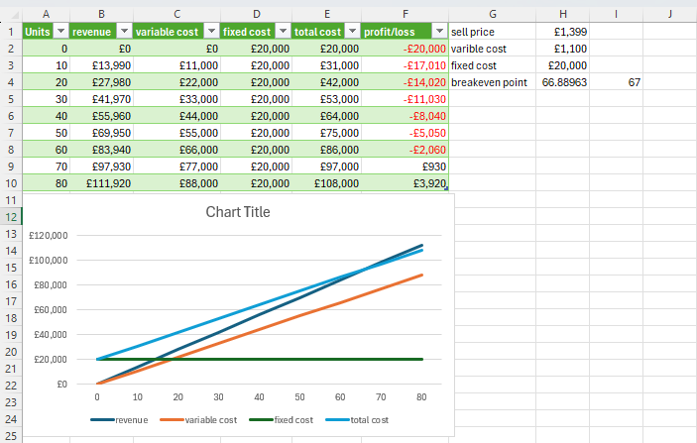

Slide 15
Scenario A – Selling Price Drops to £1,299 New contribution per unit: £1,299 − £1,100 = £199 New breakeven: £20,000 ÷ £199 = 100.50 → 101 units Breakeven increases from 67 → 101 units Business becomes riskier because it must sell more units to break even.

Slide 16
Components | Value/costs | Description
Selling price per unit | £1,299 | Competitive price compared with other premium smartphones
Variable cost per unit | £1,100 | Includes components (£1,000) + packaging (£50) + distribution (£50)
Fixed costs per month | £20,000 | Includes research, factories, staff salaries, marketing, software
Expected monthly sales | 200 units | Market research survey
Maximum production capacity | 600 Units | Manufacturing capacity

Slide 17
Calculations Variable costs
Formula: Total Variable costs = Variable cost per unit x Number of units
Example for 200 units
£1,100 X 200 = £220,000
Calculations Total costs
Formula: Total costs = Fixed costs + Variable costs
Example for 200 units
£20,000 + £220,000 = £240,000
Calculations Revenue
Example for 200 units
Formula: Revenue = Sales Volume x Selling price
200 x £1,299 = £259,800

Slide 18
Calculations Profit/loss
Formula: Profit/loss = Revenue – Total costs
Example for 200 units
£259,800 – £240,000 = £19,800
Calculations Breakeven
Example for 200 units
Formula:
Breakeven point = | Fixed Costs
 | Selling Price – Variable cost
£20,000 | £20,000 | £20,000 | £20,000 | 100.50 units
£1,299 | -£1,100 | £199 | £199
Rounded up:
Breakeven point = 101
Calculations Margin of safety
Formula: Margin of safety = Actual sales (predicted sales in this case)-Breakeven sales
200 - 101 = 99

Slide 19
Components | Value | Cost | Left | Total
 |  |  |  | £1,299
Battery | £50 | £50 | £1,249 | £1,299
Processor | £150 | £150 | £1,099 | £1,249
Camera system | £180 | £180 | £919 | £1,099
Face id sensors | £40 | £40 | £879 | £919
Screen | £200 | £200 | £679 | £879
Ram | £30 | £30 | £649 | £679
Storage | £80 | £80 | £569 | £649
Motherboard | £60 | £60 | £509 | £569
Speaker and Microphone | £20 | £20 | £489 | £509
Charging Port type-C | £15 | £15 | £474 | £489
Frame and glass body | £75 | £75 | £399 | £474
Other small parts | £100 | £100 | £299 | £399
Distribution | £50 | £50 | £249 | £299
Packing | £50 | £50 | £199 | £249
Total | £1,100 | £1,100 | £199 | £199
Profit | £0 | £0 | £199 | £199

Slide 20
Components 200 Units | Value 1 Unit | Cost 200 Units | Left 200 Units | Total 200 Units
 |  |  |  | £259,800
Includes research, factories, staff salaries, marketing, software | £20,000 | £20,000 | £239,800 | £259,800
Battery | £50 | £10,000 | £229,800 | £239,800
Processor | £150 | £30,000 | £199,800 | £229,800
Camera system | £180 | £36,000 | £163,800 | £199,800
Face id sensors | £40 | £8,000 | £155,800 | £163,800
Screen | £200 | £40,000 | £115,800 | £155,800
Ram | £30 | £6,000 | £109,800 | £115,800
Storage | £80 | £16,000 | £93,800 | £109,800
Motherboard | £60 | £12,000 | £81,800 | £93,800
Speaker and Microphone | £20 | £4,000 | £77,800 | £81,800
Charging Port type-C | £15 | £3,000 | £74,800 | £77,800
Frame and glass body | £75 | £15,000 | £59,800 | £74,800
Other small parts | £100 | £20,000 | £39,800 | £59,800
Distribution | £50 | £10,000 | £29,800 | £39,800
Packing | £50 | £10,000 | £19,800 | £29,800
Total | £1,100 | £240,000 | £19,800 | £19,800
Profit | £0 | £0 | £19,800 | £19,800

Slide 21
Item | Amount
Total revenue (200 units) | £259,800
Total variable cost | £220,000
Fixed costs | £20,000
Total cost | £240,000
Profit | £19,800
Breakeven point | 101 units
Margin of safety | 99 units

Slide 22
Breakeven Analysis – iPhone 18 Pro Max my company has carried out a breakeven analysis for its new product, the iPhone 18 Pro Max, to assess whether the product will be profitable and to determine the minimum number of units that must be sold to cover all costs.
Assumptions To complete the breakeven analysis, my company has made the following assumptions: The selling price of the iPhone 18 Pro Max is £1,299 per unit, which is competitive with other premium smartphones on the market. The variable cost per unit is £1,100, which includes the cost of components (£1,000), packaging (£50), and distribution (£50). Fixed costs are £20,000 per month, covering research and development, factories, staff salaries, marketing, and software. Expected monthly sales are 200 units, based on market research. The maximum production capacity is 600 units per month.

Slide 23
Variable Costs Calculation Formula: Variable costs = Variable cost per unit × Number of units Calculation: £1,100 × 200 = £220,000 Therefore, the total variable cost of producing 200 units is £220,000.
Total Costs Calculation Formula: Total costs = Fixed costs + Variable costs Calculation: £20,000 + £220,000 = £240,000 The total cost of producing 200 units is £240,000.
Revenue Calculation Formula: Revenue = Selling price × Sales volume Calculation: 200 × £1,299 = £259,800 The total revenue generated from selling 200 units is £259,800.

Slide 24
PROFIT CALCULATION FORMULA: PROFIT = REVENUE − TOTAL COSTS CALCULATION: £259,800 − £240,000 = £19,800 THIS SHOWS THAT MY COMPANY WOULD MAKE A PROFIT OF £19,800 IF 200 UNITS ARE SOLD.
Breakeven Point Calculation The breakeven point shows the number of units that must be sold for total revenue to equal total costs. Formula: Breakeven point (units) = Fixed costs ÷ (Selling price − Variable cost) Calculation: £20,000 ÷ (£1,299 − £1,100) £20,000 ÷ £199 = 100.50 units As part units cannot be sold, the breakeven point is rounded up to 101 units.

Slide 25
Margin of Safety The margin of safety shows how much sales can fall before the business reaches the breakeven point. Formula: Margin of safety = Actual sales − Breakeven sales Calculation: 200 − 101 = 99 units This means sales could fall by 99 units before my company begins to make a loss.

Slide 26
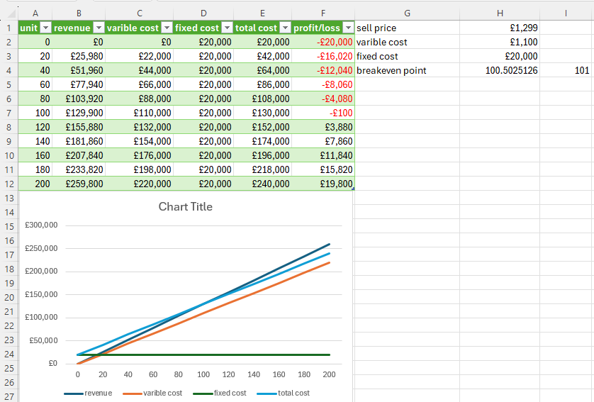

Slide 27
Scenario B – Variable Costs Increase to £1,150 New contribution per unit: £1,399 − £1,150 = £249 New breakeven: £20,000 ÷ £249 = 80.32 → 81 units Breakeven increases from 67 → 81 units Profit becomes smaller.

Slide 28
Components | Value/costs | Description
Selling price per unit | £1,399 | Competitive price compared with other premium smartphones
Variable cost per unit | £1,150 | Includes components (£1,000) + packaging (£50) + distribution (£50) + Tax (£50)
Fixed costs per month | £20,000 | Includes research, factories, staff salaries, marketing, software
Expected monthly sales | 200 units | Market research survey
Maximum production capacity | 600 Units | Manufacturing capacity

Slide 29
Calculations Variable costs
Formula: Total Variable costs = Variable cost per unit x Number of units
Example for 200 units
£1,150 X 200 = £230,000
Calculations Total costs
Formula: Total costs = Fixed costs + Variable costs
Example for 200 units
£20,000 + £230,000 = £250,000
Calculations Revenue
Example for 200 units
Formula: Revenue = Sales Volume x Selling price
200 x £1,399 = £279,800

Slide 30
Calculations Profit/loss
Formula: Profit/loss = Revenue – Total costs
Example for 200 units
£279,800 – £250,000 = £29,800
Calculations Breakeven
Example for 200 units
Formula:
Breakeven point = | Fixed Costs
 | Selling Price – Variable cost
£20,000 | £20,000 | £20,000 | £20,000 | 80.32 units
£1,399 | -£1,150 | £249 | £249
Rounded up:
Breakeven point = 81
Calculations Margin of safety
Formula: Margin of safety = Actual sales (predicted sales in this case)-Breakeven sales
200 - 81 = 119

Slide 31
Components | Value | Cost | Left | Total
 |  |  |  | £1,399
Battery | £50 | £50 | £1,349 | £1,399
Processor | £150 | £150 | £1,199 | £1,349
Camera system | £180 | £180 | £1,019 | £1,199
Face id sensors | £40 | £40 | £979 | £1,019
Screen | £200 | £200 | £779 | £979
Ram | £30 | £30 | £749 | £779
Storage | £80 | £80 | £669 | £749
Motherboard | £60 | £60 | £609 | £669
Speaker and Microphone | £20 | £20 | £589 | £609
Charging Port type-C | £15 | £15 | £574 | £589
Frame and glass body | £75 | £75 | £499 | £574
Other small parts | £100 | £100 | £399 | £499
Distribution | £50 | £50 | £349 | £399
Packing | £50 | £50 | £299 | £349
Tax | £50 | £50 | £249 | £299
Total | £1,150 | £1,150 | £249 | £249
Profit | £0 | £0 | £249 | £249

Slide 32
Components 200 Units | Value 1 Unit | Cost 200 Units | Left 200 Units | Total 200 Units
 |  |  |  | £279,800
Includes research, factories, staff salaries, marketing, software | £20,000 | £20,000 | £259,800 | £279,800
Battery | £50 | £10,000 | £249,800 | £259,800
Processor | £150 | £30,000 | £219,800 | £249,800
Camera system | £180 | £36,000 | £183,800 | £219,800
Face id sensors | £40 | £8,000 | £175,800 | £183,800
Screen | £200 | £40,000 | £135,800 | £175,800
Ram | £30 | £6,000 | £129,800 | £135,800
Storage | £80 | £16,000 | £113,800 | £129,800
Motherboard | £60 | £12,000 | £101,800 | £113,800
Speaker and Microphone | £20 | £4,000 | £97,800 | £101,800
Charging Port type-C | £15 | £3,000 | £94,800 | £97,800
Frame and glass body | £75 | £15,000 | £79,800 | £94,800
Other small parts | £100 | £20,000 | £59,800 | £79,800
Distribution | £50 | £10,000 | £49,800 | £59,800
Packing | £50 | £10,000 | £39,800 | £49,800
Tax | £50 | £10,000 | £29,800 | £39,800
Total | £1,150 | £240,000 | £29,800 | £29,800
Profit | £0 | £0 | £29,800 | £29,800

Slide 33
Item | Amount
Total revenue (200 units) | £279,800
Total variable cost | £230,000
Fixed costs | £20,000
Total cost | £250,000
Profit | £29,800
Breakeven point | 81 units
Margin of safety | 119 units

Slide 34
Breakeven Analysis – iPhone 18 Pro Max my company has carried out a breakeven analysis for its new product, the iPhone 18 Pro Max, to assess whether the product will be profitable and to determine the minimum number of units that must be sold to cover all costs.
Assumptions To complete the breakeven analysis, my company has made the following assumptions: The selling price of the iPhone 18 Pro Max is £1,399 per unit, which is competitive with other premium smartphones on the market. The variable cost per unit is £1,150, which includes the cost of components (£1,000), packaging (£50), distribution (£50) and tax (£50). Fixed costs are £20,000 per month, covering research and development, factories, staff salaries, marketing, and software. Expected monthly sales are 200 units, based on market research. The maximum production capacity is 600 units per month.

Slide 35
Variable Costs Calculation Formula: Variable costs = Variable cost per unit × Number of units Calculation: £1,150 × 200 = £230,000 Therefore, the total variable cost of producing 200 units is £230,000.
Total Costs Calculation Formula: Total costs = Fixed costs + Variable costs Calculation: £20,000 + £230,000 = £250,000 The total cost of producing 200 units is £250,000.
Revenue Calculation Formula: Revenue = Selling price × Sales volume Calculation: 200 × £1,399 = £279,800 The total revenue generated from selling 200 units is £279,800.

Slide 36
Profit Calculation Formula: Profit = Revenue − Total costs Calculation: £279,800 − £250,000 = £29,800 This shows that my company would make a profit of £29,800 if 200 units are sold.
Breakeven Point Calculation The breakeven point shows the number of units that must be sold for total revenue to equal total costs. Formula: Breakeven point (units) = Fixed costs ÷ (Selling price − Variable cost) Calculation: £20,000 ÷ (£1,399 − £1,150) £20,000 ÷ £249 = 80.32 units As part units cannot be sold, the breakeven point is rounded up to 81 units.

Slide 37
Margin of Safety The margin of safety shows how much sales can fall before the business reaches the breakeven point. Formula: Margin of safety = Actual sales − Breakeven sales Calculation: 200 − 81 = 119 units This means sales could fall by 119 units before my company begins to make a loss.

Slide 38
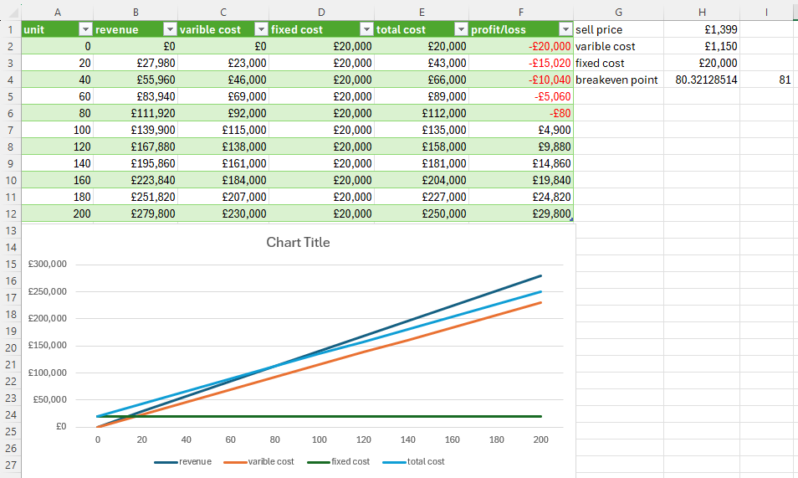

Slide 39
Scenario C – Fixed Costs Increase to £30,000 Breakeven: £30,000 ÷ £299 = 100.33 → 101 units Breakeven increases from 67 → 101 units Business must sell more units to cover costs.

Slide 40
Components | Value/costs | Description
Selling price per unit | £1,399 | Competitive price compared with other premium smartphones
Variable cost per unit | £1,100 | Includes components (£1,000) + packaging (£50) + distribution (£50)
Fixed costs per month | £30,000 | Includes research, factories, staff salaries, marketing, software
Expected monthly sales | 200 units | Market research survey
Maximum production capacity | 600 Units | Manufacturing capacity

Slide 41
Calculations Variable costs
Formula: Total Variable costs = Variable cost per unit x Number of units
Example for 200 units
£1,100 X 200 = £220,000
Calculations Total costs
Formula: Total costs = Fixed costs + Variable costs
Example for 200 units
£30,000 + £220,000 = £250,000
Calculations Revenue
Example for 200 units
Formula: Revenue = Sales Volume x Selling price
200 x £1,399 = £279,800

Slide 42
Calculations Profit/loss
Formula: Profit/loss = Revenue – Total costs
Example for 200 units
£279,800 – £250,000 = £29,800
Calculations Breakeven
Example for 200 units
Formula:
Breakeven point = | Fixed Costs
 | Selling Price – Variable cost
£30,000 | £30,000 | £30,000 | £30,000 | 100.33 units
£1,399 | -£1,100 | £299 | £299
Rounded up:
Breakeven point = 101
Calculations Margin of safety
Formula: Margin of safety = Actual sales (predicted sales in this case)-Breakeven sales
200 - 101 = 99

Slide 43
COMPONENTS | VALUE | COST | LEFT | TOTAL
 |  |  |  | £1,399
Battery | £50 | £50 | £1,349 | £1,399
Processor | £150 | £150 | £1,199 | £1,349
Camera system | £180 | £180 | £1,019 | £1,199
Face id sensors | £40 | £40 | £979 | £1,019
Screen | £200 | £200 | £779 | £979
Ram | £30 | £30 | £749 | £779
Storage | £80 | £80 | £669 | £749
Motherboard | £60 | £60 | £609 | £669
Speaker and Microphone | £20 | £20 | £589 | £609
Charging Port type-C | £15 | £15 | £574 | £589
Frame and glass body | £75 | £75 | £499 | £574
Other small parts | £100 | £100 | £399 | £499
Distribution | £50 | £50 | £349 | £399
Packing | £50 | £50 | £299 | £349
Total | £1,100 | £1,100 | £299 | £299
Profit | £0 | £0 | £299 | £299

Slide 44
Components 200 Units | Value 200 Units | Cost 200 Units | Left 200 Units | Total 200 Units
 |  |  |  | £279,800
Includes research, factories, staff salaries, marketing, software | £30,000 | £30,000 | £249,800 | £279,800
Battery | £50 | £10,000 | £239,800 | £249,800
Processor | £150 | £30,000 | £209,800 | £239,800
Camera system | £180 | £36,000 | £173,800 | £209,800
Face id sensors | £40 | £8,000 | £165,800 | £173,800
Screen | £200 | £40,000 | £125,800 | £165,800
Ram | £30 | £6,000 | £119,800 | £125,800
Storage | £80 | £16,000 | £103,800 | £119,800
Motherboard | £60 | £12,000 | £91,800 | £103,800
Speaker and Microphone | £20 | £4,000 | £87,800 | £91,800
Charging Port type-C | £15 | £3,000 | £84,800 | £87,800
Frame and glass body | £75 | £15,000 | £69,800 | £84,800
Other small parts | £100 | £20,000 | £49,800 | £69,800
Distribution | £50 | £10,000 | £39,800 | £49,800
Packing | £50 | £10,000 | £29,800 | £39,800
Total | £1,100 | £240,000 | £29,800 | £29,800
Profit | £0 | £0 | £29,800 | £29,800

Slide 45
ITEM | AMOUNT
Total revenue (200 units) | £279,800
Total variable cost | £220,000
Fixed costs | £30,000
Total cost | £250,000
Profit | £29,800
Breakeven point | 101 units
Margin of safety | 133 units

Slide 46
Breakeven Analysis – iPhone 18 Pro Max my company has carried out a breakeven analysis for its new product, the iPhone 18 Pro Max, to assess whether the product will be profitable and to determine the minimum number of units that must be sold to cover all costs.
Assumptions To complete the breakeven analysis, my company has made the following assumptions: The selling price of the iPhone 18 Pro Max is £1,399 per unit, which is competitive with other premium smartphones on the market. The variable cost per unit is £1,100, which includes the cost of components (£1,000), packaging (£50), and distribution (£50). Fixed costs are £30,000 per month, covering research and development, factories, staff salaries, marketing, and software. Expected monthly sales are 200 units, based on market research. The maximum production capacity is 600 units per month.

Slide 47
Variable Costs Calculation Formula: Variable costs = Variable cost per unit × Number of units Calculation: £1,100 × 200 = £220,000 Therefore, the total variable cost of producing 200 units is £220,000.
Total Costs Calculation Formula: Total costs = Fixed costs + Variable costs Calculation: £30,000 + £220,000 = £250,000 The total cost of producing 200 units is £250,000.
Revenue Calculation Formula: Revenue = Selling price × Sales volume Calculation: 200 × £1,399 = £279,800 The total revenue generated from selling 200 units is £279,800.
Profit Calculation Formula: Profit = Revenue − Total costs Calculation: £279,800 − £250,000 = £29,800 This shows that my company would make a profit of £29,800 if 200 units are sold.

Slide 48
BREAKEVEN POINT CALCULATION THE BREAKEVEN POINT SHOWS THE NUMBER OF UNITS THAT MUST BE SOLD FOR TOTAL REVENUE TO EQUAL TOTAL COSTS. FORMULA: BREAKEVEN POINT (UNITS) = FIXED COSTS ÷ (SELLING PRICE − VARIABLE COST) CALCULATION: £30,000 ÷ (£1,399 − £1,100) £30,000 ÷ £299 = 100.33 UNITS AS PART UNITS CANNOT BE SOLD, THE BREAKEVEN POINT IS ROUNDED UP TO 101 UNITS.

Slide 49
MARGIN OF SAFETY THE MARGIN OF SAFETY SHOWS HOW MUCH SALES CAN FALL BEFORE THE BUSINESS REACHES THE BREAKEVEN POINT. FORMULA: MARGIN OF SAFETY = ACTUAL SALES − BREAKEVEN SALES CALCULATION: 200 − 101 = 99 UNITS THIS MEANS SALES COULD FALL BY 99 UNITS BEFORE MY COMPANY BEGINS TO MAKE A LOSS.

Slide 50
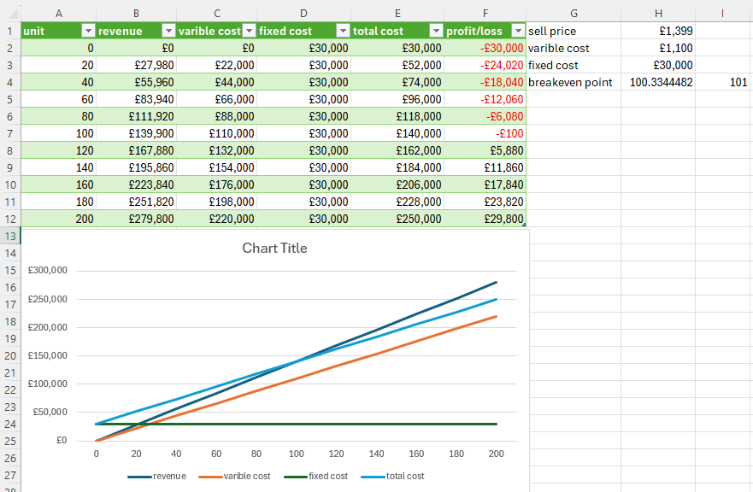

Slide 51
Pricing Strategy Shows that lower price increases breakeven Helps decide if discounts are safe
Cost Control Shows if variable or fixed costs are too high Helps choose cheaper suppliers
Sales Targets Helps set a minimum target: 67 units per month
Risk Assessment Margin of safety is 133 units, so risk is low If sales fall below 67 units, my company will make a loss

Slide 52
Planning and Forecasting Helps plan production levels and monthly budgets
Investor Confidence Shows the business understands costs and profit clearly
Conclusion This breakeven analysis shows My company must sell at least 67 units of iPhone 18 Pro Max each month to avoid losses. With expected sales of 200 units, my company is likely to make £39,800 profit per month. The margin of safety is 133 units, which shows low financial risk and good profit potential.

Slide 53
Evaluate: How Breakeven Analysis Informs Business Decisions Breakeven analysis is useful because it supports decision-making by showing the relationship between price, costs, and sales volume. However, it has limitations, so it should be used alongside other data.

Slide 54
HOW IT INFORMS DECISIONS
1) Pricing decisions Breakeven analysis shows how price changes affect contribution and risk. For example, when price falls from £1,399 to £1,299, the breakeven point increases from 67 to 101 units, which reduces profit and increases risk. This helps My Company decide whether discounts are financially safe.
2) Cost control and supplier decisions By separating costs into variable and fixed, the business can identify which cost increases harm profitability most. Scenario B shows that a rise in variable costs increases breakeven and reduces profit, so My Company may negotiate supplier contracts or redesign components to lower unit costs.

Slide 55
3) SALES TARGETS AND PERFORMANCE MONITORING THE BREAKEVEN POINT PROVIDES A CLEAR MINIMUM TARGET. MY COMPANY KNOWS IT MUST SELL AT LEAST 67 UNITS IN THE BASE CASE. THIS CAN BE USED TO SET REALISTIC MONTHLY TARGETS AND TRACK PERFORMANCE.
4) Risk assessment and planning Margin of safety helps measure risk. In the base case the margin of safety is 133 units, showing low risk. In Scenario A/C it falls to 99 units, showing higher risk. This supports decisions such as improving marketing, increasing capacity utilisation, or avoiding unnecessary fixed costs.
5) Investment and budgeting decisions Breakeven analysis helps plan budgets and justify spending. If fixed costs increase Scenario C, breakeven rises sharply. This helps My Company decide whether higher marketing or factory costs are worth it.

Slide 56
LIMITATIONS BALANCED EVALUATION IT ASSUMES SELLING PRICE AND COSTS STAY CONSTANT, BUT COSTS E.G., COMPONENTS AND TAX MAY CHANGE. IT ASSUMES ALL UNITS PRODUCED ARE SOLD, BUT DEMAND CAN FLUCTUATE. IT DOES NOT CONSIDER COMPETITOR ACTIONS, ECONOMIC CONDITIONS, OR SUDDEN CHANGES IN TECHNOLOGY.
Overall judgement Overall, breakeven analysis is an effective planning tool because it shows the minimum sales required to avoid losses and allows My Company to test “what-if” scenarios. However, My Company should combine breakeven analysis with market research, competitor analysis, and cash-flow forecasting to make the most accurate decisions.

Slide 57
Reference
I copy my all calculation and paste on ChatGPT, and it tell me my mistake and then I write "Rewrite it in simpler GCSE / BTEC language and Turn this into a perfect Grade A / Distinction version" https://chatgpt.com/c/6985d389-3aac-8392-a25d-8bd181f64dc6 (Accessed:3 February 2026).

Slide 58
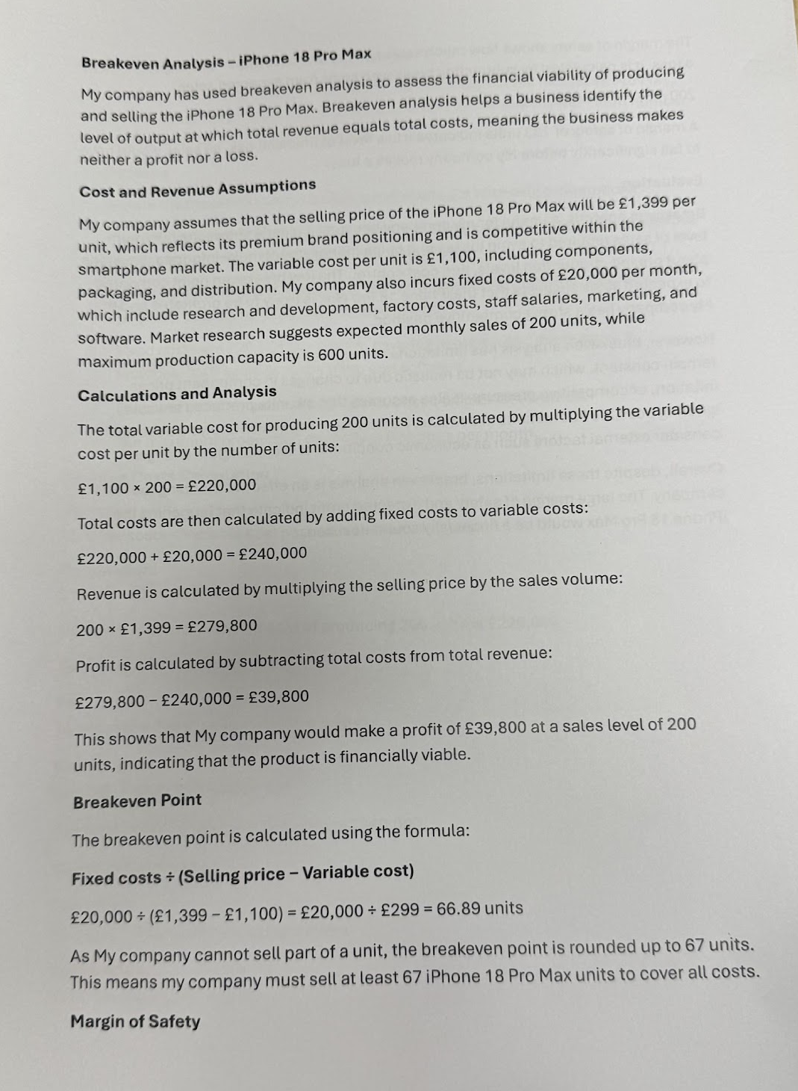
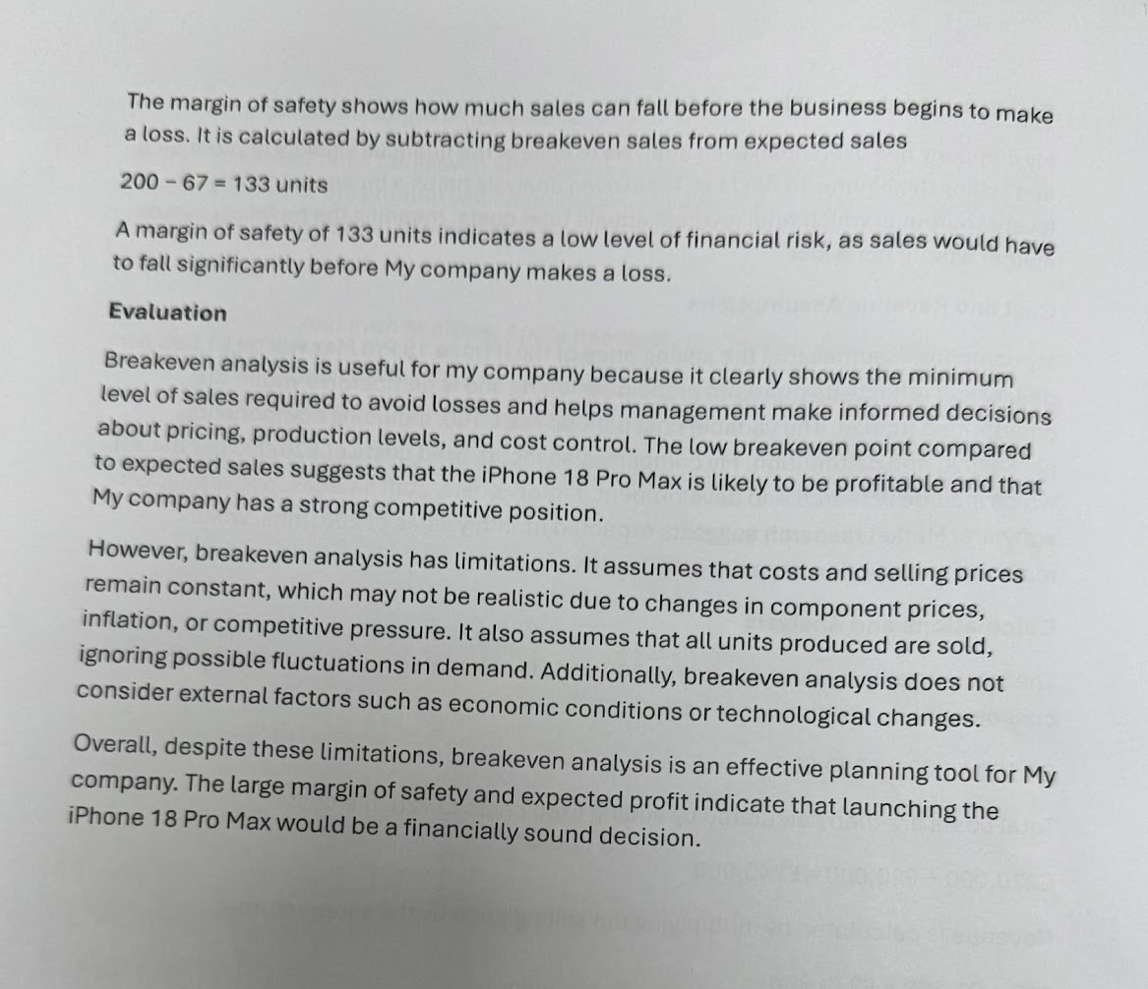
Rewrite it in simpler GCSE / BTEC language and Turn this into a perfect Grade A / Distinction version

Slide 59
Reference
"exam answer version" https://chatgpt.com/c/6985d389-3aac-8392-a25d-8bd181f64dc6 (Accessed: 3 February 2026)

Slide 60
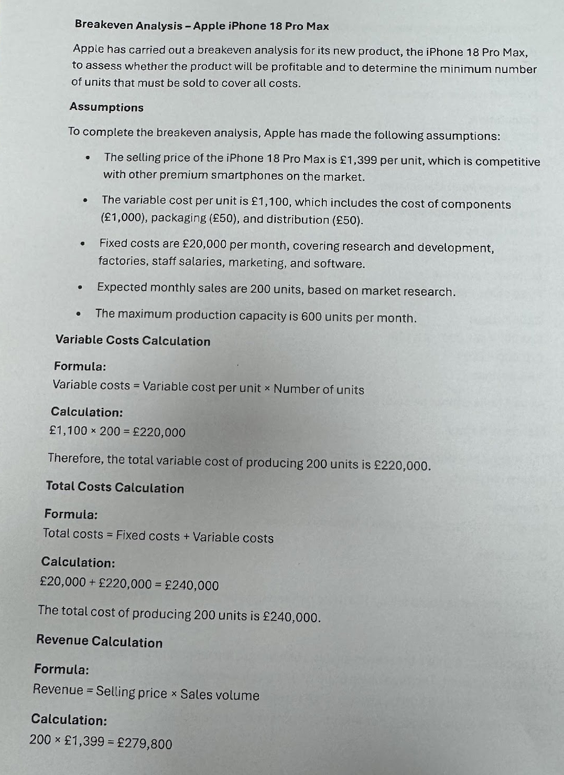
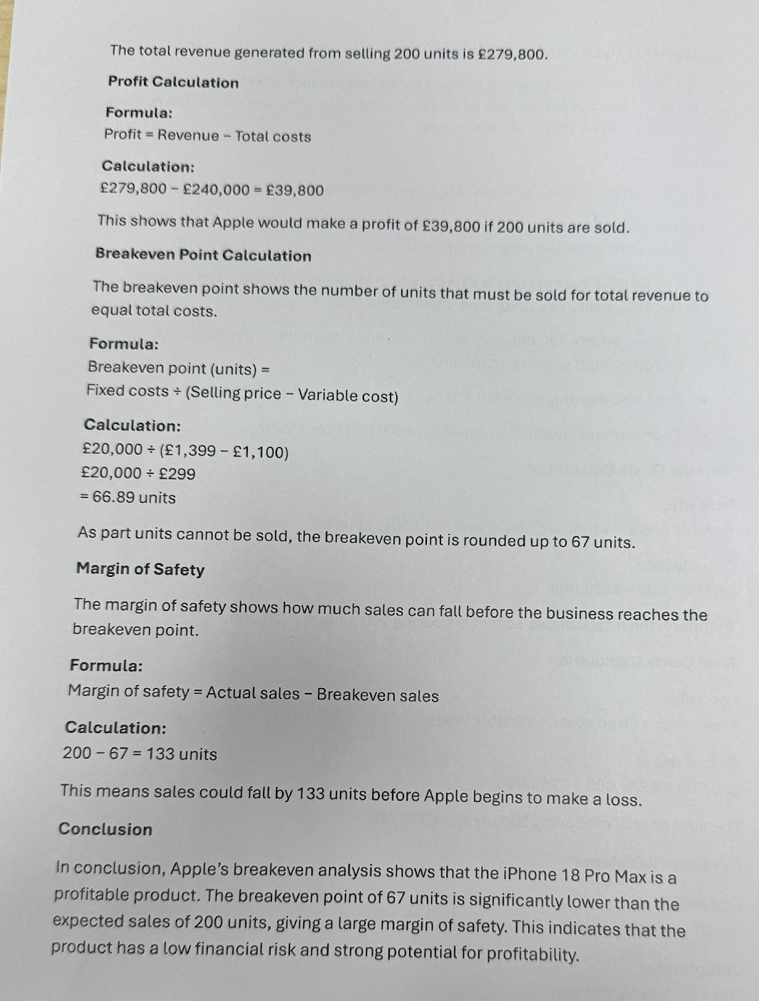
exam-answer version

Slide 61
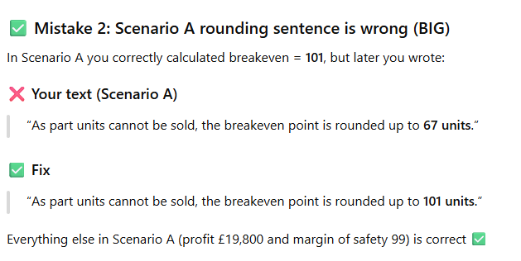
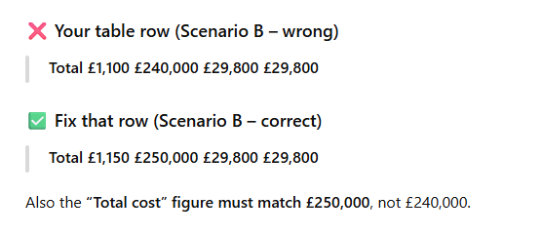
My mistakes fix by ChatGPT and Deepseek

