Slide 1

Unit 21- Technology business
Shahzaib Asim S2312202

Slide 2

Breakeven Analysis
Breakeven analysis shows the level of output or sales needed for a business to cover all its costs.
Key parts of breakeven analysis
Fixed costs – costs that do not change with output (e.g. rent, salaries, marketing)
Variable costs – costs that change with output (e.g. components, packaging)
Revenue – money earned from sales
Contribution – selling price minus variable cost
Breakeven point – the number of units needed to cover all costs

Slide 3
Purpose
My Company has carried out a breakeven analysis for the iPhone 18 Pro Max to check if the product is profitable and to calculate the minimum number of units that must be sold to cover all costs.

Slide 4
To produce a breakeven analysis My company has made the following assumptions
Components | Value/costs | Description
Selling price per unit | £1,399 | Competitive price compared with other premium smartphones
Variable cost per unit | £1,100 | Includes components (£1,000) + packaging (£50) + distribution (£50)
Fixed costs per month | £20,000 | Includes research, factories, staff salaries, marketing, software
Expected monthly sales | 200 units | Market research survey
Maximum production capacity | 600 Units | Manufacturing capacity

Slide 5
Item | Amount
Total revenue (200 units) | £279,800
Total variable cost | £220,000
Fixed costs | £20,000
Total cost | £240,000
Profit | £39,800
Breakeven point | 67 units
Margin of safety | 133 units

Slide 6
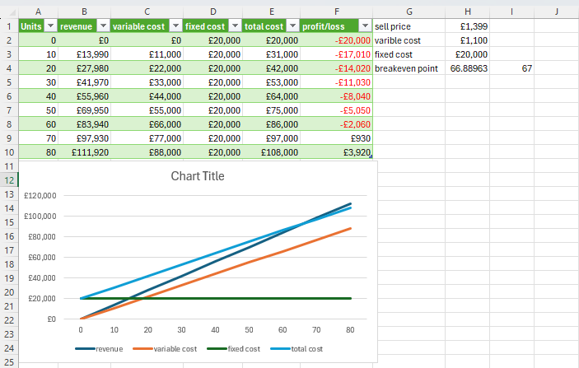

Slide 7
Scenario A – Selling Price Drops to £1,299 New contribution per unit: £1,299 − £1,100 = £199 New breakeven: £20,000 ÷ £199 = 100.50 → 101 units Breakeven increases from 67 → 101 units Business becomes riskier because it must sell more units to break even.

Slide 8
Components | Value/costs | Description
Selling price per unit | £1,299 | Competitive price compared with other premium smartphones
Variable cost per unit | £1,100 | Includes components (£1,000) + packaging (£50) + distribution (£50)
Fixed costs per month | £20,000 | Includes research, factories, staff salaries, marketing, software
Expected monthly sales | 200 units | Market research survey
Maximum production capacity | 600 Units | Manufacturing capacity

Slide 9
Item | Amount
Total revenue (200 units) | £259,800
Total variable cost | £220,000
Fixed costs | £20,000
Total cost | £240,000
Profit | £19,800
Breakeven point | 101 units
Margin of safety | 99 units

Slide 10
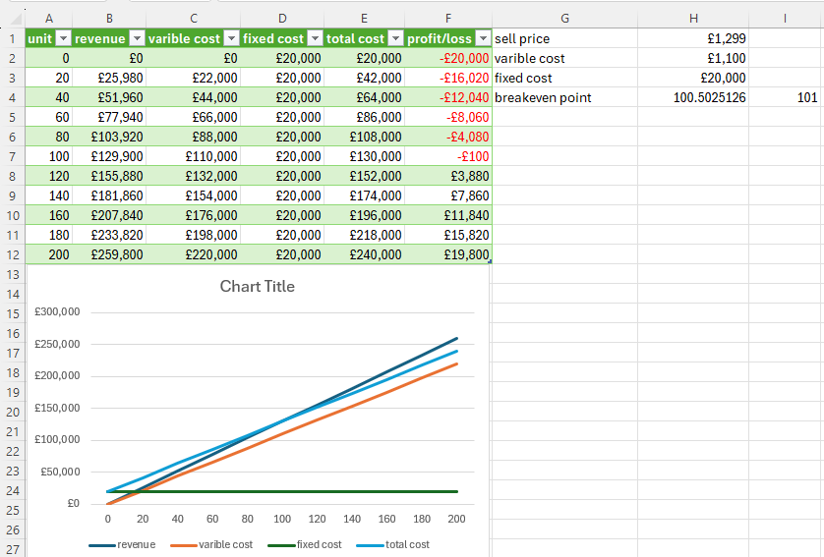

Slide 11
Scenario B – Variable Costs Increase to £1,150 New contribution per unit: £1,399 − £1,150 = £249 New breakeven: £20,000 ÷ £249 = 80.32 → 81 units Breakeven increases from 67 → 81 units Profit becomes smaller.

Slide 12
Components | Value/costs | Description
Selling price per unit | £1,399 | Competitive price compared with other premium smartphones
Variable cost per unit | £1,150 | Includes components (£1,000) + packaging (£50) + distribution (£50) + Tax (£50)
Fixed costs per month | £20,000 | Includes research, factories, staff salaries, marketing, software
Expected monthly sales | 200 units | Market research survey
Maximum production capacity | 600 Units | Manufacturing capacity

Slide 13
ITEM | AMOUNT
Total revenue (200 units) | £279,800
Total variable cost | £230,000
Fixed costs | £20,000
Total cost | £250,000
Profit | £29,800
Breakeven point | 81 units
Margin of safety | 119 units

Slide 14
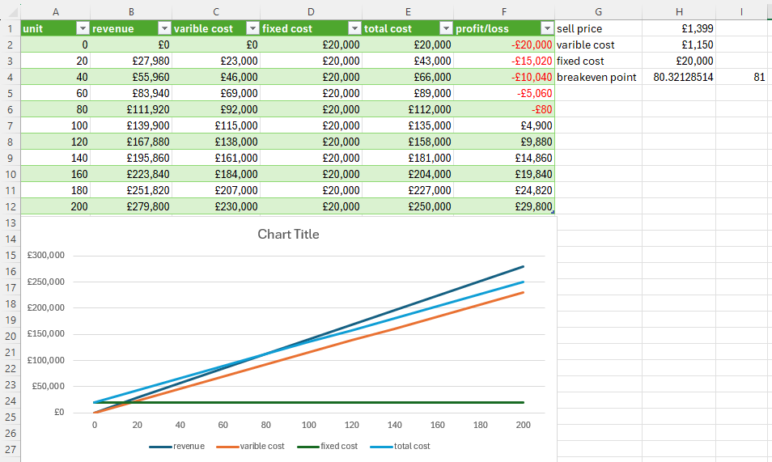

Slide 15
Scenario C – Fixed Costs Increase to £30,000 Breakeven: £30,000 ÷ £299 = 100.33 → 101 units Breakeven increases from 67 → 101 units Business must sell more units to cover costs.

Slide 16
Components | Value/costs | Description
Selling price per unit | £1,399 | Competitive price compared with other premium smartphones
Variable cost per unit | £1,100 | Includes components (£1,000) + packaging (£50) + distribution (£50)
Fixed costs per month | £30,000 | Includes research, factories, staff salaries, marketing, software
Expected monthly sales | 200 units | Market research survey
Maximum production capacity | 600 Units | Manufacturing capacity

Slide 17
Item | Amount
Total revenue (200 units) | £279,800
Total variable cost | £220,000
Fixed costs | £30,000
Total cost | £250,000
Profit | £29,800
Breakeven point | 101 units
Margin of safety | 133 units

Slide 18
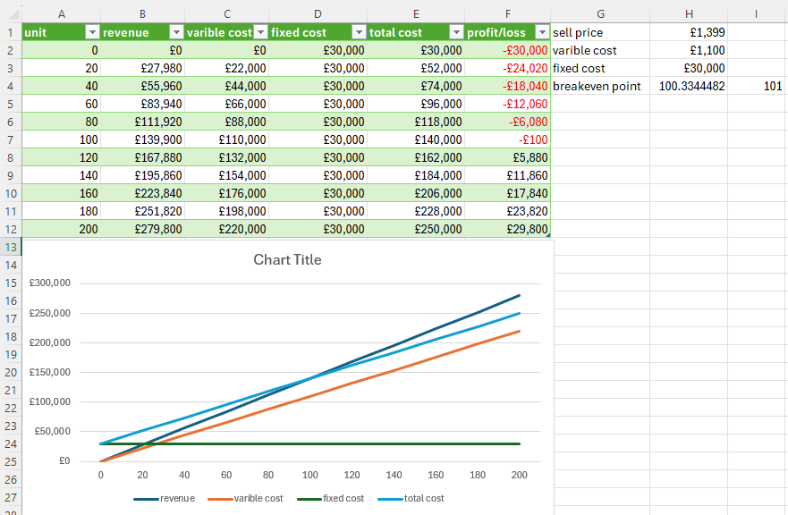

Slide 19
Pricing Strategy Shows that lower price increases breakeven Helps decide if discounts are safe
Cost Control Shows if variable or fixed costs are too high Helps choose cheaper suppliers
Sales Targets Helps set a minimum target: 67 units per month
Risk Assessment Margin of safety is 133 units, so risk is low If sales fall below 67 units, my company will make a loss

Slide 20
Planning and Forecasting Helps plan production levels and monthly budgets
Investor Confidence Shows the business understands costs and profit clearly
Conclusion This breakeven analysis shows My company must sell at least 67 units of iPhone 18 Pro Max each month to avoid losses. With expected sales of 200 units, my company is likely to make £39,800 profit per month. The margin of safety is 133 units, which shows low financial risk and good profit potential.

Slide 21
Evaluate: How Breakeven Analysis Informs Business Decisions Breakeven analysis is useful because it supports decision-making by showing the relationship between price, costs, and sales volume. However, it has limitations, so it should be used alongside other data.

Slide 22
HOW IT INFORMS DECISIONS
1) Pricing decisions Breakeven analysis shows how price changes affect contribution and risk. For example, when price falls from £1,399 to £1,299, the breakeven point increases from 67 to 101 units, which reduces profit and increases risk. This helps My Company decide whether discounts are financially safe.
2) Cost control and supplier decisions By separating costs into variable and fixed, the business can identify which cost increases harm profitability most. Scenario B shows that a rise in variable costs increases breakeven and reduces profit, so My Company may negotiate supplier contracts or redesign components to lower unit costs.

Slide 23
3) Sales targets and performance monitoring The breakeven point provides a clear minimum target. My Company knows it must sell at least 67 units in the base case. This can be used to set realistic monthly targets and track performance.
4) Risk assessment and planning Margin of safety helps measure risk. In the base case the margin of safety is 133 units, showing low risk. In Scenario A/C it falls to 99 units, showing higher risk. This supports decisions such as improving marketing, increasing capacity utilisation, or avoiding unnecessary fixed costs.
5) Investment and budgeting decisions Breakeven analysis helps plan budgets and justify spending. If fixed costs increase Scenario C, breakeven rises sharply. This helps My Company decide whether higher marketing or factory costs are worth it.

Slide 24
Limitations balanced evaluation It assumes selling price and costs stay constant, but costs e.g., components and tax may change. It assumes all units produced are sold, but demand can fluctuate. It does not consider competitor actions, economic conditions, or sudden changes in technology.
Overall judgement Overall, breakeven analysis is an effective planning tool because it shows the minimum sales required to avoid losses and allows My Company to test “what-if” scenarios. However, My Company should combine breakeven analysis with market research, competitor analysis, and cash-flow forecasting to make the most accurate decisions.

Slide 25
Reference
I copy my all calculation and paste on ChatGPT, and it tell me my mistake and then I write "Rewrite it in simpler GCSE / BTEC language and Turn this into a perfect Grade A / Distinction version" https://chatgpt.com/c/6985d389-3aac-8392-a25d-8bd181f64dc6 (Accessed:3 February 2026).

Slide 26
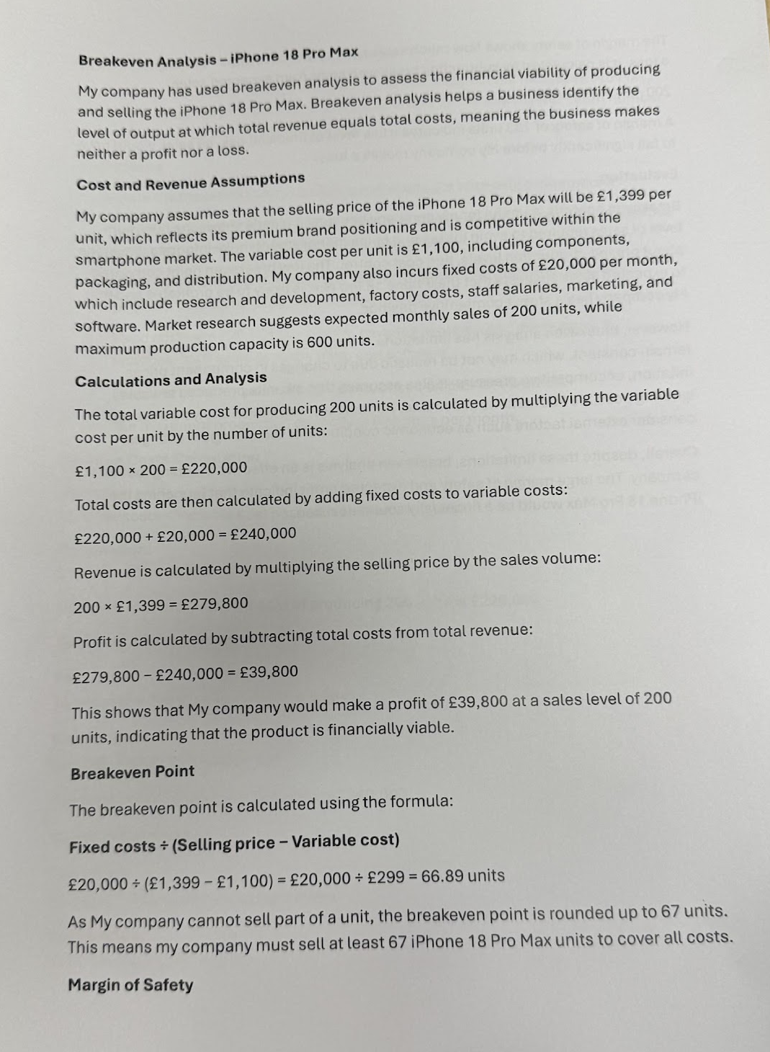
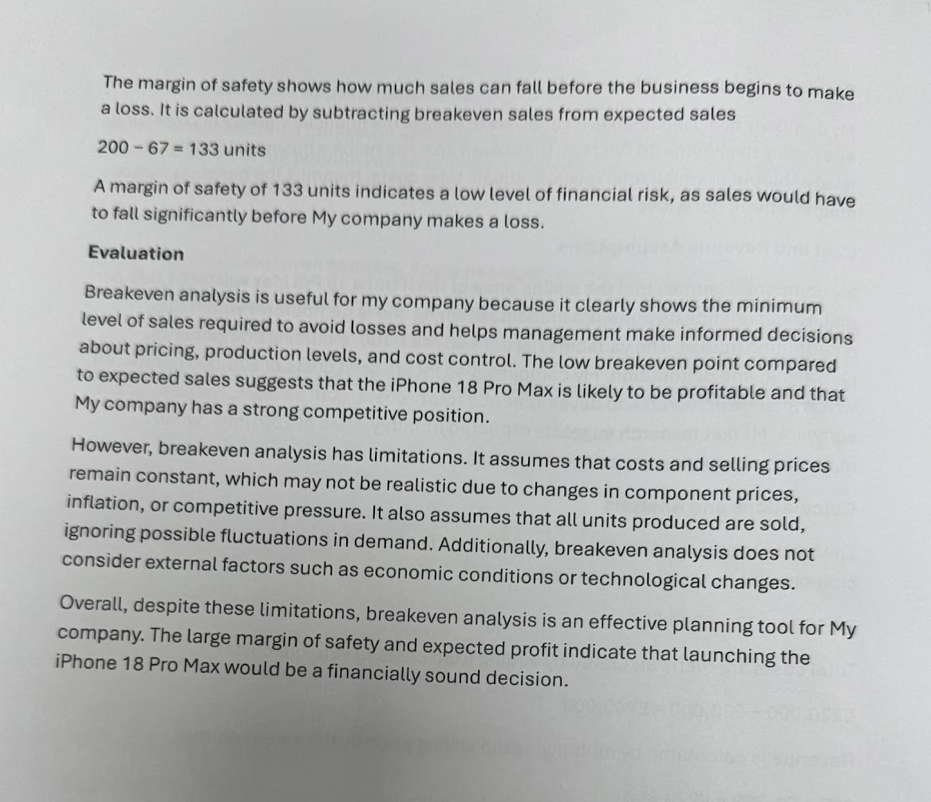
Rewrite it in simpler GCSE / BTEC language and Turn this into a perfect Grade A / Distinction version

Slide 27
Reference
"exam answer version" https://chatgpt.com/c/6985d389-3aac-8392-a25d-8bd181f64dc6 (Accessed: 3 February 2026)

Slide 28
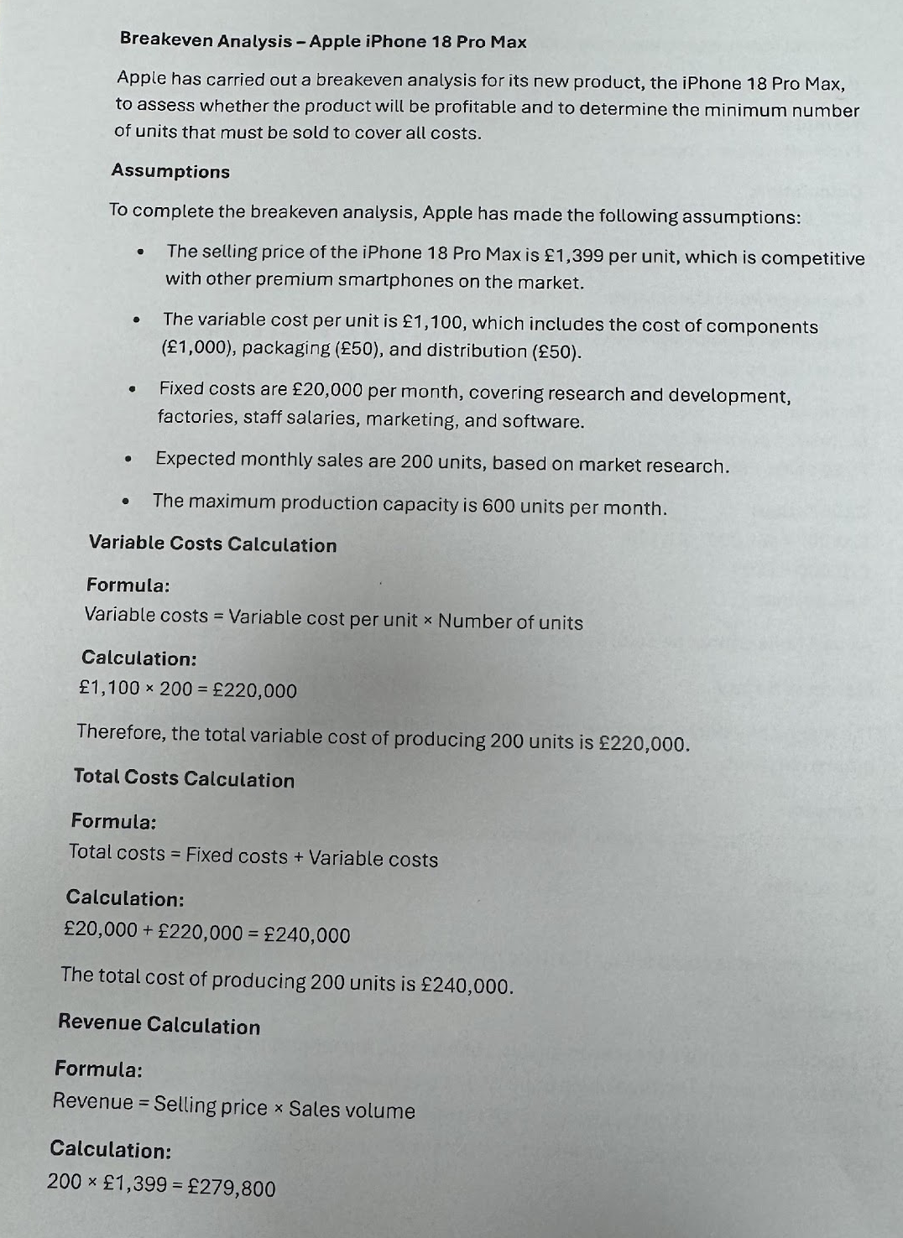
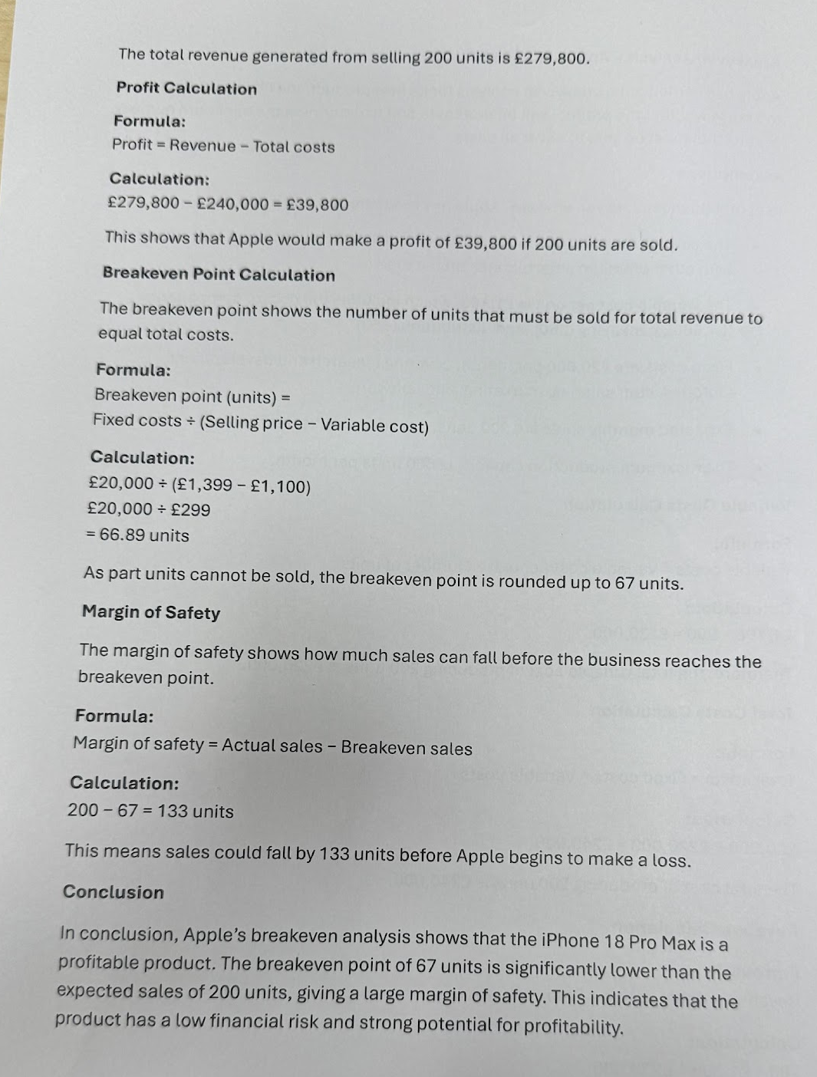
exam-answer version

Slide 29
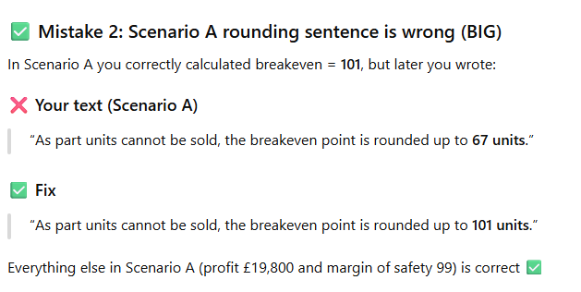
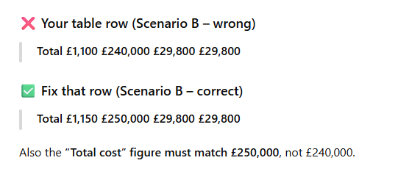
My mistakes fix by ChatGPT and Deepseek

