Slide 1

UNIT 3
Digital
Portfolio
Shahzaib Asim

Slide 2
Purpose of the Digital Portfolio
The purpose of the digital portfolio is to present my skills, coursework, and achievements to potential employers such as Leyton Tech World. The portfolio allows employers to see examples of the work I have completed during my BTEC course, including written documents, images, videos, and assignments from different units. This helps demonstrate my abilities, creativity, and understanding of IT. The portfolio is designed to make it easy for employers to review my work and assess whether I am suitable for an apprenticeship or job in the IT industry.

Slide 3
User Needs
The main users of the digital portfolio are employers, teachers, and assessors who want to review my work. They need a portfolio that is clear, organised, and easy to navigate. The website should include simple navigation so users can move between pages easily and quickly find the information they need. It should also present content such as assignments, images, and videos in a clear layout so users can understand my skills and experience. The design should be professional and visually appealing to make a good impression on potential employers.

Slide 4
Time line Assignment 1
Date | Task | Description | How long to complete | Finished by
08/12/2025 | Describe audience & purpose | Identified target audience and purpose of the digital portfolio | 15–30 minutes | 08/12/2025
08/12/2025 | Produce timeline | Created a timeline to plan the project stages | 30–45 minutes | 08/12/2025
09/12/2025 | Create storyboards | Designed layouts for pages and content structure | 1 hour – 1 hour 30 minutes | 09/12/2025
09/12/2025 | Structure chart | Created navigation structure of the website | 45 minutes – 1 hour | 09/12/2025
10/12/2025 | Research assets | Found images, content, and references for use | 30–45 minutes | 10/12/2025
10/12/2025 | Design alternatives | Created different design ideas for the portfolio | 45 minutes – 1 hour | 10/12/2025
11/12/2025 | Justify design (purpose) | Explained how design meets the purpose | 1 hour | 11/12/2025
11/12/2025 | Justify design (audience) | Explained how design meets audience needs | 1 hour | 11/12/2025
12/12/2025 | Prepare content | Organised files and prepared portfolio content | 30–45 minutes | 12/12/2025
12/12/2025 | Create website pages | Built homepage and section pages | 1 hour – 1 hour 15 minutes | 12/12/2025
13/12/2025 | Create contact page | Designed and added contact section | 45 minutes – 1 hour | 13/12/2025
13/12/2025 | Testing | Tested website on different browsers and devices | 30–45 minutes | 13/12/2025
14/12/2025 | Organise content | Improved structure and file organisation | 1 hour – 1 hour 15 minutes | 14/12/2025
14/12/2025 | Add assets | Added images and content to pages | 1 hour – 1 hour 30 minutes | 14/12/2025
15/12/2025 | Improve navigation | Ensured consistent navigation across pages | 1 hour – 1 hour 30 minutes | 15/12/2025
15/12/2025 | Add commentary | Added explanations for portfolio content | 1 hour – 1 hour 30 minutes | 15/12/2025
16/12/2025 | Gather feedback | Collected feedback from others | 30–45 minutes | 16/12/2025
16/12/2025 | Refine portfolio | Improved design and navigation based on feedback | 45 minutes – 1 hour | 16/12/2025
17/12/2025 | Explain suitability | Explained how portfolio suits audience and purpose | 30–45 minutes | 17/12/2025
17/12/2025 | Review effectiveness | Reviewed portfolio using feedback | 45 minutes – 1 hour | 17/12/2025
17/12/2025 | Final evaluation | Evaluated final product and suggested improvements | 1–2 hours | 17/12/2025

Slide 5
Time line Assignment 2
Date | Task | Description | How long to complete | Finished by
30th January 2026 | Read Assignment 2 brief | Read and understood the requirements for Assignment 2 | 20–30 minutes | 30th January 2026
2nd February 2026 | Research digital portfolios | Researched examples of professional digital portfolios and websites | 30–45 minutes | 2nd February 2026
5th February 2026 | Analyse audience needs | Identified what employers, teachers, and students need from the portfolio | 30–45 minutes | 5th February 2026
9th February 2026 | Create design ideas | Planned colours, layouts, and page styles for the website | 45 minutes – 1 hour | 9th February 2026
12th February 2026 | Create storyboard designs | Designed page structures and planned content placement | 1 hour – 1 hour 30 minutes | 12th February 2026
16th February 2026 | Create navigation structure | Planned navigation buttons and links between pages | 45 minutes – 1 hour | 16th February 2026
19th February 2026 | Gather assets | Collected coursework screenshots and portfolio files | 30–45 minutes | 19th February 2026
23rd February 2026 | Create homepage | Designed homepage with navigation and introduction | 1 hour – 1 hour 15 minutes | 23rd February 2026
26th February 2026 | Create About Me page | Added personal information, education, and experience | 45 minutes – 1 hour | 26th February 2026
2nd March 2026 | Create unit pages | Added Unit 1, Unit 2, Unit 3, Unit 13, Unit 18, and Unit 21 pages | 1 hour – 1 hour 30 minutes | 2nd March 2026
5th March 2026 | Add coursework evidence | Uploaded assignments, screenshots, and documents | 1 hour – 1 hour 30 minutes | 5th March 2026
9th March 2026 | Add explanations | Added written explanations for each unit page | 1 hour | 9th March 2026
12th March 2026 | Improve page design | Improved colours, fonts, spacing, and layout | 45 minutes – 1 hour | 12th March 2026
16th March 2026 | Test website navigation | Checked all navigation buttons and hyperlinks | 30–45 minutes | 16th March 2026
19th March 2026 | Test on devices | Tested website on mobile, laptop, and tablet | 30–45 minutes | 19th March 2026
23rd March 2026 | Gather feedback | Collected feedback from friends and classmates | 30–45 minutes | 23rd March 2026
26th March 2026 | Improve website from feedback | Made improvements based on feedback received | 45 minutes – 1 hour | 26th March 2026
30th March 2026 | Evaluate website | Reviewed strengths, weaknesses, and effectiveness | 1 hour | 30th March 2026
6th April 2026 | Suggest future improvements | Suggested improvements for future development | 30–45 minutes | 6th April 2026
16th April 2026 | Final review and submission | Completed final checks and prepared submission | 1–2 hours | 16th April 2026

Slide 6
Time line Assignment 3
Date | Task | Description | How long to complete | Finished by
16th April 2026 | Read Assignment 3 brief | Read and understood the Assignment 3 requirements | 20–30 minutes | 16th April 2026
17th April 2026 | Review portfolio work | Reviewed completed portfolio pages and coursework | 30–45 minutes | 17th April 2026
18th April 2026 | Compare storyboard and website | Compared original storyboard with final website | 45 minutes – 1 hour | 18th April 2026
19th April 2026 | Explain design changes | Explained changes made during website development | 45 minutes – 1 hour | 19th April 2026
20th April 2026 | Justify design choices | Explained why colours, layouts, and navigation were changed | 1 hour | 20th April 2026
21st April 2026 | Review navigation structure | Evaluated how users move around the website | 30–45 minutes | 21st April 2026
22nd April 2026 | Review strengths | Identified strengths such as layout, organisation, and navigation | 45 minutes – 1 hour | 22nd April 2026
23rd April 2026 | Review weaknesses | Identified weaknesses and areas needing improvement | 45 minutes – 1 hour | 23rd April 2026
24th April 2026 | Gather feedback | Collected feedback from teacher, friends, and classmates | 30–45 minutes | 24th April 2026
25th April 2026 | Analyse feedback | Reviewed feedback and selected useful suggestions | 30–45 minutes | 25th April 2026
26th April 2026 | Improve website design | Improved colours, layout, and page structure | 1 hour – 1 hour 30 minutes | 26th April 2026
27th April 2026 | Improve content organisation | Improved page structure and coursework organisation | 45 minutes – 1 hour | 27th April 2026
28th April 2026 | Test website again | Retested buttons, hyperlinks, and navigation | 30–45 minutes | 28th April 2026
29th April 2026 | Test on different devices | Checked website on laptop, mobile phone, and tablet | 30–45 minutes | 29th April 2026
30th April 2026 | Suggest future improvements | Suggested improvements for future development | 45 minutes – 1 hour | 30th April 2026
1st May 2026 | Explain suitability | Explained how portfolio meets audience and purpose | 30–45 minutes | 1st May 2026
3rd May 2026 | Write evaluation | Wrote full evaluation of the final digital portfolio | 1–2 hours | 3rd May 2026
4th May 2026 | Final proofreading | Checked spelling, grammar, and page consistency | 45 minutes – 1 hour | 4th May 2026
5th May 2026 | Final corrections | Made final improvements and corrections | 45 minutes – 1 hour | 5th May 2026
6th May 2026 | Prepare final submission | Organised all evidence and completed final submission | 30–45 minutes | 6th May 2026

Slide 7







Asset list
Image description | Source | Where it will be used | What it is for | Image | Location
Image of online world | https://encrypted-tbn0.gstatic.com/images?q=tbn:ANd9GcS4pwdnDZbMVNxMjEf3eUtaXUPJAlsSBIucqw&s | Unit 1 | Background |  | OneDrive-Docs-Unit 3-Unit1
Image of Information technology | https://www.nrhosting.com/wp-content/uploads/2021/01/Information-Technology-868x490.jpg.webp | Home | Picture of Info tech |  | OneDrive-Docs-Unit 3-Home
Image of tech systems | https://media.licdn.com/dms/image/v2/C4E1BAQE0_QIel73lGw/company-background_10000/company-background_10000/0/1584498411473/integrated_technology_systems_cover?e=2147483647&v=beta&t=vVBmxdTk9v5F-ghO5cVUNrf7aaZbLzpnFhvA_mH9k4c | Unit 2 | Background |  | OneDrive-Docs-Unit 3-Unit2
Image of digital portfolio | https://encrypted-tbn0.gstatic.com/images?q=tbn:ANd9GcTsN975PFncGGhvpS6YatTF0YQYD5h8MnDz4g&s | Unit 3 | Background |  | OneDrive-Docs-Unit 3-Unit3
Image of website development | https://cmcglobal.com.vn/wp-content/uploads/2023/04/web-development.jpg | Unit 13 | Background |  | OneDrive-Docs-Unit 3-Unit13
Image of computational thinking | https://trainingzone.co.uk/app/uploads/2019/01/wigglestick-1024x576.jpg | Unit 18 | Background |  | OneDrive-Docs-Unit 3-Unit18
Image of a technology business | https://www.acquisition-international.com/wp-content/uploads/2023/03/AdobeStock_576980630-870x490.jpg | Unit 21 | Background |  | OneDrive-Docs-Unit 3-Unit21

Slide 8
Structure chart/site map
Level 2 IT
Home
About me
Unit 1
Unit 2
Unit 3
Unit 13
Unit 18
Unit 21

Slide 9

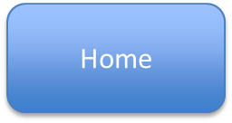

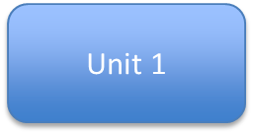
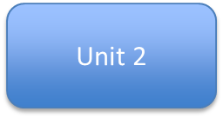
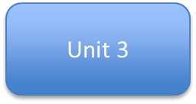
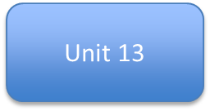
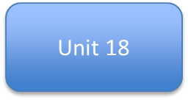
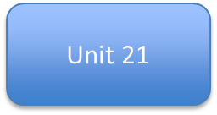





Structure/Navigation chart:

Slide 10








Navigation chart
The navigation chart shows the structure and navigation routes of my digital portfolio website. The Home page is the main page and acts as the starting point for users. From the Home page, users can navigate directly to the main sections of the website, including About Me, Unit 1, Unit 2, Unit 3, Unit 13, Unit 18, and Unit 21. This makes the website easy to use because all important pages can be accessed quickly from one location. The About Me page is linked to the CV page, where employers or teachers can view my qualifications, work experience, and skills. Unit 3, Unit 13, Unit 18, and Unit 21 also include extra work pages that contain coursework evidence and documents related to each unit. These work pages are connected to document sections so users can easily open and view my assignments and completed work. The navigation routes were designed in a clear and organised way so users do not get confused while moving between pages. Every page can be reached from the Home page, which improves accessibility and user experience. The navigation structure also helps employers and teachers quickly find the information they need, such as coursework, skills, qualifications, and project evidence.

Slide 11
Home page

Slide 12
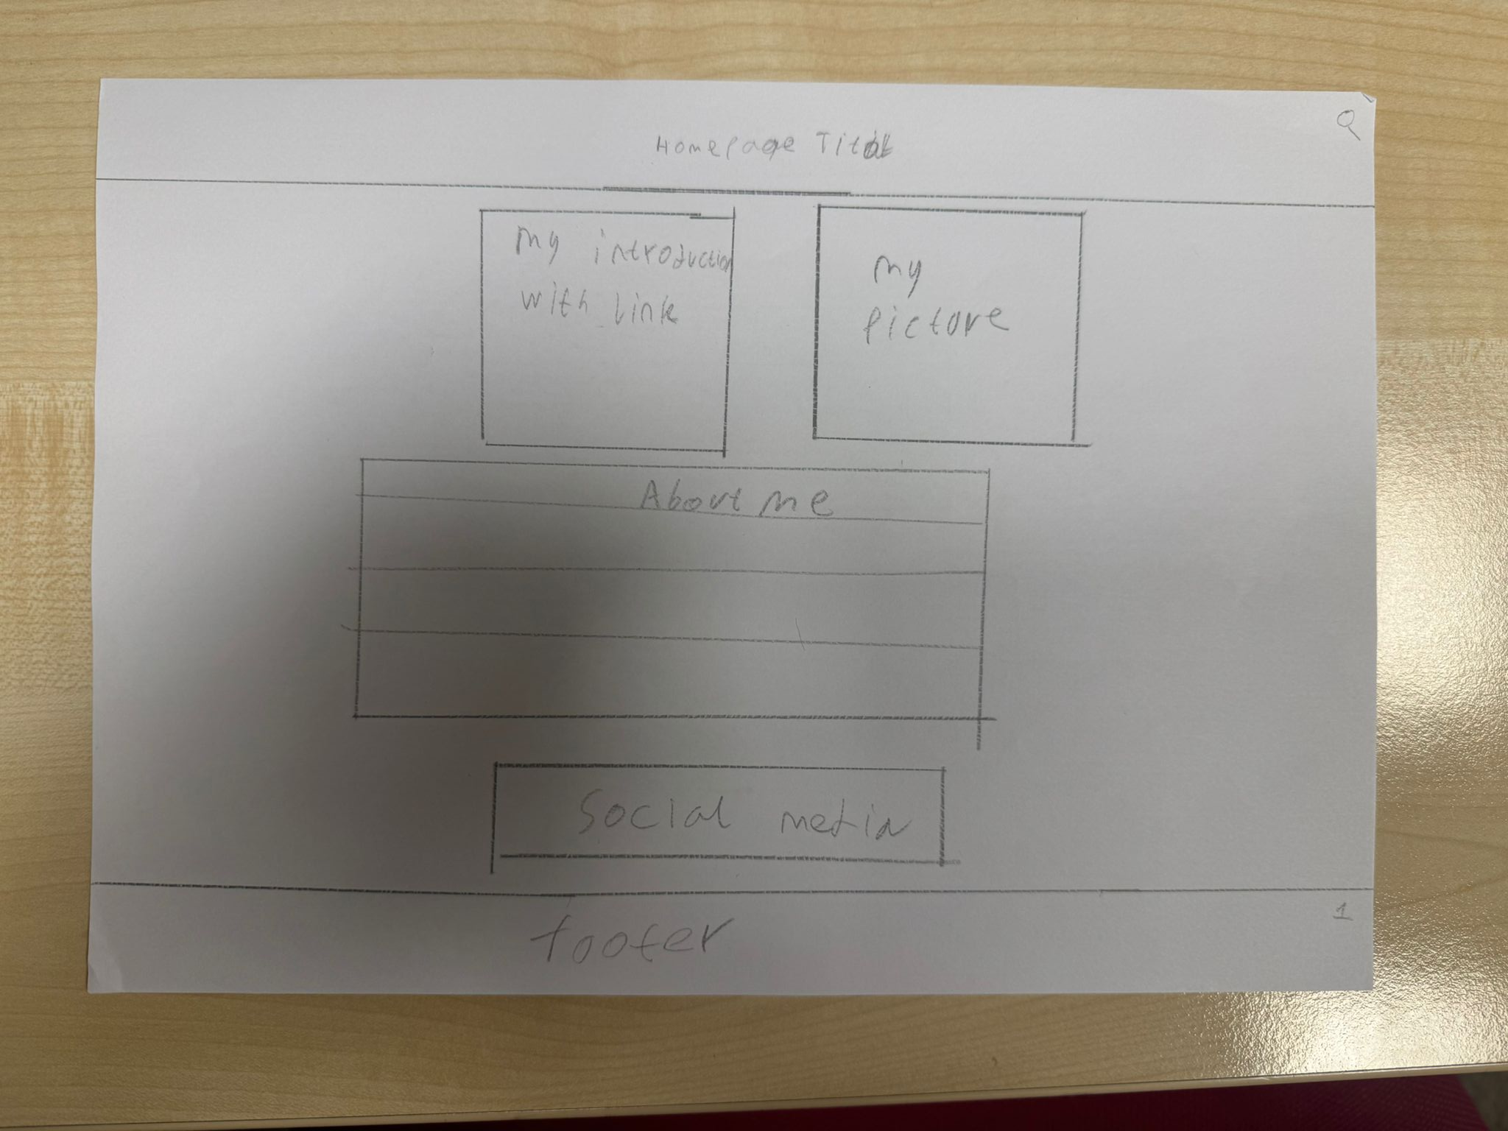
Original
Title
My introduction with website link
My picture
Small paragraph about me
My social media option to view
Footer of my website

Slide 13
Annotation of Homepage Design
Title Homepage
The title is placed at the top of the page so users immediately know they are on the homepage of my digital portfolio. It clearly introduces the website and helps users understand what the page is about.
My Introduction with Website Link
This section includes a short introduction about myself and a link to my portfolio or other work. It allows visitors and employers to quickly understand who I am and access my work easily.
My Picture
A personal photo is included to make the portfolio more professional and personal. It helps employers or teachers recognise the owner of the portfolio and makes the page feel more engaging.
Small Paragraph About Me
This section provides a short description about my background, skills, and interests in IT. It gives users a quick overview of who I am and what I study.
Social Media Section
The social media section allows users to view or contact me through platforms such as Instagram or other links. This improves communication and allows employers to see more of my work or contact me if needed.
Footer of the Website
The footer is located at the bottom of the page and may include contact details, copyright information, or additional links. It helps organise the page and provides important information that users may need.

Slide 14
Style guide
Element | Colours | Font | Size | Rationale
Title | White text | Aerial | 36 bold | White text is clear and easy to read on the background image. A large bold font makes the title stand out, so users immediately know the page name.
Intro paragraph | Red text | Aerial | 30 bold | The red text helps highlight the introduction section and makes it noticeable for users. The bold font ensures the paragraph is easy to read and draws attention to important information.
Navigation buttons | White text | Aerial | 22 | White text on the navigation buttons keeps the design clean and consistent. The size makes the buttons easy to read and click so users can navigate between pages quickly.
Social media section | White text | Aerial | 36 bold | The larger font helps users easily find the social media links. This allows visitors or employers to quickly contact or follow me.
Footer | White text | Aerial | 22 | The footer contains important information such as links or contact details. Using a clear font keeps it readable and consistent with the rest of the website design.

Slide 15
Home page
The homepage is the main page of my digital portfolio. This page introduces who I am and what the website is about. It includes my introduction with a link, a section about me, and my picture so visitors can easily recognise me. The page also includes links to my social media and contact information. At the bottom of the page there is a footer that contains additional information and navigation.

Slide 16
Purpose of the home Page
The purpose of the homepage is to introduce my digital portfolio and give visitors a quick overview of who I am. It helps teachers, assessors, or employers understand the purpose of the website and see important information about me. The homepage also allows users to access other parts of the website easily.

Slide 17
Design
The homepage includes several main sections. At the top there is a homepage title which clearly shows the name of the page. Below the title there are two sections: my introduction with a link and my picture. Under these sections there is a larger About Me section which provides more detailed information about my background. Below that there is a social media section where users can find links to my social profiles. At the bottom of the page there is a footer, which is commonly used for extra information.

Slide 18
Aesthetic Features
The design uses a clean and simple layout which makes the page look organised and professional. The elements are spaced out evenly so the page does not look crowded. The large About Me section helps balance the page visually. Using sections for different information improves readability and makes the page look structured.

Slide 19
Design Features
The page includes several design features such as clear content sections, headings, and visual areas for images. The layout places important information near the top so visitors can quickly see who I am. The structure follows a common website layout, which makes it easier for users to understand.

Slide 20
Interactive Features / User Interaction
The page allows users to interact with the website through clickable links. For example, users can click the introduction link to access more information, and they can click social media links to visit my profiles. Users can also scroll through the page to read more about me.

Slide 21
Why This Design is Effective
This design is effective because it presents the most important information in a clear and organised way. Users can easily see my introduction, picture, and personal information without being confused. The layout is simple, which improves user experience and helps visitors quickly understand the purpose of the website.
The design is effective because it meets the needs of the users. Teachers and employers canquickly find information about me and view my work. The simple layout makes the websiteeasy to read and navigate, while the use of sections ensures that the content is organised andeasy to follow.

Slide 22
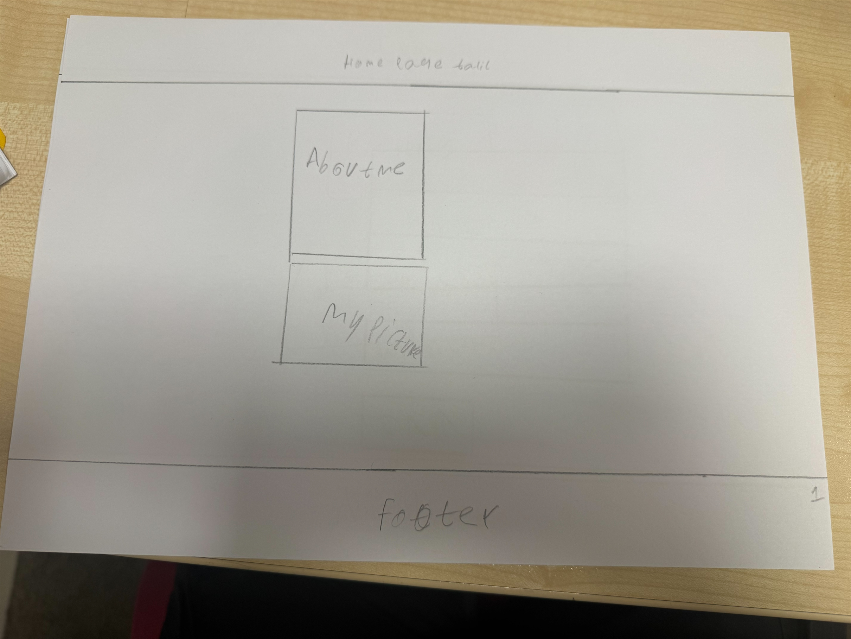
Alternative
Title
My picture
Small paragraph about me
Footer of my website

Slide 23
Annotation of Alternative Homepage Design
Title
The title is placed at the top of the page so users can immediately recognise the page they are visiting. It clearly introduces the homepage of my digital portfolio.
Small Paragraph About Me
This section contains a short paragraph about myself, including my interests and background in IT. It helps users quickly understand who I am and what the portfolio is about.
My Picture
A personal image is included to make the portfolio more engaging and personal. It helps employers and teachers identify the owner of the portfolio and makes the website feel more professional.
Footer of My Website
The footer is located at the bottom of the page and would contain additional information such as contact details, copyright information, or links. It helps organise the page and provides important information for users.

Slide 24
Style guide
Element | Colours | Font | Size | Rationale
Title | White text | Aerial | 36 bold | White text is clear and easy to read on the background image. A large bold font makes the title stand out, so users immediately know the page name.
Intro paragraph | Red text | Aerial | 30 bold | The red text helps highlight the introduction section and makes it noticeable for users. The bold font ensures the paragraph is easy to read and draws attention to important information.
Navigation buttons | White text | Aerial | 22 | White text on the navigation buttons keeps the design clean and consistent. The size makes the buttons easy to read and click so users can navigate between pages quickly.
Footer | White text | Aerial | 22 | The footer contains important information such as links or contact details. Using a clear font keeps it readable and consistent with the rest of the website design.

Slide 25
About me

Slide 26
About Me
I am a designer-developer who enjoys turning ideas into clean, interactive digital experiences. I mix simple design with solid coding to create smooth and easy-to-use products. I like clear layouts, creativity, and user-friendly flows. I enjoy solving front-end problems and turning ideas into real projects. I am studying for a BTEC Level 2 First Certificate in ICT, where I’ve completed several assignments that helped build my skills.

Slide 27
skills
UI design and layout design
HTML and CSS basic front-end development
Problem-solving and debugging
Working with design tools and digital documents
Creativity and attention to detail

Slide 28
Education
2023 - Present
Leyton Sixth Form College
2019 - 2023
The City School
Gulshan campus A
2013 - 2019
The City School
Gulshan campus B

Slide 29
Work experience
2023 - Present
BEST TUTOR
Admin
2024 - 2024
TESCO
Stocker
2020 - 2023
HAQ EYE HOSPITAL
owner

Slide 30
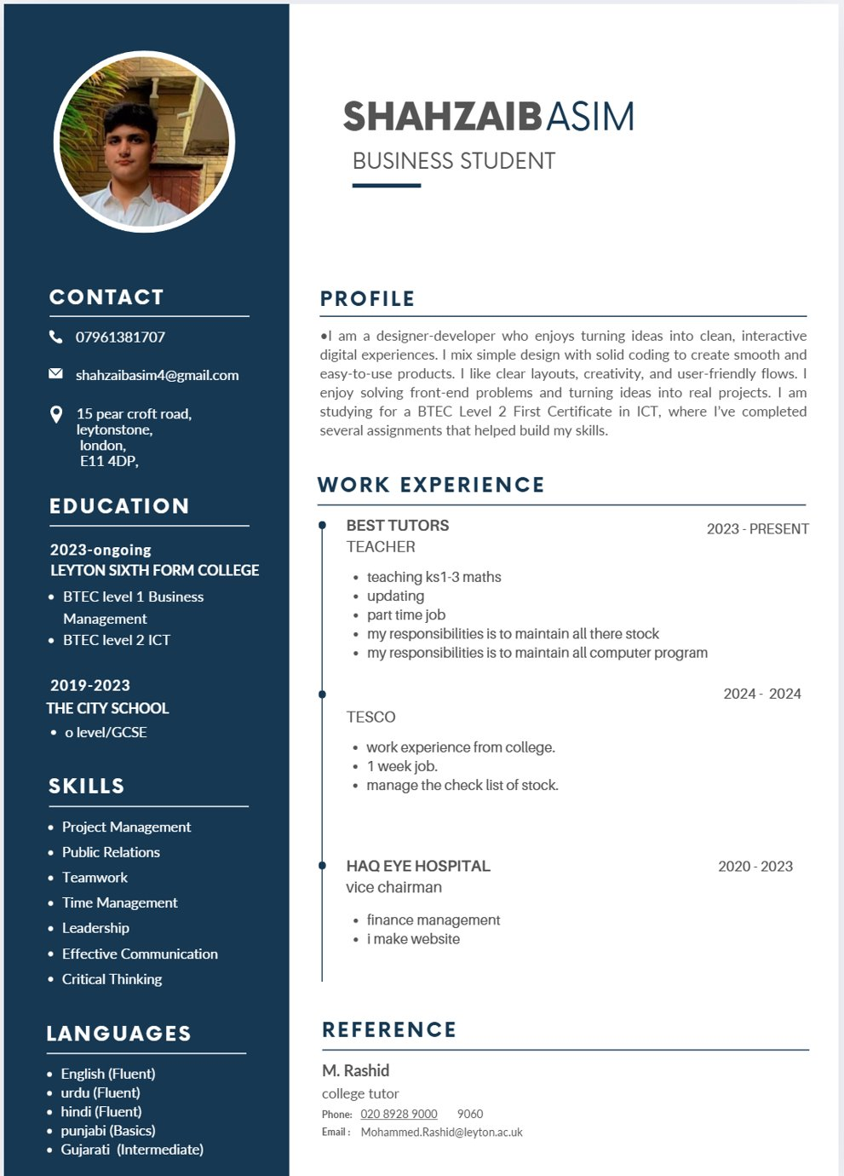
My Cv

Slide 31
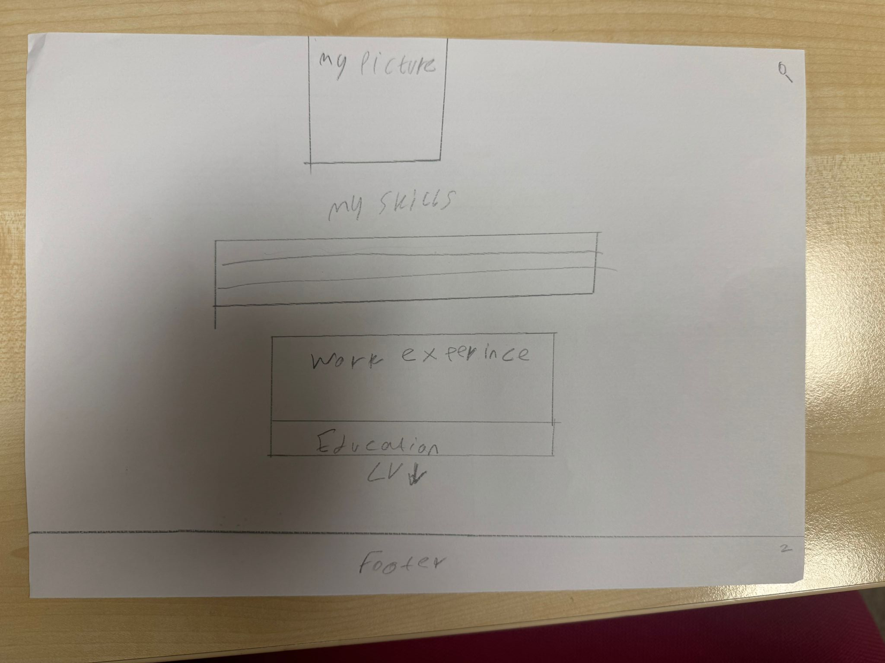
Original
My picture
My skills in which I am good
My work experience with years
My education with years
Cv button to open pdf
Footer of my website

Slide 32
Annotation of About Me / CV Page Design
My Picture
A personal picture is placed at the top of the page to make the portfolio more professional and personal. It helps employers and teachers easily recognise the owner of the portfolio and makes the page more engaging.
My Skills
This section shows the IT skills that I am good at. It allows employers to quickly see my strengths and understand what areas of technology I have knowledge in.
My Work Experience
This section displays any work experience I have, including the number of years or time spent in each role. This helps employers understand my practical experience and background.
My Education
The education section shows the courses or qualifications I have studied and the years I completed them. This gives employers information about my academic background.
CV Button
The CV button allows users to open and view my full CV in PDF format. This makes it easy for employers to download or review more detailed information about my experience and qualifications.
Footer of My Website
The footer is located at the bottom of the page and contains additional information such as contact details, copyright information, or links. It helps organise the page and keeps the layout consistent across the website.

Slide 33
Style guide
Element | Colours | Font | Size | Rationale
Page Title | White text on dark/purple background | Arial | 36 bold | Large white text makes the title clear and easy to read. It helps users quickly understand what the page is about.
introduction Paragraph | White text on dark/purple background | Arial | 20-24 | This paragraph introduces the portfolio and provides information about me. The size makes it readable without overwhelming the page.
Navigation Buttons | White text on purple buttons | Arial | 22 | Simple buttons make it easy for users to move between pages such as Home, About Me, and Units.
Section Headings | Dark text | Arial | 26-30 bold | Headings help organise the page and separate different sections such as Skills, Education, and Work Experience.
Body Text | Black text on white/light background | Arial | 16-18 | Standard readable text size allows users to comfortably read information about my skills, education, and experience.
Footer | White text on dark background | Arial | 14-16 | The footer provides extra information and keeps the design consistent across all pages of the website.

Slide 34
About me
The About Me page gives more detailed information about me. It includes my work experience, education, skills, and a picture of myself. This page helps visitors and employers understand my background, qualifications, and abilities. It shows what I have studied at college and what skills I have developed.

Slide 35
Purpose of the about me Page
The purpose of the About Me page is to provide detailed information about my background, skills, education, and work experience. This page allows visitors such as teachers, assessors, or potential employers to understand my abilities and qualifications.

Slide 36
Design
The page includes several organised sections. At the top there is my picture, which helps visitors recognise the person behind the portfolio. Below this section there is my skills, which shows the abilities I have developed. Under the skills section there is work experience and education, which provides information about my past work and academic background. A CV link is also included so users can easily access my full CV. At the bottom of the page there is a footer which is used for additional information.

Slide 37
Aesthetic Features
The page uses a clean and structured layout which makes the information easy to read. The sections are spaced out clearly so the page does not look crowded. Placing the picture at the top adds a personal and professional look to the page. The use of separate sections for skills, work experience, and education helps organise the information visually.

Slide 38
Design Features
The design uses clear content blocks for different types of information. This helps users quickly identify the sections they are interested in. The layout follows a logical order, starting with personal identity (picture), followed by skills, and then work experience and education.

Slide 39
Interactive Features / User Interaction
Users can scroll through the page to read information about my skills and experience. The CV link allows users to click and view or download my CV. Navigation links also allow users to move to other pages of the website.

Slide 40
Why This Design is Effective
This design is effective because it clearly presents the most important information about me. Users can easily see my skills, experience, and education in a structured way. The layout is simple, which improves readability and user experience.
The page design meets the needs of users by organising information clearly and logically. Teachers or employers can quickly find important information such as my skills, education, and work experience. The simple layout also makes the page easy to navigate and understand.

Slide 41
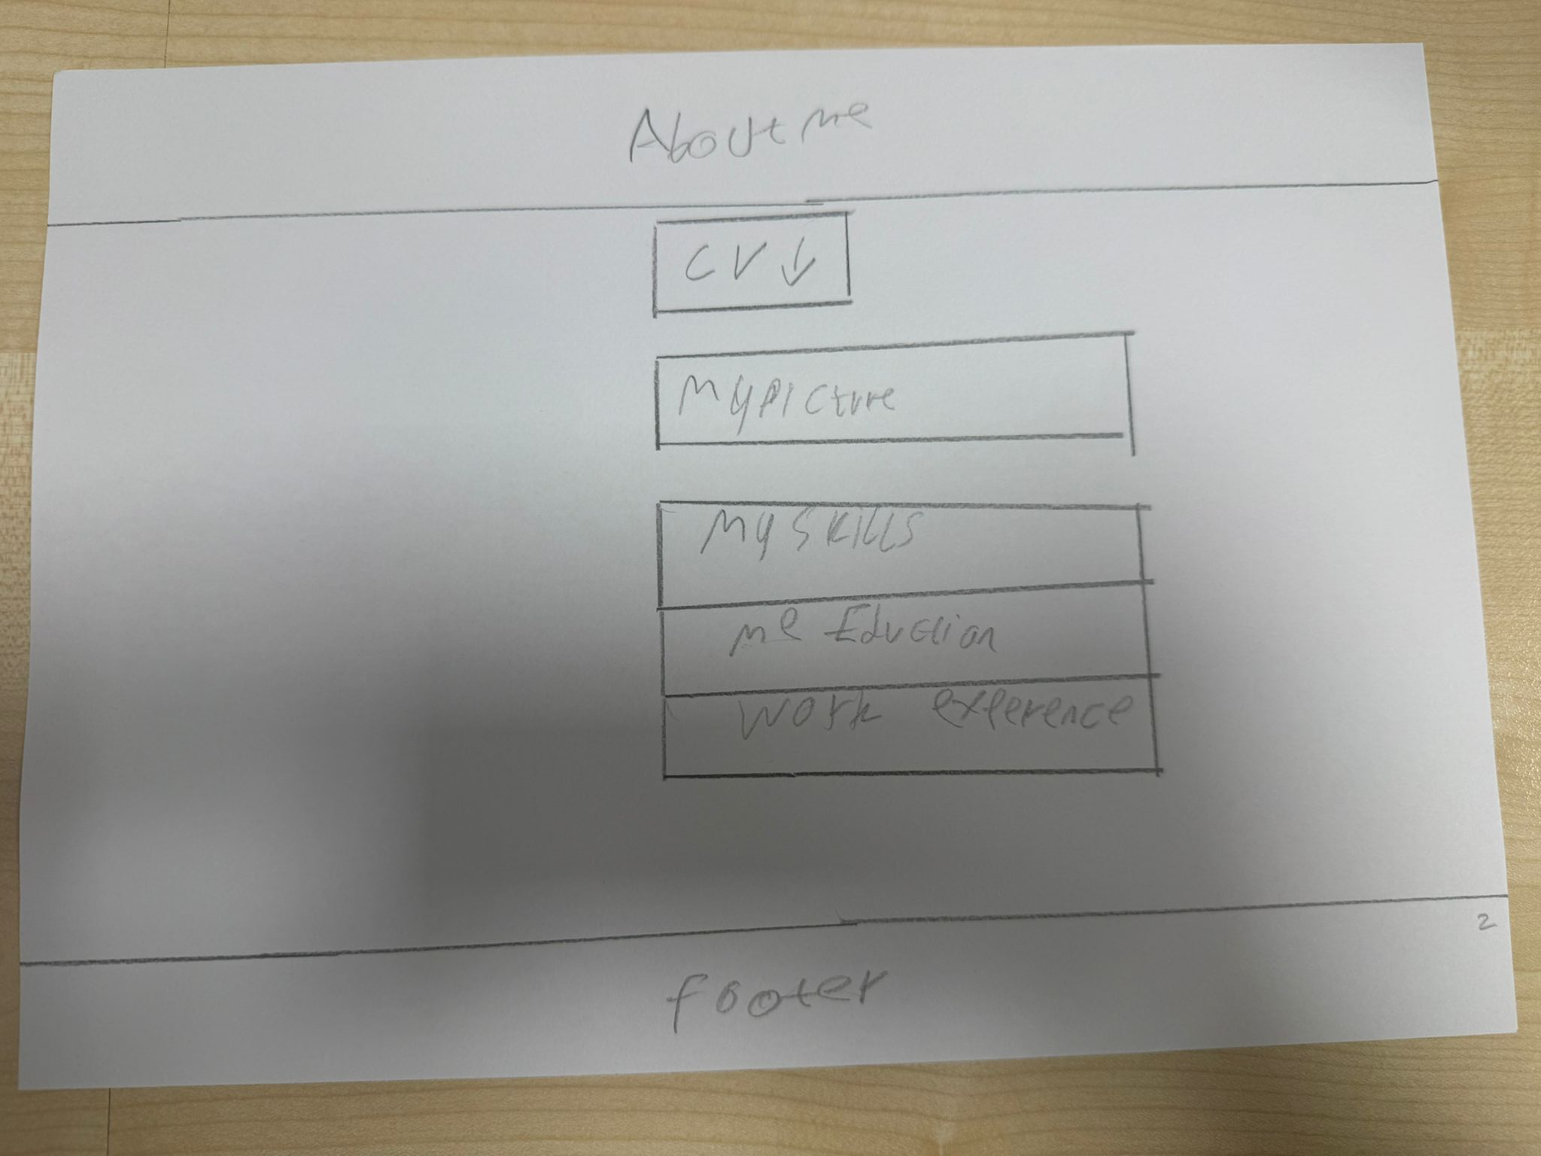
Alternative
Title
Title
Cv button to open pdf
My picture
My skills in which I am good
My work experience with years
My education with years
Footer of my website

Slide 42
Annotation of Alternative About Me Page Design
Title
The title is placed at the top of the page so users immediately understand what the page is about. A clear title helps organise the content and improves readability.
CV Button
The CV button allows users to open and download my CV in PDF format. This makes it easy for employers or teachers to quickly access detailed information about my qualifications and experience.
My Picture
A picture of myself is included to make the portfolio more personal and professional. It helps employers recognise who the portfolio belongs to.
My Skills
This section lists the skills that I am good at, particularly in IT. It helps employers quickly see my strengths and technical abilities.
My Education
The education section shows my qualifications and the years I completed them. This provides important information about my academic background.
My Work Experience
This section explains my work experience and how long I worked in each role. It helps demonstrate practical experience and skills gained.
Footer of My Website
The footer appears at the bottom of the page and keeps the design consistent with other pages on the website. It can include contact information, copyright details, or links.

Slide 43
Style guide
Element | Colours | Font | Size | Rationale
Page Title | White text on purple/dark background | Arial | 36 bold | The large white title stands out and clearly shows what the page is about, making it easy for users to understand the page quickly.
Navigation Menu | White text on purple buttons | Arial | 22 | Simple navigation buttons allow users to easily move between pages such as Home, About Me, and Units.
Section Headings Skills, Education, Experience | Dark text on light background | Arial | 26-30 bold | Headings help organise the content and allow users to quickly find important information.
Body Text | Black text on white/light background | Arial | 16-18 | This size makes the content easy to read and suitable for paragraphs explaining my skills and experience.
Buttons CV / Links | White text on coloured button | Arial | 18-20 | This size makes the content easy to read and suitable for paragraphs explaining my skills and experience.
Footer | White text on dark background | Arial | 14-16 | The footer keeps the design consistent and can contain contact information or copyright details.

Slide 44
BTEC Level 2 First Certificate in ICT
Projects
Unit 1 - The Online World (Exam)
Unit 2 - Technology Systems (Exam)
Unit 3 - A Digital Portfolio (Assignments)
Unit 13 - Website Development (Assignments)
Unit 18 - Computational Thinking (Assignments)
Unit 21 - A Technology Business (Assignments)

Slide 45
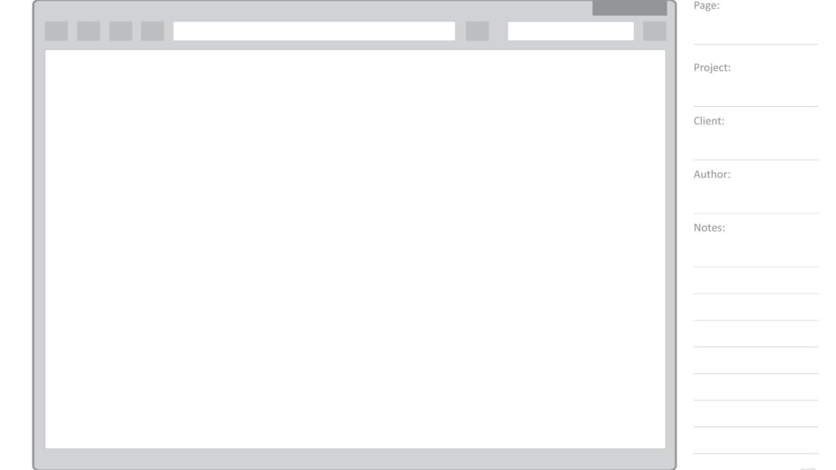
Unit 1 -Online World (Exam)

Slide 46
UNIT 1
This project is based on my Unit 1 exam, The Online World, and demonstrates my understanding of internet services, online communication, and digital safety. It shows the knowledge I developed during my BTEC ICT course.
The Online World demonstrates the knowledge I developed about online services, digital communication, and internet safety. In this unit, I learned how different online services work, how people communicate online, and how to stay safe and responsible when using the internet.

Slide 47
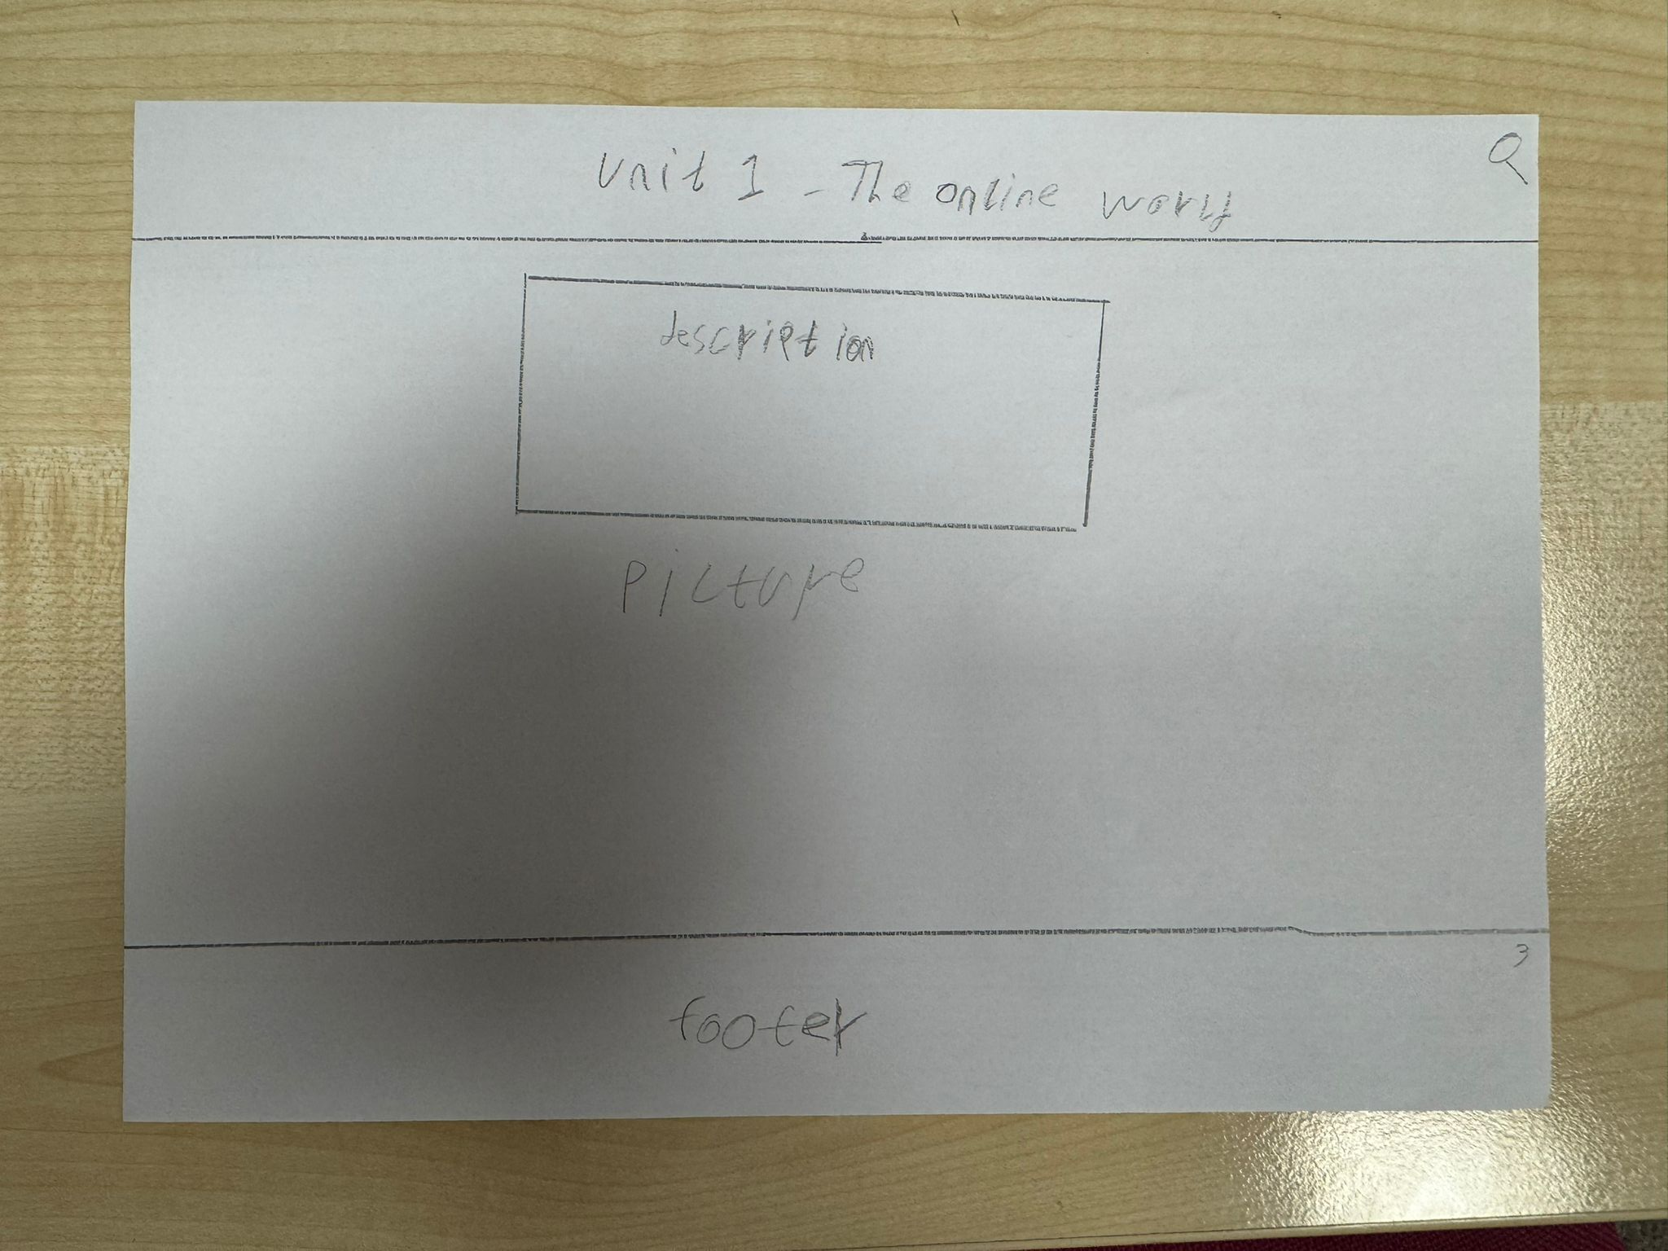
Original
Title
Description of whole unit what it teaches
Pictures related to unit 1
Footer of my website

Slide 48
Annotation of Unit 1 Page Design
Title Unit 1 – The Online World
The title is placed at the top of the page to clearly show which unit the page is about. This helps users quickly understand the content they are viewing.
Description of the Unit
This section contains a description explaining what Unit 1 teaches. It provides a short overview of the topics covered in the unit so users can understand the purpose of the work.
Pictures Related to Unit 1
Images are included to make the page more visually appealing and engaging. They also help represent the topic of the unit and support the written content.
Footer of My Website
The footer is placed at the bottom of the page and keeps the design consistent across the whole website. It may include information such as contact details or navigation links.

Slide 49
Style guide
Element | Colours | Font | Size | Rationale
Page Title | White text on purple/dark background | Arial | 32 bold | The large white title makes the page clear and easy to identify. It helps users quickly understand which section of the portfolio they are viewing.
Navigation Menu | White text on purple buttons | Arial | 22 | Simple navigation buttons make it easy for users to move between pages such as Home, About Me, and Units.
Section Headings | Dark text on light background | Arial | 26-30 bold | Headings separate the content into sections like Skills, Education, and Experience, helping users quickly find information.
Body Text | Dark text on light background | Arial | 16-18 | This font size is easy to read and suitable for paragraphs describing my work and learning.
Images | Black text on white/light background | N/A | Medium size | Images make the website more visually appealing and help explain the content of each unit.
Footer | Natural colours with white background | Arial | 14-16 | The footer keeps the design consistent across the website and may contain contact details or extra links.

Slide 50
Unit 1 - online world
This page shows the work I completed for Unit 1. The page includes pictures of my work and a description explaining the unit. In this unit I learned about online services, internet communication, and how the internet works. The pictures help demonstrate the work I completed during the unit

Slide 51
Purpose of the Page
The purpose of this page is to present my work from Unit 1 – The Online World. This page allows teachers and assessors to see the assignments I completed and understand the knowledge I developed about online services, communication, and internet safety.

Slide 52
Design
The page includes a title at the top showing the unit name, which clearly tells users which unit they are viewing. In the centre of the page there is a description box that explains the assignment and what I learned. Below the description there is a picture section where images of my work or assignment can be displayed. At the bottom of the page there is a footer, which keeps the design consistent with the rest of the website.

Slide 53
Aesthetic Features
The page uses a simple and organised layout so the information is easy to read. The title is placed at the top to clearly identify the page. The description box is placed in the centre to make it the main focus of the page. The picture section adds a visual element to make the page more engaging.

Slide 54
Design Features
The design includes clear content areas for the title, description, and pictures. These sections help organise the information and allow users to quickly understand the structure of the page. The layout is consistent with the other pages of the website to maintain a professional appearance.

Slide 55
Interactive Features / User Interaction
Users can scroll through the page to read the description and view the images of my assignment work. Navigation links allow users to move between different units and pages of the portfolio.

Slide 56
Why This Design is Effective
This design is effective because it clearly presents both the explanation and the visual evidence of my work. Users can easily understand what the assignment is about and see examples of the work I completed.
The design meets user requirements because it is simple, organised, and easy to navigate. Teachers and assessors can quickly find the information they need and view my work without confusion.

Slide 57
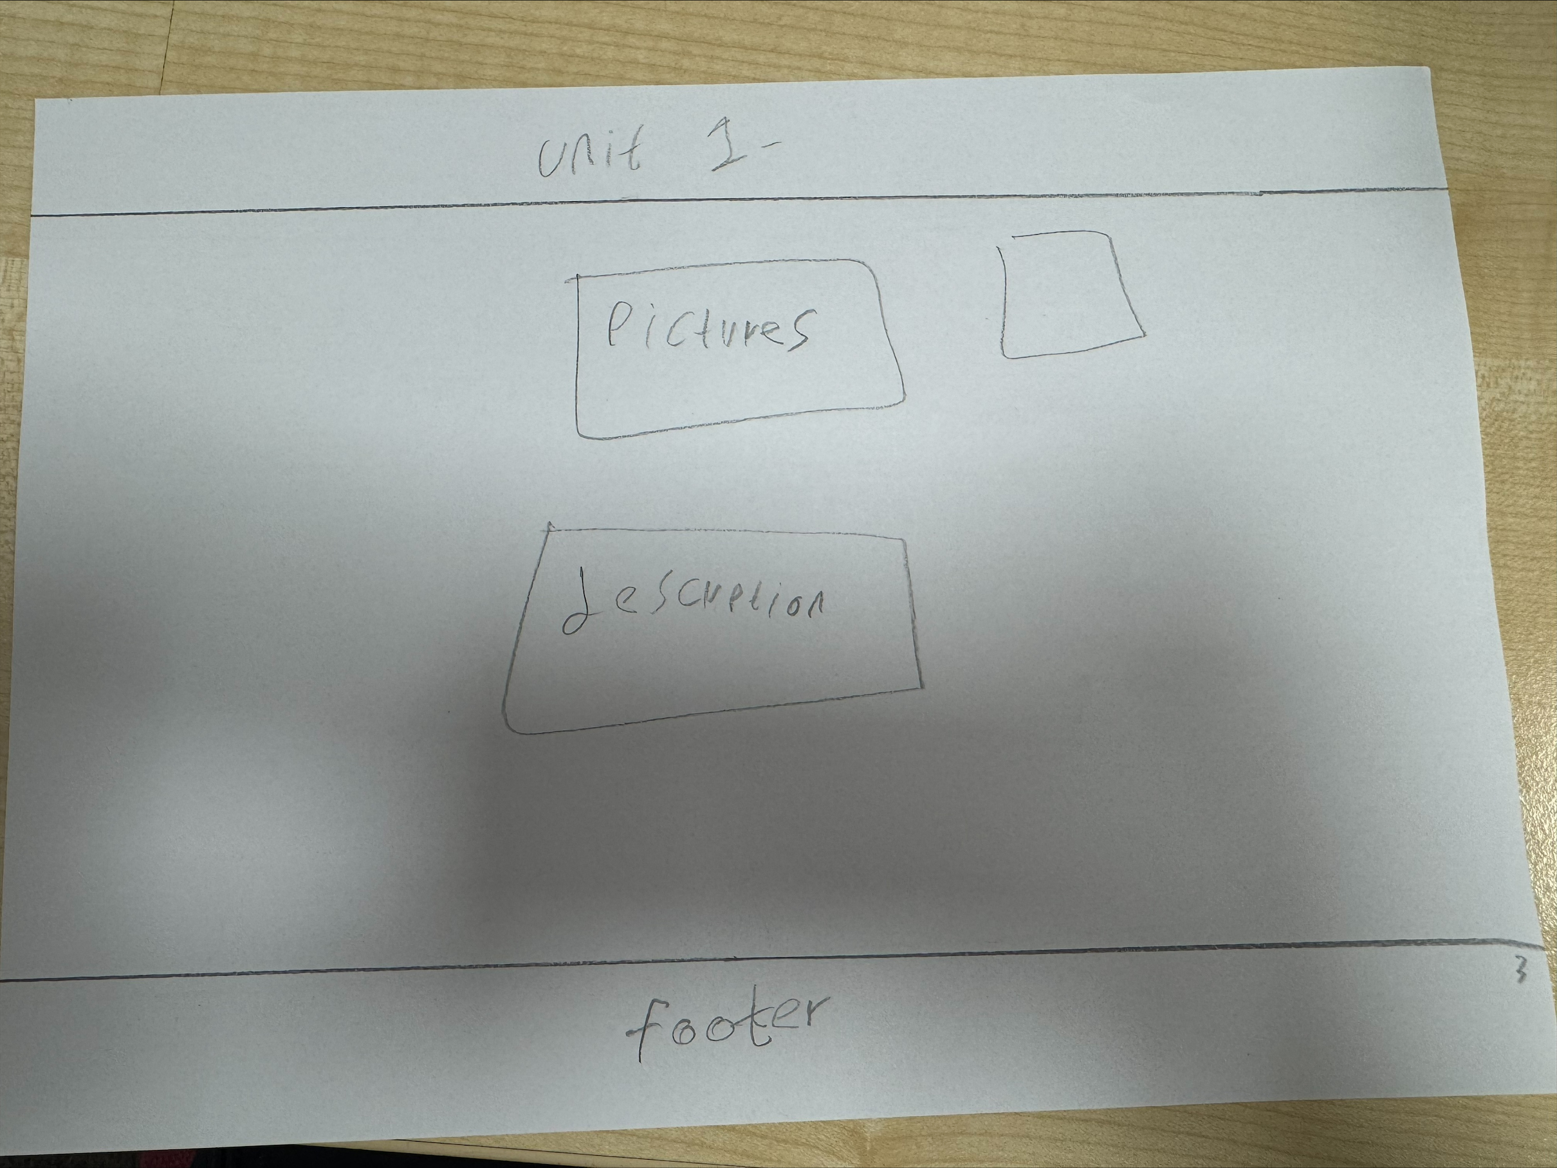
Alternative
Title
Pictures related to unit 1
Description of whole unit what it teaches
Footer of my website

Slide 58
Annotation of Alternative Unit 1 Page Design
Title Unit 1
The title is placed at the top of the page so users can clearly see which unit the page is about. This helps organise the portfolio and allows users to quickly identify the content.
Pictures Related to Unit 1
Images related to Unit 1 are included to make the page more visually interesting. The pictures help represent the topic of the unit and support the written information.
Description of the Unit
This section provides a description explaining what the unit teaches and what topics are covered. It helps users understand the purpose of the unit and the knowledge gained from it.
Footer of My Website
The footer is located at the bottom of the page and keeps the design consistent with other pages in the portfolio. It may include contact details or additional links.

Slide 59
Style guide
Element | Colours | Font | Size | Rationale
Page Title | White text on purple/dark background | Arial | 36 bold | The title is large and bold so users can easily identify the page they are viewing. It helps make the portfolio look clear and organised.
Navigation Buttons | White text on purple buttons | Arial | 22 | Navigation buttons allow users to move easily between pages such as Home, About Me and Units. The colour makes them easy to see and use.
Section Headings | Dark text on light background | Arial | 28 bold | Headings help organise the content into sections such as skills, education and work experience. This makes the page easier to read.
Body Text | Black text on white/light background | Arial | 16–18 | Standard body text size ensures the content is readable and not too large or small for users.
Images | Natural colours | N/A | Medium size | Images help make the page more visually appealing and support the information shown on the page.
Footer | White text on dark background | Arial | 14–16 | The footer keeps the design consistent across the website and may include contact information or additional links.

Slide 60
Unit 2 – TECHNOLOGY SYSTEM (eXAM)

Slide 61
Unit 2
Technology Systems demonstrates the knowledge I developed about computer hardware, software, and how technology systems work together. In this unit, I learned about different system components such as input and output devices, storage, processors, and operating systems. I also developed an understanding of how data is processed and how technology systems are used in everyday situations.

Slide 62
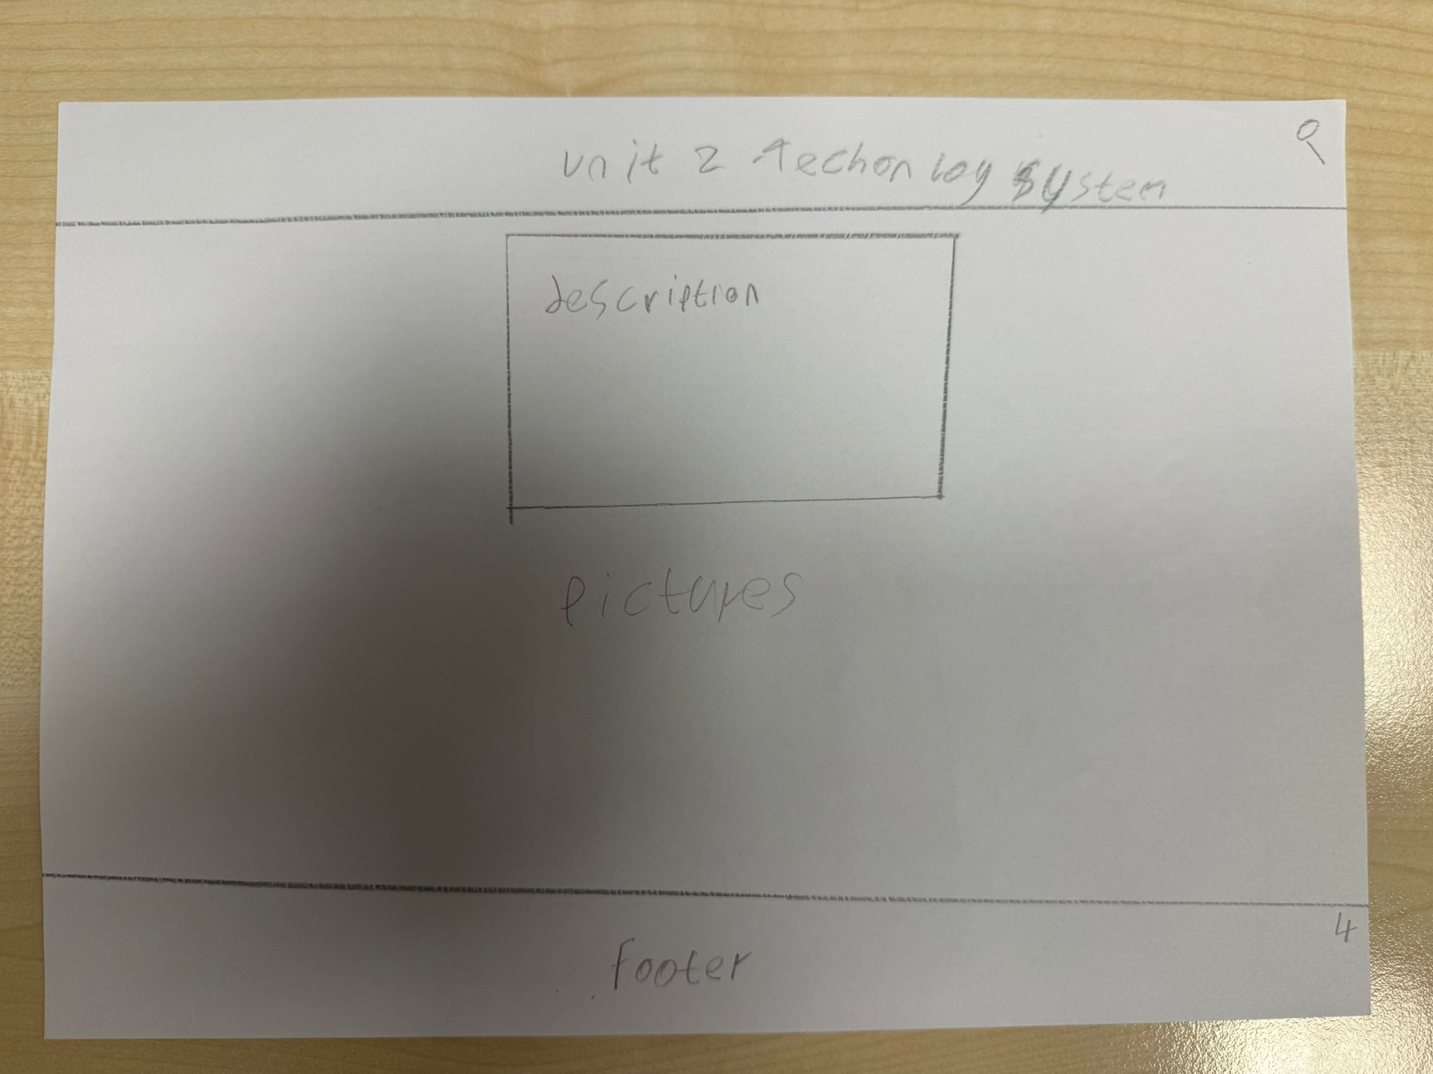
Original
Title
Description of whole unit what it teaches
Pictures related to unit 1
Footer of my website

Slide 63
Annotation of Unit 2 Page Design
Title Unit 2 – Technology Systems
The title is placed at the top of the page to clearly show which unit the page is about. This helps users quickly understand the topic of the page.
Description of the Unit
This section contains a description explaining what Unit 2 teaches. It provides an overview of the key topics and knowledge covered in the unit.
Pictures Related to Unit 2
Images related to technology systems are included to make the page more visually engaging. The pictures help support the written content and make the page more interesting for users.
Footer of My Website
The footer is placed at the bottom of the page and keeps the layout consistent across the entire portfolio. It can include information such as contact details, navigation links, or copyright information.

Slide 64
Style guide
Element | Colours | Font | Size | Rationale
Page Title | White text on purple/dark background | Arial | 36 bold | The title is large and bold so users can clearly see the page heading. It helps make the website organised and easy to understand.
Navigation Menu | White text on purple buttons | Arial | 22 | Navigation buttons allow users to easily move between pages such as Home, About Me, and different Units.
Section Headings | Dark text on light background | Arial | 28 bold | Headings separate sections such as description, skills, and education so users can quickly find information.
Body Text | Black text on white/light background | Arial | 16–18 | The body text size is easy to read and suitable for paragraphs explaining the unit content and my work.
Images | Natural colours | N/A | Medium size | Images make the website visually appealing and help explain the topics of each unit.
Footer | White text on dark background | Arial | 14–16 | The footer keeps the website layout consistent and may include contact details or extra navigation links.

Slide 65
Unit2-technology
This page presents my work for Unit 2. It includes pictures of my assignments and a description explaining what I learned. In this unit I studied computer systems, including hardware, software, storage devices, and system performance.

Slide 66
Purpose of the Page
The purpose of this page is to present my work from Unit 2 – Technology Systems. This page allows teachers and assessors to see the assignments I completed and understand the knowledge I gained about computer systems, hardware, software, and system performance.

Slide 67
Design
The page includes a title at the top showing the name of the unit, which helps users clearly identify the page. In the centre of the page there is a description section where I explain the assignment and what I learned from the unit. Below the description there is a pictures section where images of my work or assignment can be displayed. At the bottom of the page there is a footer which keeps the design consistent across the website.

Slide 68
Aesthetic Features
The page uses a simple and organised layout which improves readability. The title is placed at the top so users can immediately recognise which unit they are viewing. The description section is positioned in the centre to focus attention on the explanation of the work. The picture section adds a visual element which makes the page more interesting.

Slide 69
Design Features
The design includes clearly defined sections for the title, description, and pictures. These sections help organise the content so users can quickly understand the structure of the page. The layout is consistent with other unit pages, which helps maintain a professional and organised appearance across the website.

Slide 70
Interactive Features / User Interaction
Users can scroll down the page to read the description and view the pictures of my work. Navigation links allow users to move to other units or pages within the portfolio.

Slide 71
Why This Design is Effective
This design is effective because it clearly presents both the explanation of the assignment and visual examples of my work. Users can easily understand the topic and see evidence of the work I completed
The page design is effective because it meets user requirements by presenting information clearly and in an organised way. Teachers and assessors can quickly read the description and view the assignment evidence without confusion.

Slide 72
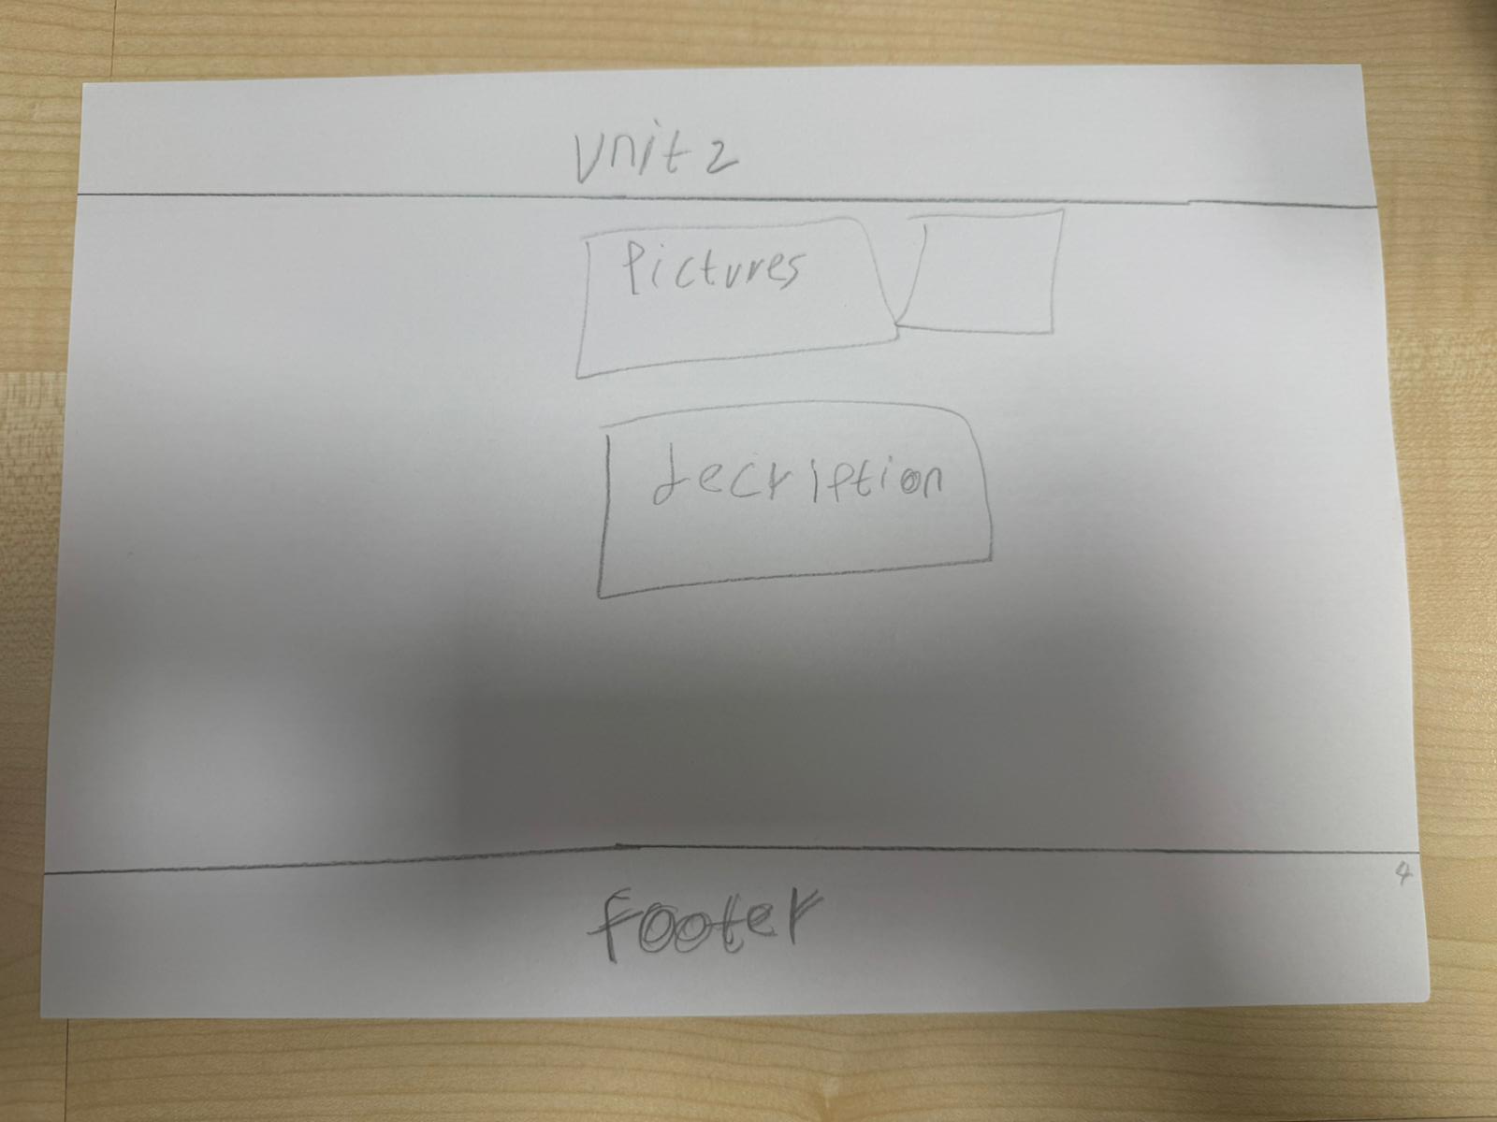
Alternative
Title
Pictures related to unit 1
Description of whole unit what it teaches
Footer of my website

Slide 73
Annotation of Alternative Unit 2 Page Design
Title Unit 2
The title is placed at the top of the page so users can clearly see which unit they are viewing. This helps organise the portfolio and makes navigation easier.
Pictures Related to Unit 2
Images related to the unit are placed near the top of the page. These pictures help make the page more visually interesting and represent the topic of technology systems.
Description of the Unit
The description section explains what the unit teaches and what topics are covered. This helps users understand the purpose of the unit and the knowledge gained from it.
Footer of My Website
The footer is located at the bottom of the page and keeps the design consistent with the rest of the portfolio. It can include information such as contact details or navigation links.

Slide 74
Style guide
Element | Colours | Font | Size | Rationale
Title | White text with dark purple background | Arial | 36 bold | Large title makes the page clear and helps users immediately understand which section or unit they are viewing.
Navigation buttons | White text with purple background | Arial | 22 | Simple and readable buttons help users move between pages easily.
Description text | Black text on white background | Arial | 18–20 | Clear colour contrast makes the text easy to read and helps users understand the information quickly.
Pictures | Natural colours | N/A | Medium image size | Images make the page visually engaging and help users understand the topic better.
Section headings | Dark purple text | Arial | 24 bold | Headings help organise information and make the page structure clear.
Footer | White text with dark purple background | Arial | 14–16 | Footer keeps the design consistent and can contain contact information or navigation links.

Slide 75
Unit 3 - A Digital Portfolio (Assignments)

Slide 76
Unit 3
This project comes from Unit 3, A Digital Portfolio, where I completed several assignments to design and plan a professional portfolio website. It demonstrates my skills in organising content, creating layouts, and presenting my work clearly for employers.

Slide 77
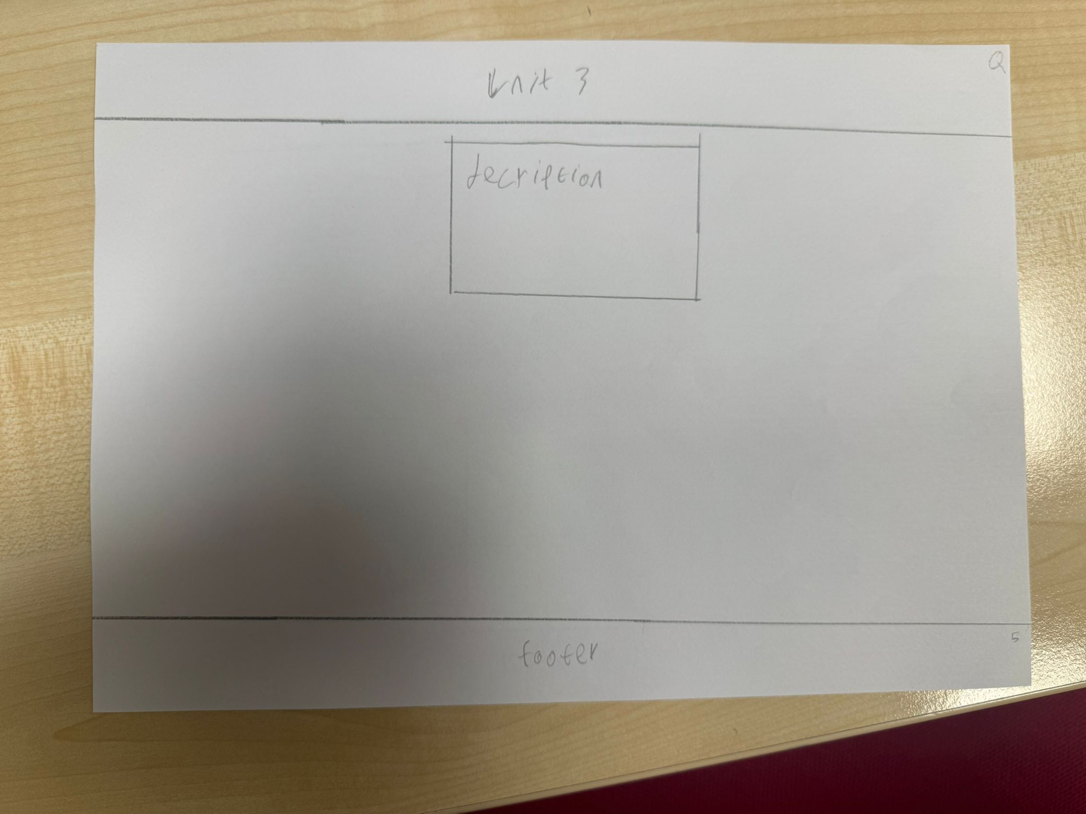
Original
Title
Description of whole unit what it teaches
Footer of my website

Slide 78
Annotation of Unit 3 Page Design
Title Unit 3
The title is placed at the top of the page so users can immediately see which unit they are viewing. This helps organise the portfolio and keeps the layout consistent across all unit pages.
Description of the Unit
The description section is placed in the centre of the page. This section explains what the unit teaches and what skills or knowledge are learned in this unit. Placing it in the centre makes it easy for users to read and understand the content.
Footer of My Website
The footer is located at the bottom of the page. It keeps the design consistent with the other pages of the website and can contain important information such as navigation links or contact information.

Slide 79
Style guide
Element | Colours | Font | Size | Rationale
Page Title | White text with dark purple background | Arial | 36 bold | The large title clearly shows which unit page the user is viewing and makes the page easy to understand.
Description Text | Black text on white background | Arial | 18–20 | Simple colours make the text easy to read and help users understand the unit information clearly.
Images | Natural colours | N/A | Medium image size | Images make the page more engaging and help users visually understand the topic of the unit.
Section Headings | Dark purple text | Arial | 24 bold | Headings organise the content and make the layout clearer for users.
Navigation Buttons | White text with purple background | Arial | 22 | Clear navigation helps users move between pages easily and improves usability.
Footer | White text with dark purple background | Arial | 14–16 | The footer keeps the design consistent across all pages and can contain contact information or links.

Slide 80
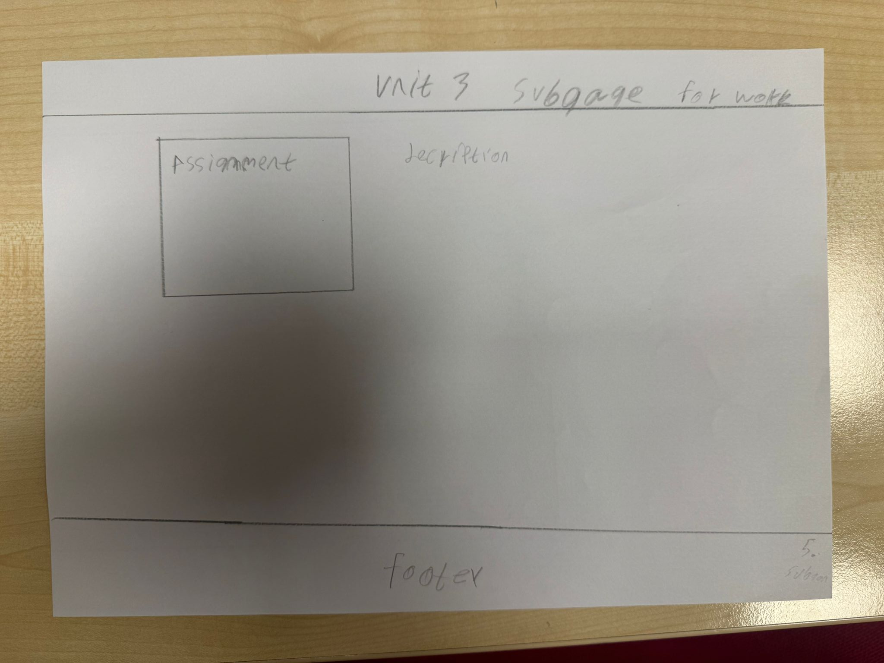
Original
Title
Description of whole assignment
Assignment I make
Footer of my website

Slide 81
Annotation of Unit 3 Subpage Design
Title Unit 3 Subpage for Work
The title is placed at the top of the page so users can easily identify which section of the website they are viewing. This helps keep the portfolio organised and consistent with other pages.
Description of the Unit
The description section explains what the unit is and what knowledge or skills were developed. This helps users understand the purpose of the unit and the work completed.
Assignment I Made
This section shows the assignment that was completed for the unit. Displaying the assignment allows users, such as teachers or employers, to see examples of the work produced and the skills demonstrated.
Footer of My Website
The footer is placed at the bottom of the page to maintain a consistent design across the whole website. It can include information such as navigation links or contact details.

Slide 82
Style guide
Element | Colours | Font | Size | Rationale
Page Title | White text with dark purple background | Arial | 36 bold | The title is large and clear so users can easily see which page they are on. It keeps the website organised.
Assignment Section | Black text on white background | Arial | 20 | Shows the work completed in the unit and allows users to view examples of assignments.
Description Text | Black text on white background | Arial | 18–20 | Simple and readable text helps users understand what the unit teaches.
Section Headings | Dark purple text | Arial | 24 bold | Headings help organise information and make the page easier to navigate.
Images / Assignment Preview | Natural colours | N/A | Medium size | Images or previews make the page visually engaging and show evidence of the work completed.
Footer | White text with dark purple background | Arial | 14–16 | The footer keeps the design consistent across the website and can include links or contact information.

Slide 83
UNIT3 DIGITAL PORTFOLIO
This page explains the work I completed for Unit 3. The page contains a description of the assignments I completed. In this unit I learned how to design and create a digital portfolio to present my work professionally.

Slide 84
Purpose of the Page
The purpose of the Unit 3 page is to display my work and learning from Unit 3. This page allows teachers and users to view the assignments and information related to this unit. It provides a clear explanation of the work completed and helps demonstrate my understanding of the topic.

Slide 85
Design
The page includes a clear title at the top labelled “Unit 3” so users can easily identify which unit they are viewing. In the centre of the page there is a description box where the explanation of the unit work will be written. At the bottom of the page there is a footer, which keeps the layout consistent with the rest of the website.

Slide 86
Aesthetic Features
The design is simple and organised, which makes the page look clean and professional. The title is placed at the top to create a clear visual structure. The description section is placed in the centre so it becomes the main focus of the page. The simple layout helps make the content easy to read.

Slide 87
Design Features
The page uses clear sections including the title, description area, and footer. These features help organise the information in a structured way. The layout is similar to other unit pages so users can easily recognise the design and understand how to navigate the website.

Slide 88
Interactive Features / User Interaction
Users can scroll through the page to read the description and view the information about the unit. Navigation links will allow users to move between different unit pages and other sections of the portfolio website.

Slide 89
Why This Design is Effective
This design is effective because it focuses on presenting the unit information clearly. The simple structure allows users to quickly understand the topic and read the explanation without distractions.
The page design is effective because it meets the user requirements by providing clear information about the unit in a simple and organised format. The consistent layout across pages helps users navigate the website easily and find the information they need.

Slide 90
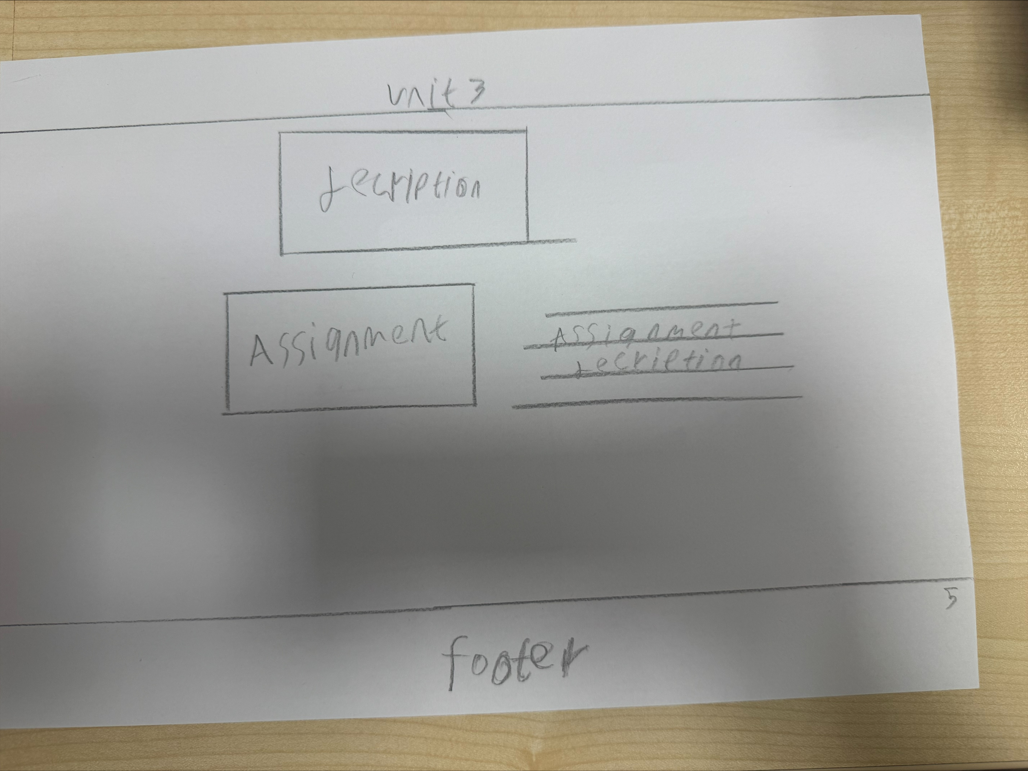
Alternative
Title
Description of whole unit what it teaches
Description of whole assignment
Assignment I make
Footer of my website

Slide 91
Annotation of Alternative Unit 3 Subpage Design
Title (Unit 3)
The title is placed at the top of the page so users can quickly identify which unit they are viewing. This keeps the structure of the website consistent and organised.
Description of the Unit
The description section explains what the unit teaches and what topics are covered. Placing it near the top helps users understand the purpose of the unit before viewing the assignment.
Assignment I Made
This section displays the assignment that was completed for the unit. Showing the assignment allows users, such as teachers or employers, to see examples of the work produced and the skills demonstrated.
Assignment Description
The assignment description explains the purpose of the assignment and what was required to complete it. This helps users understand the context of the work shown.
Footer of My Website
The footer is located at the bottom of the page to maintain a consistent layout across all pages. It can contain information such as navigation links or contact details.

Slide 92
Style guide
Element | Colours | Font | Size | Rationale
Page Title | White text with dark purple background | Arial | 36 bold | The title clearly shows which unit page the user is viewing and keeps the website organised and easy to understand.
Unit Description | Black text on white background | Arial | 18–20 | Simple colours improve readability and help users understand what the unit teaches.
Assignment Section | Black text on white background | Arial | 20 | This section displays the assignment work so users can see examples of the skills demonstrated.
Assignment Description | Black text on white background | Arial | 18 | Explains the purpose of the assignment and helps users understand the context of the work.
Section Headings | Dark purple text | Arial | 24 bold | Headings help structure the page and make it easier for users to scan the information.
Footer | White text with dark purple background | Arial | 14–16 | The footer keeps the design consistent across the website and can include navigation links or contact information.

Slide 93
Unit 13 - Website Development (Assignments)

Slide 94
Unit 13
Unit 13 – Website Development includes the assignments I completed using HTML and CSS to plan, design, and develop websites. For example, I created multi-page websites with a navigation menu, header, content sections, and footer, and used CSS to control layout, colours, fonts, and spacing. I improved user experience by designing clear page structures and simple navigation so users could easily find information.
During this unit, I also developed teamwork and communication skills by discussing design ideas with classmates, receiving feedback, and making changes based on suggestions. I explained my design decisions and helped solve layout problems during group discussions. This unit helped me build strong front-end development skills, problem-solving ability, attention to detail, and the confidence to work in a team, which are all important skills for employers.

Slide 95
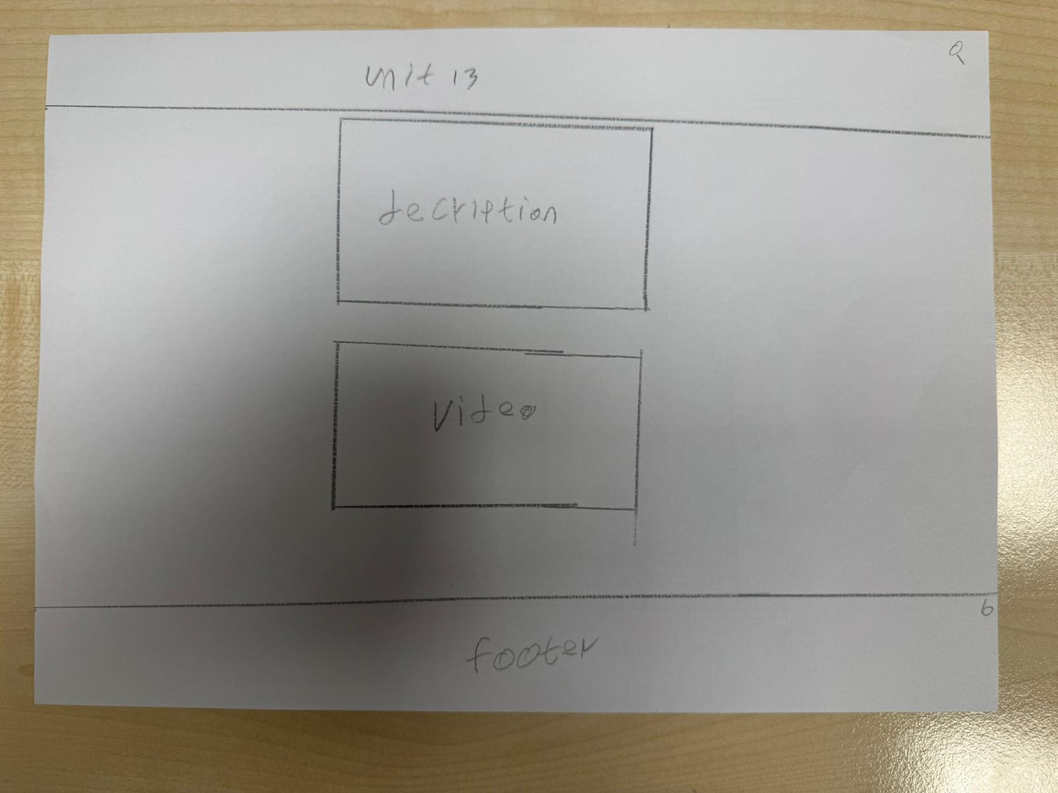
Original
Title
Description of whole unit what it teaches
Video explaining whole unit
Footer of my website

Slide 96
Annotation of Unit 13 Page Design
Title
The title is placed at the top of the page so users can quickly identify which unit they are viewing. This helps keep the website organised and consistent with the other unit pages.
Description of the Unit
The description section explains what the unit teaches and what topics are covered. This helps users understand the purpose of the unit and the knowledge gained.
Video Explaining the Unit
The video section provides a visual explanation of the unit. Including a video makes the page more engaging and allows users to understand the content in an interactive way.
Footer of My Website
The footer is placed at the bottom of the page to maintain a consistent layout across all pages. It can include information such as navigation links or contact details.

Slide 97
Style guide
Element | Colours | Font | Size | Rationale
Page Title | White text with dark purple background | Arial | 36 bold | The large title clearly shows which unit the user is viewing and keeps the layout consistent across all pages.
Unit Description | Black text on white background | Arial | 18–20 | Simple colours improve readability and help users understand what the unit teaches.
Video Section | Natural video colours with white background | N/A | Medium video frame | The video provides a visual explanation of the unit, making the page more interactive and engaging for users.
Section Headings | Dark purple text | Arial | 24 bold | Headings organise the information and make the page easier to scan.
Content Area Background | Light grey background | N/A | Full page section | A light background separates sections and makes the content easier to read.
Footer | White text with dark purple background | Arial | 14–16 | The footer keeps the design consistent across the website and can include navigation links or contact information.

Slide 98
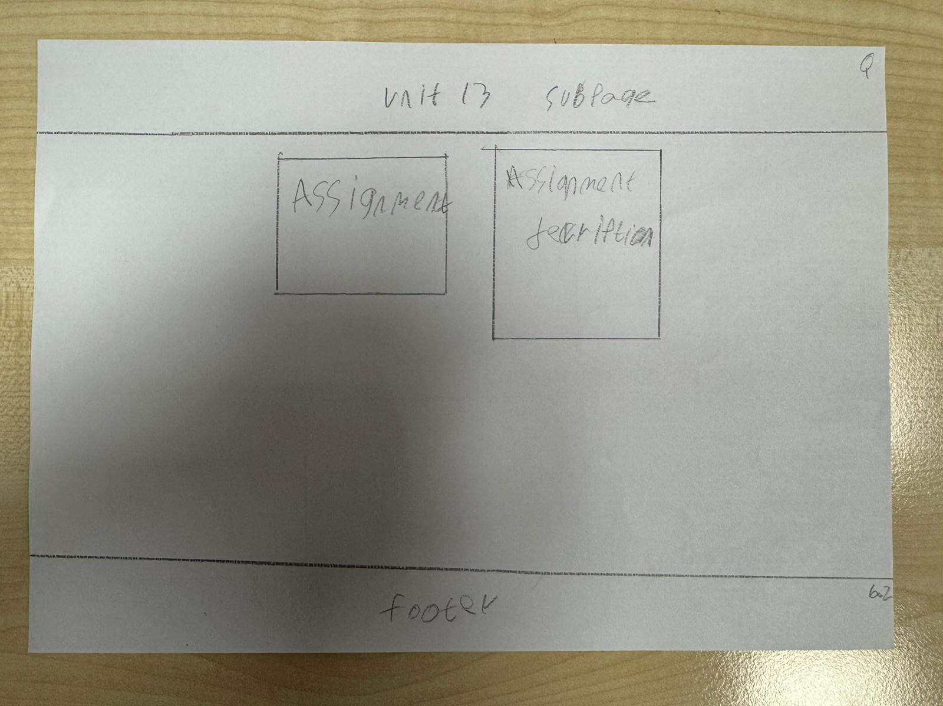
Original
Title
Description of whole assignment
Assignment I make
Footer of my website

Slide 99
Annotation of Unit 13 Subpage Design
Title
The title is placed at the top of the page so users can easily identify which section of the website they are viewing. This keeps the layout organised and consistent with the other unit pages.
Assignment I Made
This section shows the assignment that was completed for Unit 13. Displaying the assignment allows users to see examples of the work produced and the skills demonstrated.
Assignment Description
The assignment description explains what the assignment was about and what tasks were required. This helps users understand the purpose of the work shown.
Footer of My Website
The footer is placed at the bottom of the page to maintain consistency across the website. It can include navigation links or contact information.

Slide 100
Style guide
Element | Colours | Font | Size | Rationale
Page Title | White text with dark purple background | Arial | 36 bold | The title clearly shows which unit page the user is viewing and keeps the website organised and consistent.
Assignment Display | Black text on white background | Arial | 20 | This section shows the assignment work so users can easily see examples of the work produced.
Assignment Description | Black text on white background | Arial | 18 | The description explains what the assignment is about and helps users understand the work shown.
Section Headings | Dark purple text | Arial | 24 bold | Headings organise the page and make it easier for users to scan the content quickly.
Content Area | White background | N/A | Full section width | A simple background keeps the layout clean and improves readability.
Footer | White text with dark purple background | Arial | 14–16 | The footer keeps the design consistent across all pages and can include navigation links or contact details.

Slide 101
UNIT13 – WEBSITE DEVELOPMENT
This page shows the work I completed for Unit 13. It includes a video and a description explaining my assignments. In this unit I learned how to create websites using HTML and CSS and how to design user-friendly web pages.

Slide 102
Purpose of the Page
The purpose of the Unit 13 page is to present the work and knowledge I gained from Unit 13. This page allows teachers and users to view my assignments and understand the topic covered in this unit. It provides a clear explanation of the work completed and includes supporting content such as a video

Slide 103
Design
The page includes a title at the top labelled “Unit 13” so users can easily identify the unit. In the centre of the page there is a description section where information about the unit and my work will be explained. Below the description there is a video section where a video related to the assignment or topic can be shown. A footer is placed at the bottom of the page to keep the website layout consistent.

Slide 104
Aesthetic Features
The design is simple and well organised to make the page easy to read. The title is placed clearly at the top to create structure. The description box is positioned in the centre to focus attention on the information. The video section adds a visual and interactive element which makes the page more engaging.

Slide 105
Design Features
The page contains clear sections including the title, description box, video area, and footer. These design features help organise the content and make the layout consistent with the other pages in the portfolio website. This helps users understand where to find information easily.

Slide 106
Interactive Features / User Interaction
Users can scroll down the page to read the description and watch the video. The video allows users to interact with the content by playing or pausing it. Navigation links on the website will also allow users to move between different unit pages.

Slide 107
Why This Design is Effective
This design is effective because it combines written explanation with a video. The description provides information while the video helps demonstrate the topic visually, making the content easier to understand.
The page design is effective because it clearly presents the unit information in a structured way. The combination of text and video makes the page more engaging and helps meet user requirements by providing clear and interactive content.

Slide 108
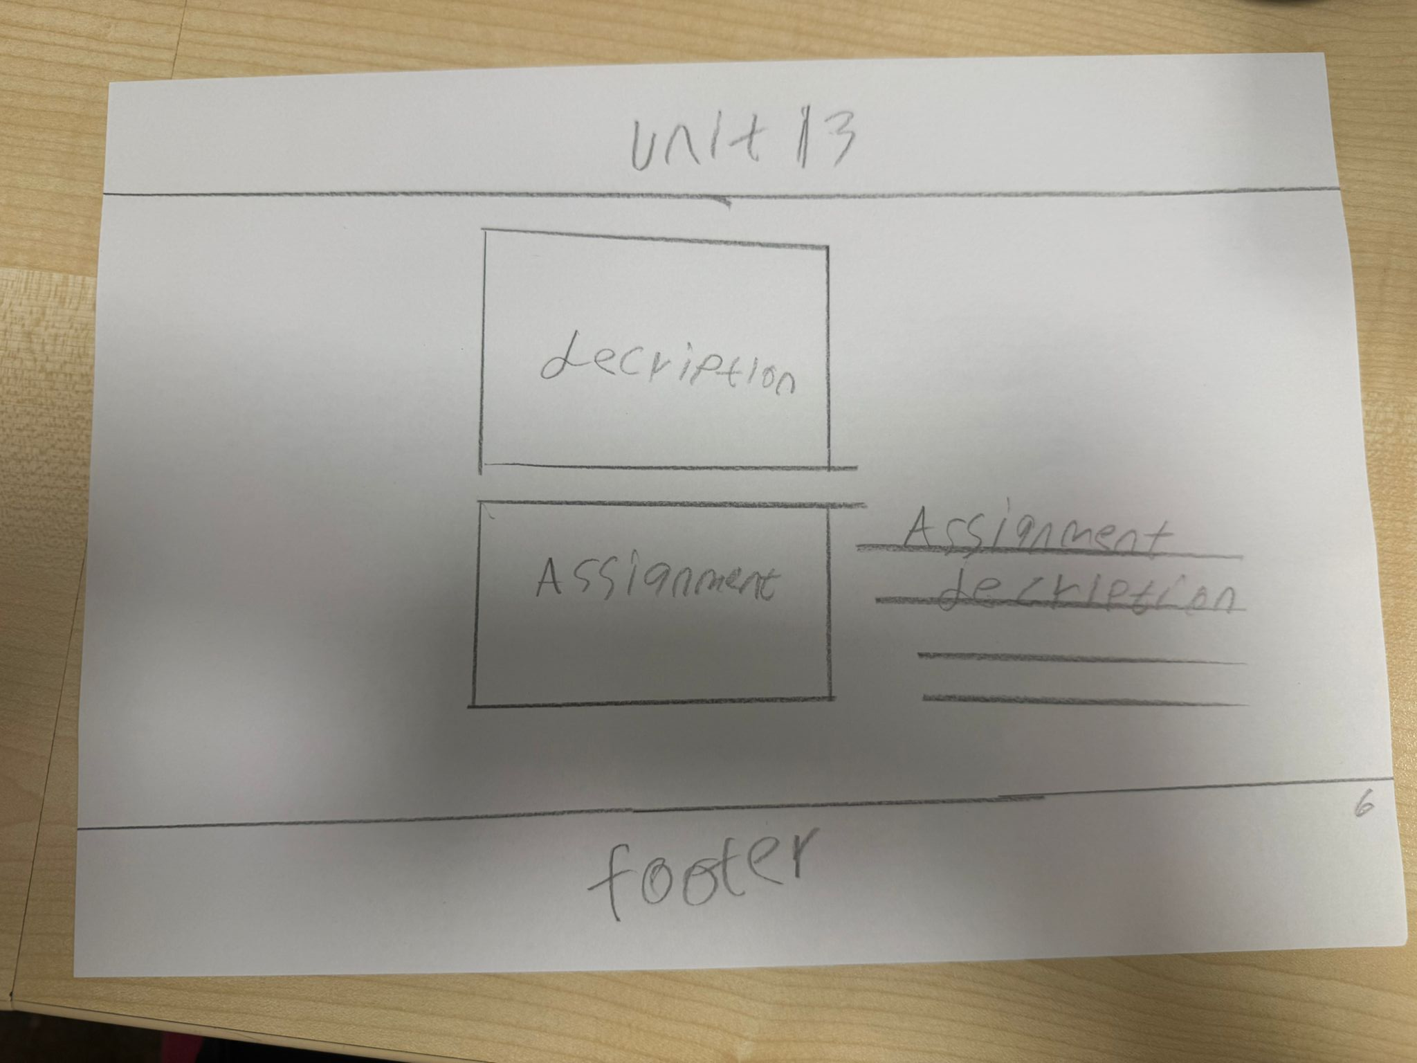
Alternative
Title
Description of whole unit what it teaches
Description of whole assignment
Assignment I make
Footer of my website

Slide 109
Annotation of Alternative Unit 13 Subpage Design
Title
The title is placed at the top of the page so users can clearly see which unit they are viewing. This helps keep the website organised and consistent with other pages.
Description of the Unit
The unit description explains what the unit teaches and what knowledge or skills were developed. Placing it near the top helps users understand the unit before viewing the assignment.
Assignment I Made
This section displays the assignment completed for the unit. Showing the assignment allows users to see examples of the work produced and the skills demonstrated.
Assignment Description
The assignment description explains what the assignment involved and what tasks were completed. This helps users understand the context of the work shown.
Footer of My Website
The footer is located at the bottom of the page and keeps the design consistent across the website. It can include navigation links or contact information.

Slide 110
Style guide
Element | Colours | Font | Size | Rationale
Title | Dark purple | Arial / Sans-serif | 32 bold | The title is large and bold so users can easily identify which unit page they are viewing.
Unit Description | Black / Dark grey | Arial | 16–18 | A readable font size makes it easy for users to understand what the unit teaches.
Assignment Title | Dark purple | Arial Bold | 20 | The assignment title stands out so users can clearly identify the work created for the unit.
Assignment Description | Black / Dark grey | Arial | 14–16 | A smaller but readable font is used to explain the assignment clearly without overwhelming the page.
Footer | Light grey background with dark text | Arial | 12–14 | The footer separates the main content and provides consistent navigation or information across all pages.
Page Background | Light grey / white | Default | N/A | A neutral background keeps the page clean and ensures the content is easy to read.

Slide 111
Unit 18 - Computational Thinking (Assignments)

Slide 112
Unit 18
In Unit 18, I learned about computational thinking and how it is used to solve problems in technology. Computational thinking involves breaking a problem into smaller parts, recognising patterns, creating step-by-step solutions, and designing algorithms. This unit helped me understand how computer systems and programmers solve complex problems logically and efficiently. It also improved my problem-solving skills and my ability to think in a structured way when developing digital solutions.

Slide 113
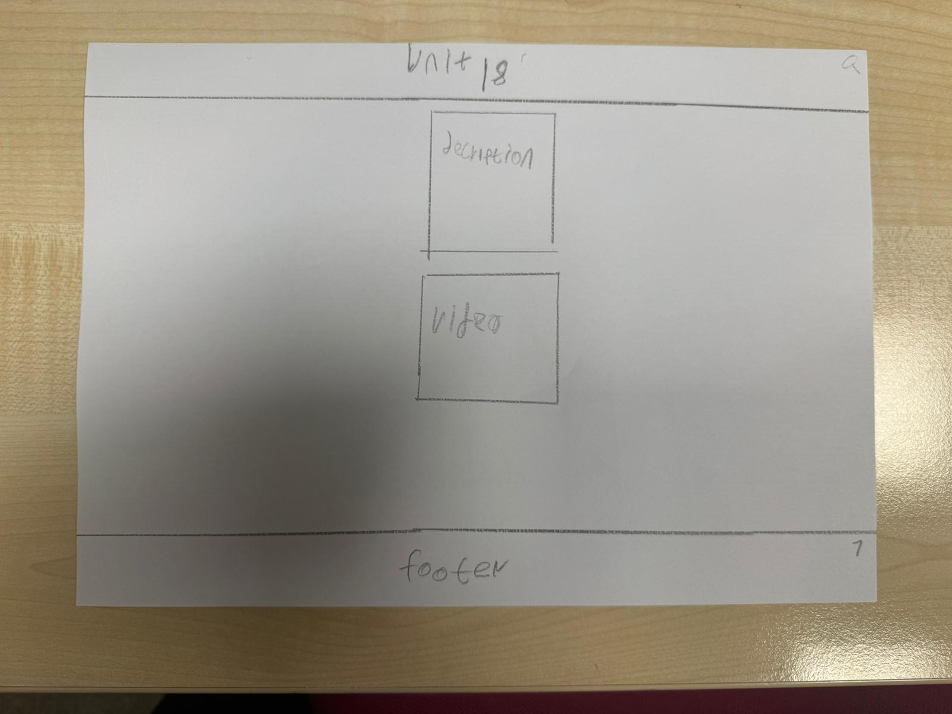
Original
Title
Description of whole unit what it teaches
Video explaining whole unit
Footer of my website

Slide 114
Annotation of Original Unit 18 Page Design
Title
The title is placed at the top of the page so users can immediately identify which unit they are viewing. This keeps the page organised and consistent with the rest of the website.
Description of the Unit
The unit description explains what the unit teaches and what knowledge or skills are covered. Placing it near the top helps users understand the content of the unit before viewing additional materials.
Video Explaining the Whole Unit
The video provides a visual explanation of the unit, which can help users understand the topic more easily. Including a video also makes the page more engaging and interactive.
Footer of My Website
The footer is placed at the bottom of the page to keep the layout consistent across the whole website. It can contain navigation links or additional information.

Slide 115
Style guide
Element | Colours | Font | Size | Rationale
Page Title | Dark purple | Arial / Sans-serif | 32 bold | A large title helps users immediately identify which unit page they are viewing.
Section Headings Description / Assignment / Video | Dark purple | Arial Bold | 20–24 | Headings highlight different sections of the page so users can easily navigate the content.
Body Text Descriptions | Dark grey / Black | Arial | 16 | A clear and readable font ensures the information is easy for users to understand.
Assignment / Video Content Area | Light grey background | Arial | 16 | A separate content box visually separates assignments or videos from the rest of the page.
Footer | Light grey background with dark text | Arial | 12–14 | The footer keeps the layout consistent across all pages and may contain navigation or additional information.
Page Background | White / very light grey | Default | N/A | A neutral background keeps the design clean and makes text easier to read.

Slide 116
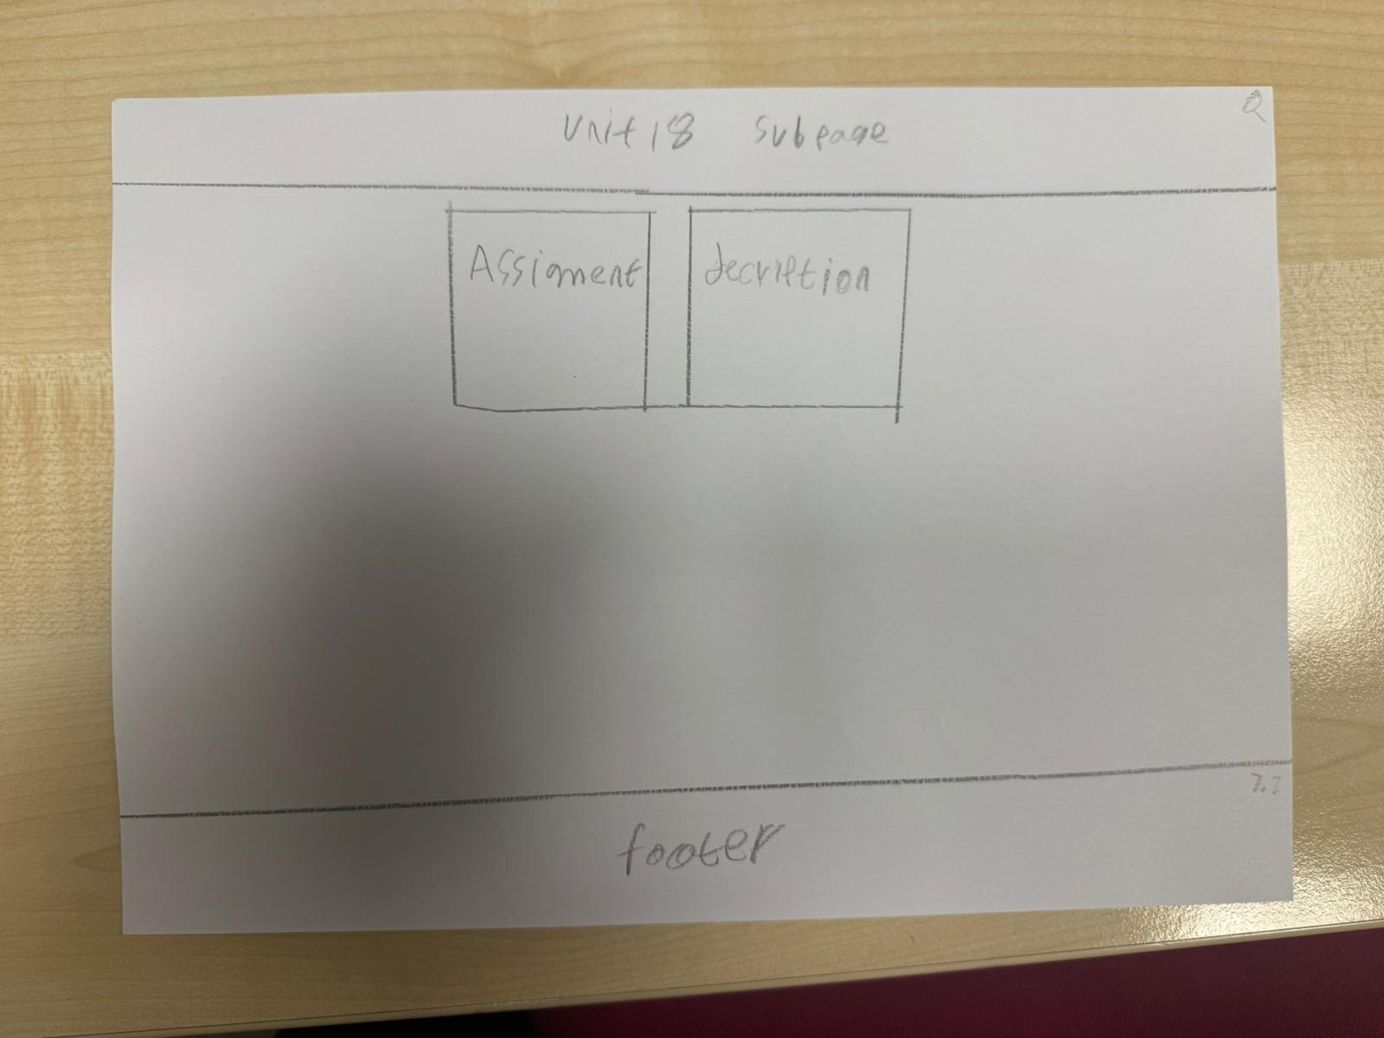
Original
Title
Description of whole assignment
Assignment I make
Footer of my website

Slide 117
Annotation of Original Unit 18 Subpage Design
Title
The title is placed at the top of the page so users can easily identify which unit they are viewing. This keeps the website organised and consistent with the other unit pages.
Assignment I Made
This section shows the assignment created for the unit. Displaying the assignment allows users to see the work produced and understand the practical outcome of the unit.
Description of the Whole Assignment
The assignment description explains what the assignment involved and what tasks were completed. This helps users understand the purpose and context of the work displayed.
Footer of My Website
The footer is positioned at the bottom of the page to keep the layout consistent across the website. It can include navigation links or other important information

Slide 118
Style guide
Element | Colours | Font | Size | Rationale
Page Title | Dark purple | Arial / Sans-serif | 32 bold | A large bold title helps users quickly identify which unit page they are viewing.
Section Headings Description / Assignment / Video | Dark purple | Arial Bold | 20–24 | Headings separate different sections of the page and help users navigate the content easily.
Body Text | Black / Dark grey | Arial | 16 | A clear and readable font improves readability and helps users understand the information.
Assignment / Video Section | Light grey background | Arial | 16 | A separate content area highlights assignments or videos and visually separates them from the rest of the page.
Footer | Light grey background with dark text | Arial | 12–14 | The footer provides consistency across all pages and can contain navigation links or additional information.
Page Background | White / very light grey | Default | N/A | A simple neutral background keeps the design clean and ensures text and content are easy to read.

Slide 119
UNIT 18 – COMPUTATIONAL THINKING
This page presents my work for Unit 18. It includes a video and a description explaining the assignments. In this unit I learned how computational thinking operate and how computer calculate.

Slide 120
Purpose of the Page
The purpose of the Unit 18 page is to present my work and understanding from Unit 18 Computational Thinking. This page allows teachers and users to view the assignments I completed and understand the concepts I learned in this unit.

Slide 121
Design
The page includes a title at the top labelled “Unit 18” so users can easily identify the unit. In the centre of the page there is a description section where I explain the assignment and what I learned. Below this section there is a video section which allows users to watch a video related to the unit or assignment. A footer is placed at the bottom to keep the design consistent with the rest of the website.

Slide 122
Aesthetic Features
The page uses a simple and structured layout to keep the content clear and easy to read. The title at the top creates a clear heading for the page. The description and video sections are placed in the centre, so users focus on the main content. This layout makes the page look organised and professional.

Slide 123
Design Features
The page includes clear sections such as the title, description box, video area, and footer. These design features help organise the information and make the page consistent with the other unit pages in the portfolio. This consistency helps users understand the layout of the website.

Slide 124
Interactive Features / User Interaction
Users can scroll down the page to read the description and watch the video. The video allows users to interact with the content by playing or pausing it. Navigation links on the website allow users to move to other pages or units easily.

Slide 125
Why This Design is Effective
This design is effective because it combines written information and video content. The description explains the topic clearly while the video provides a visual example, helping users better understand the work.
The page design is effective because it presents the unit information in a clear and organised way. The simple layout and consistent structure make it easy for users to navigate the website and quickly find the information they need.

Slide 126
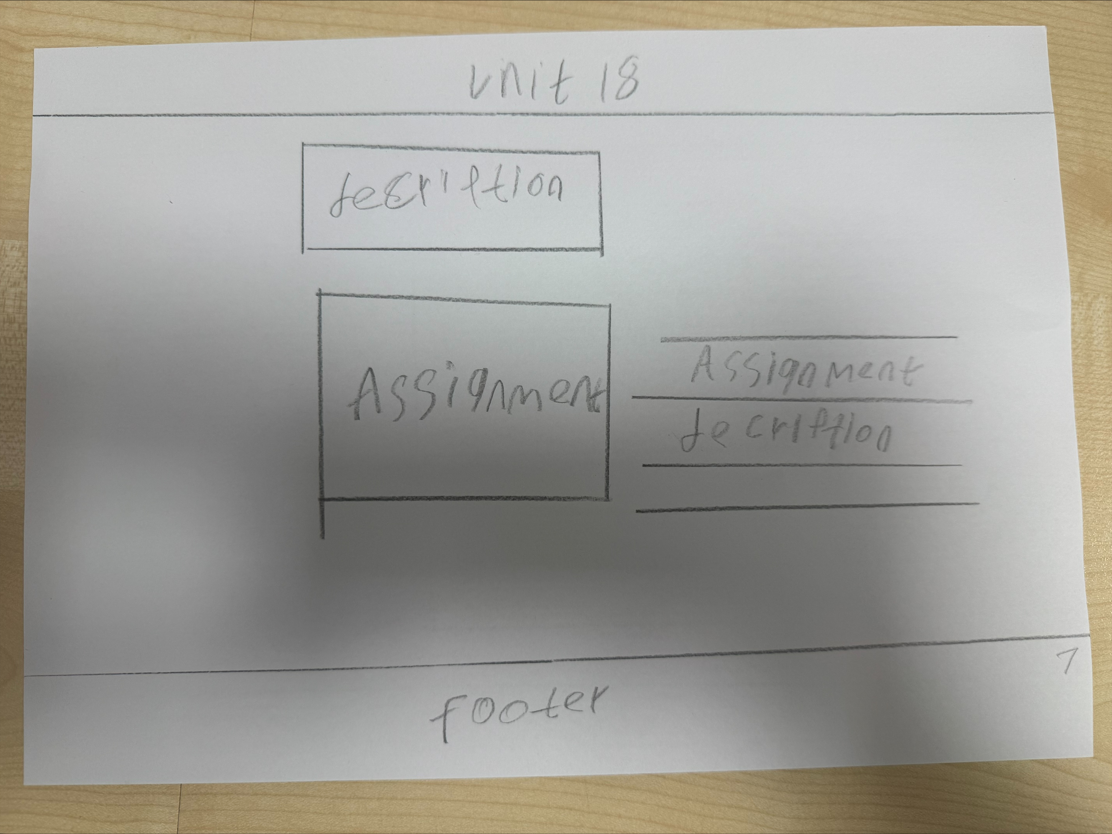
Alternative
Title
Description of whole unit what it teaches
Description of whole assignment
Assignment I make
Footer of my website

Slide 127
Annotation of Alternative Unit 18 Page Design
Title
The title is positioned at the top of the page so users can clearly identify which unit they are viewing. This helps maintain organisation and consistency across the website.
Description of the Whole Unit
This section explains what the unit teaches and what knowledge or skills are covered. Placing it near the top helps users understand the topic before viewing the assignment.
Assignment I Made
This area displays the assignment created for the unit. Showing the assignment allows users to see practical examples of the work completed.
Description of the Whole Assignment
The assignment description explains what the task involved and what was required to complete it. This helps users understand the purpose and context of the assignment.
Footer of My Website
The footer is located at the bottom of the page and provides a consistent layout across all pages of the website. It may include navigation links or other information.

Slide 128
Style guide
Element | Colours | Font | Size | Rationale
Page Title | Dark purple | Arial / Sans-serif | 32 bold | A large bold title helps users immediately identify which unit page they are viewing.
Section Headings Description / Assignment / Video | Dark purple | Arial Bold | 20–24 | Headings help organise the page and make it easier for users to navigate different sections.
Body Text | Black / Dark grey | Arial | 16 | A simple readable font ensures users can easily read and understand the information.
Assignment / Content Area | Light grey background | Arial | 16 | A separate content box highlights the assignment and separates it from other page content.
Footer | Light grey background with dark text | Arial | 12–14 | The footer keeps the design consistent across the website and can include navigation or information.
Page Background | White / very light grey | Default | N/A | A neutral background keeps the page clean and improves readability of text and content.

Slide 129
Unit 21 - A Technology Business (Assignments)

Slide 130
Unit 21 – Technology Business
Technology Business focuses on the process of planning and launching a new technology business. In this unit, I researched how to develop a successful product by analysing customer needs, market trends, and business strategies.
Technology Business, I chose the iPhone 18 Pro Max as my product idea. In this project, I researched everything about the product to understand how it could be successful in the technology market. I looked at the target customers, their needs, and what features they expect from a high-end smartphone. I also researched competitors, pricing, and marketing strategies to see how the product could stand out from other phones. This project helped me understand how technology businesses plan, design, and promote products. It also improved my research, planning, and problem-solving skills, and showed how good research can help make a technology product successful.

Slide 131
Assignment 1
Successful Product, my chosen product was the iPhone 15 Pro Max. In this assignment, I researched the product in detail to understand why it is successful in the technology market. I looked at the features of the phone, such as design, performance, and camera quality, and how these features meet customer needs. I also researched the target audience, pricing, and competitors to understand what makes the iPhone 15 Pro Max popular. This assignment helped me learn how research, good design, and marketing can make a product successful. It also improved my research, analysis, and understanding of how technology products succeed in business.

Slide 132
Assignment 2
In this assignment, I selected the Apple iPhone 18 Pro Max as a prototype technology-based product. The purpose of this workwas to carry out primary and secondary market research to evaluate the product’s potential success and identify possibleimprovements before launch.
Secondary research was used to compare the product with a key competitor, the Samsung Galaxy Ultra, focusing on features,benefits, pricing, and unique selling points. Primary research was conducted through an online survey of 10 potential customers,which identified camera quality, battery life, performance, and sustainability as key customer requirements.
Based on the research findings, justified refinements were proposed, including price adjustment, improved battery life, and optionalsolar charging. Overall, the research demonstrates that the iPhone 18 Pro Max has strong market potential if customer feedback iseffectively used to refine the final product.

Slide 133
Assignment 3
my chosen product was the iPhone 18 Pro Max. In this assignment, I focused on the business and financial side of making a product successful. I carried out different calculations, including break-even analysis, to understand costs and profit. I made assumptions such as selling 200 units per month, with a selling price of £1399 per unit. I calculated variable costs of £1100 per unit and fixed monthly costs of £20,000. This helped me understand how many units must be sold to cover costs and start making profit. This assignment improved my skills in calculations, planning, and understanding how financial decisions affect a technology business.

Slide 134
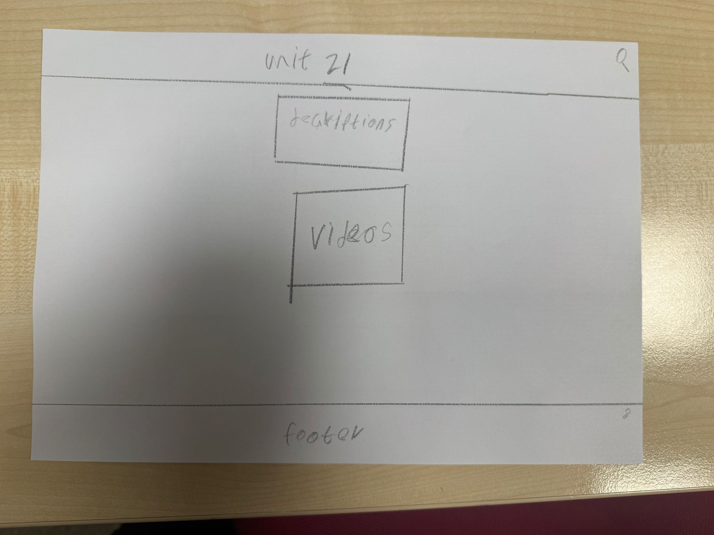
Original
Title
Description of whole unit what it teaches
Video explaining whole unit
Footer of my website

Slide 135
Annotation of Original Unit 21 Page Design
Title
The title is placed at the top of the page so users can easily identify which unit they are viewing. This keeps the website organised and consistent across all unit pages.
Description of the Whole Unit
This section explains what the unit teaches and what knowledge or skills are covered. Placing it near the top allows users to quickly understand the topic of the unit before viewing other content.
Video Explaining the Whole Unit
The video section provides a visual explanation of the unit. Videos can help users understand the topic more easily and make the page more engaging and interactive.
Footer of My Website
The footer is located at the bottom of the page and keeps the layout consistent throughout the website. It can include navigation links or additional information.

Slide 136
Style guide
Element | Colours | Font | Size | Rationale
Page Title | Dark purple | Arial / Sans-serif | 32 bold | The large title allows users to quickly identify which unit page they are viewing.
Section Headings Description / Assignment / Video | Dark purple | Arial Bold | 20–24 | Headings organise the content and help users easily navigate the page sections.
Body Text | Black / Dark grey | Arial | 16 | A simple readable font improves accessibility and allows users to easily read the information.
Content Boxes Assignment / Video | Light grey background | Arial | 16 | Content boxes visually separate important sections such as assignments or videos from the rest of the page.
Footer | Light grey background with dark text | Arial | 12–14 | The footer provides consistent navigation and information across all pages of the website.
Page Background | White / very light grey | Default | N/A | A neutral background keeps the page clean and ensures text and content are easy to read.

Slide 137
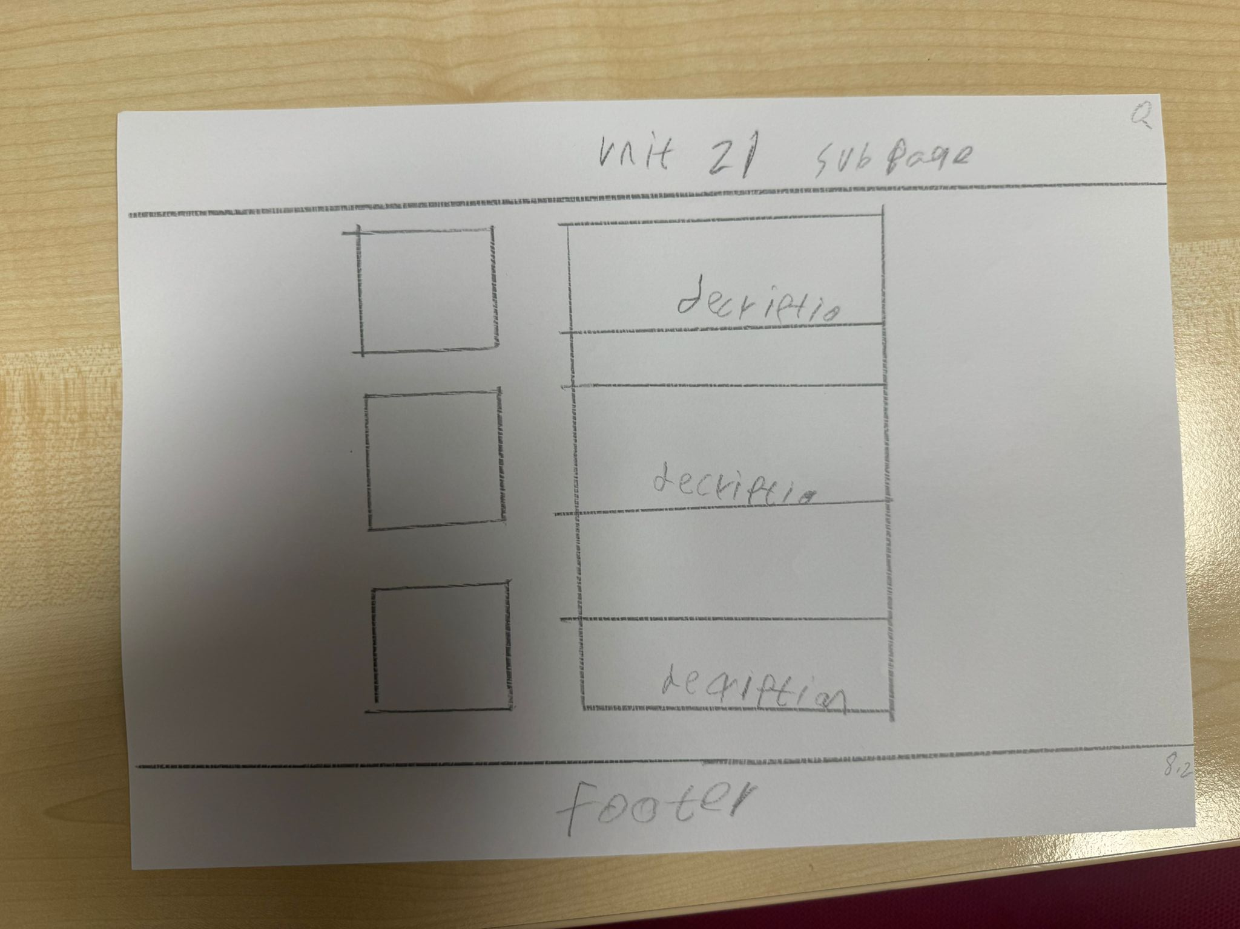
Original
Title
Description of whole assignment
Assignment I make
Footer of my website

Slide 138
Annotation of Original Unit 21 Subpage Design
Title
The title is positioned at the top of the page so users can quickly identify which unit they are viewing. This keeps the structure of the website consistent and organised.
Assignment I Made
This section shows the assignments created for the unit. Displaying the assignments allows users to see examples of the work completed during the unit.
Description of the Whole Assignment
The assignment description explains what each assignment involved and what tasks were required. This helps users understand the context and purpose of the work presented.
Footer of My Website
The footer is placed at the bottom of the page to maintain consistency across the website. It may include navigation links or additional information.

Slide 139
Style guide
Element | Colours | Font | Size | Rationale
Page Title | Dark purple | Arial / Sans-serif | 32 bold | The large title makes it easy for users to immediately identify which unit page they are viewing.
Section Headings Description / Assignment / Video | Dark purple | Arial Bold | 20–24 | Headings clearly separate different sections of the page and help users navigate the content.
Body Text | Black / Dark grey | Arial | 16 | A simple and readable font ensures the information is easy for users to read and understand.
Content Boxes Assignments / Videos | Light grey background | Arial | 16 | Content boxes highlight important elements such as assignments or videos and visually separate them from other content.
Footer | Light grey background with dark text | Arial | 12–14 | The footer keeps the layout consistent across the website and may contain navigation links or additional information.
Page Background | White / very light grey | Default | N/A | A neutral background keeps the design clean and improves readability.

Slide 140
Unit 21 – technology business
This page presents my work for Unit 21. It includes a video and a description explaining the assignments. In this unit I learned how technology businesses operate and how products are planned and developed.

Slide 141
Purpose of the Page
The purpose of the Unit 21 page is to present my work and learning from Unit 21. This page allows teachers and users to view my assignments and understand the tasks I completed during this unit. It helps show the skills and knowledge I developed while working on the digital portfolio project.

Slide 142
Design
The page includes a title at the top labelled “Unit 21” so users can easily identify the unit. In the centre of the page there is a description section where I explain the assignment and the work I completed. Below the description there is a video section where videos related to the project or assignment can be shown. A footer is placed at the bottom of the page to keep the layout consistent with the rest of the website.

Slide 143
Aesthetic Features
The page has a simple and clean layout which makes the content easy to read. The title at the top creates a clear structure for the page. The description and video sections are placed in the centre so users focus on the main content. This layout makes the page look organised and professional.

Slide 144
Design Features
The design includes different sections such as the title, description box, video area, and footer. These sections help organise the information clearly and make the page consistent with other unit pages in the website. This consistent design improves the overall structure of the portfolio.

Slide 145
Interactive Features / User Interaction
Users can scroll through the page to read the description and watch the videos. The video feature allows users to interact with the content by playing or pausing it. Navigation links on the website will also allow users to move between the different unit pages easily.

Slide 146
Why This Page Design is Effective
This design is effective because it combines written explanation with video content. The description explains the assignment clearly while the video helps demonstrate the work visually, making the page more engaging.
The page design is effective because it clearly presents the information in a structured and organised way. The simple layout and consistent design make it easy for users to navigate the website and understand the content.

Slide 147
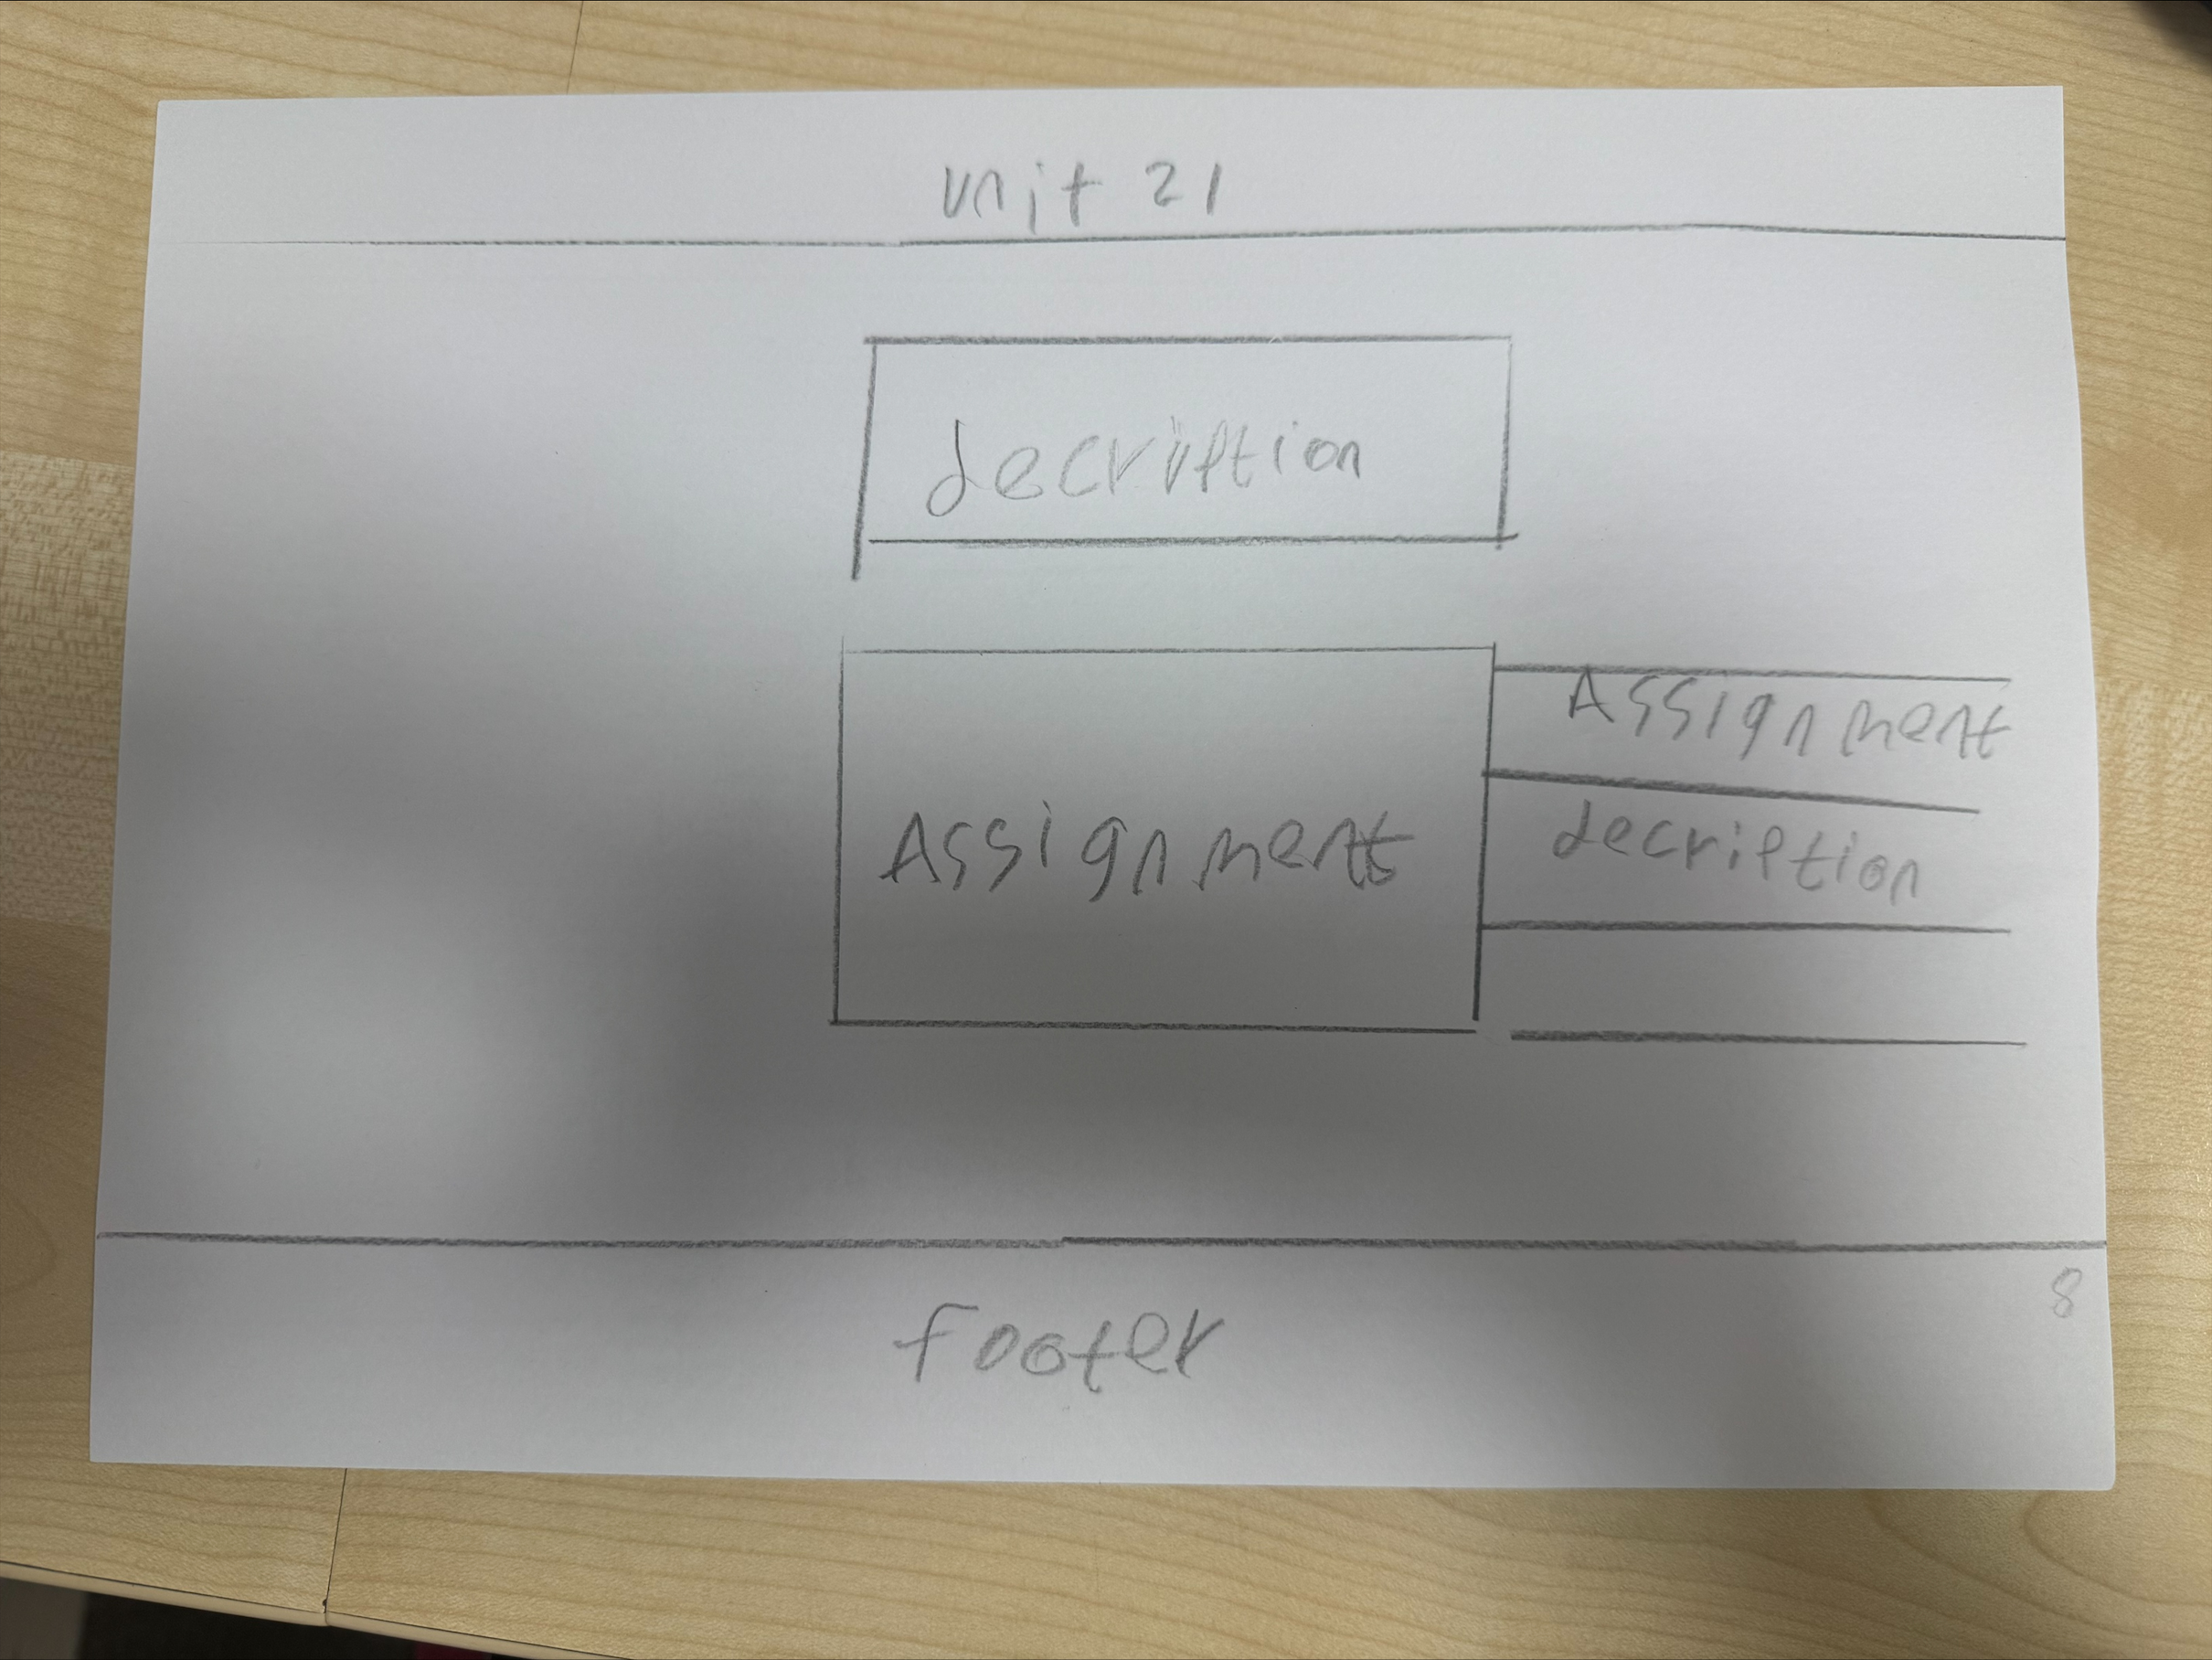
Alternative
Title
Description of whole unit what it teaches
Description of whole assignment
Assignment I make
Footer of my website

Slide 148
Annotation of Alternative Unit 21 Page Design
Title
The title is positioned at the top of the page so users can easily identify which unit they are viewing. This keeps the structure consistent with the rest of the website.
Description of the Whole Unit
This section explains what the unit teaches and provides an overview of the content covered. Placing it near the top allows users to quickly understand the topic before viewing the assignment.
Assignment I Made
This section displays the assignment created during the unit. Showing the assignment allows users to see practical examples of the work completed.
Description of the Whole Assignment
The assignment description explains what the task involved and what was required to complete it. This helps users understand the purpose and context of the assignment.
Footer of My Website
The footer is placed at the bottom of the page to keep the layout consistent across all pages. It may contain navigation links or additional information.

Slide 149
Style guide
Element | Colours | Font | Size | Rationale
Page Title | Dark purple | Arial / Sans-serif | 32 bold | The large title helps users quickly identify which unit page they are viewing and creates a clear visual hierarchy.
Section Headings Description / Assignment / Video | Dark purple | Arial Bold | 20–24 | Headings separate the page into clear sections, helping users navigate and understand the content structure.
Body Text | Black / Dark grey | Arial | 16 | A simple readable font ensures the information is easy to read and accessible to all users.
Content Boxes Assignments / Videos | Light grey background | Arial | 16 | Content boxes highlight important elements such as assignments or videos and visually organise the page.
Footer | Light grey background with dark text | Arial | 12–14 | The footer provides consistent navigation and information across all pages of the website.
Page Background | White / very light grey | Default | N/A | A neutral background keeps the design clean and improves readability of text and content.

Slide 150
Design Justification
The design of my digital portfolio uses a clear and simple layout so that users can easily understand the content on each page. The homepage contains an introduction, my picture, and a short “About Me” section which helps visitors quickly learn who I am and what the portfolio is about. The information is organised in sections which makes the page easy to read and prevents the page from looking crowded.
The navigation of the website is simple and easy to use. The main menu includes links to Home, About Me, and each unit page (Unit 1, Unit 2, Unit 3, Unit 13, Unit 18, and Unit 21). This allows users to move between different sections of the portfolio quickly. The structure chart also shows clear navigation routes so users can find documents and coursework without confusion.
The colour scheme and design style are professional and consistent throughout the website. Simple colours and clean fonts are used so that the website looks organised and suitable for employers. Using a consistent style across all pages helps create a professional appearance and improves the overall user experience.
The design helps employers because it presents my work in a clear and structured way. Employers can easily view the different units and see examples of my coursework, documents, and projects. This allows them to quickly understand my IT skills, creativity, and knowledge. The organised layout makes it easy for employers to review my work and assess whether I am suitable for an apprenticeship or job in the IT industry.

Slide 151
Overall Website Design Justification
The overall design of my website was created to present my digital portfolio in a clear and organised way. The website allows teachers and users to easily view my coursework from different units. Each page follows a consistent layout with a title, main content area, and footer, which helps users understand the structure of the website and navigate between pages easily. The design focuses on simplicity so that the main information such as descriptions, images, videos, and assignments can be viewed without distractions. Interactive elements such as navigation links and videos allow users to explore the content easily. Alternative designs with more complex layouts were rejected because they could make the website harder to use. Overall, the design meets the user requirements by providing a clear, professional, and easy-to-navigate digital portfolio.

